Slide 1
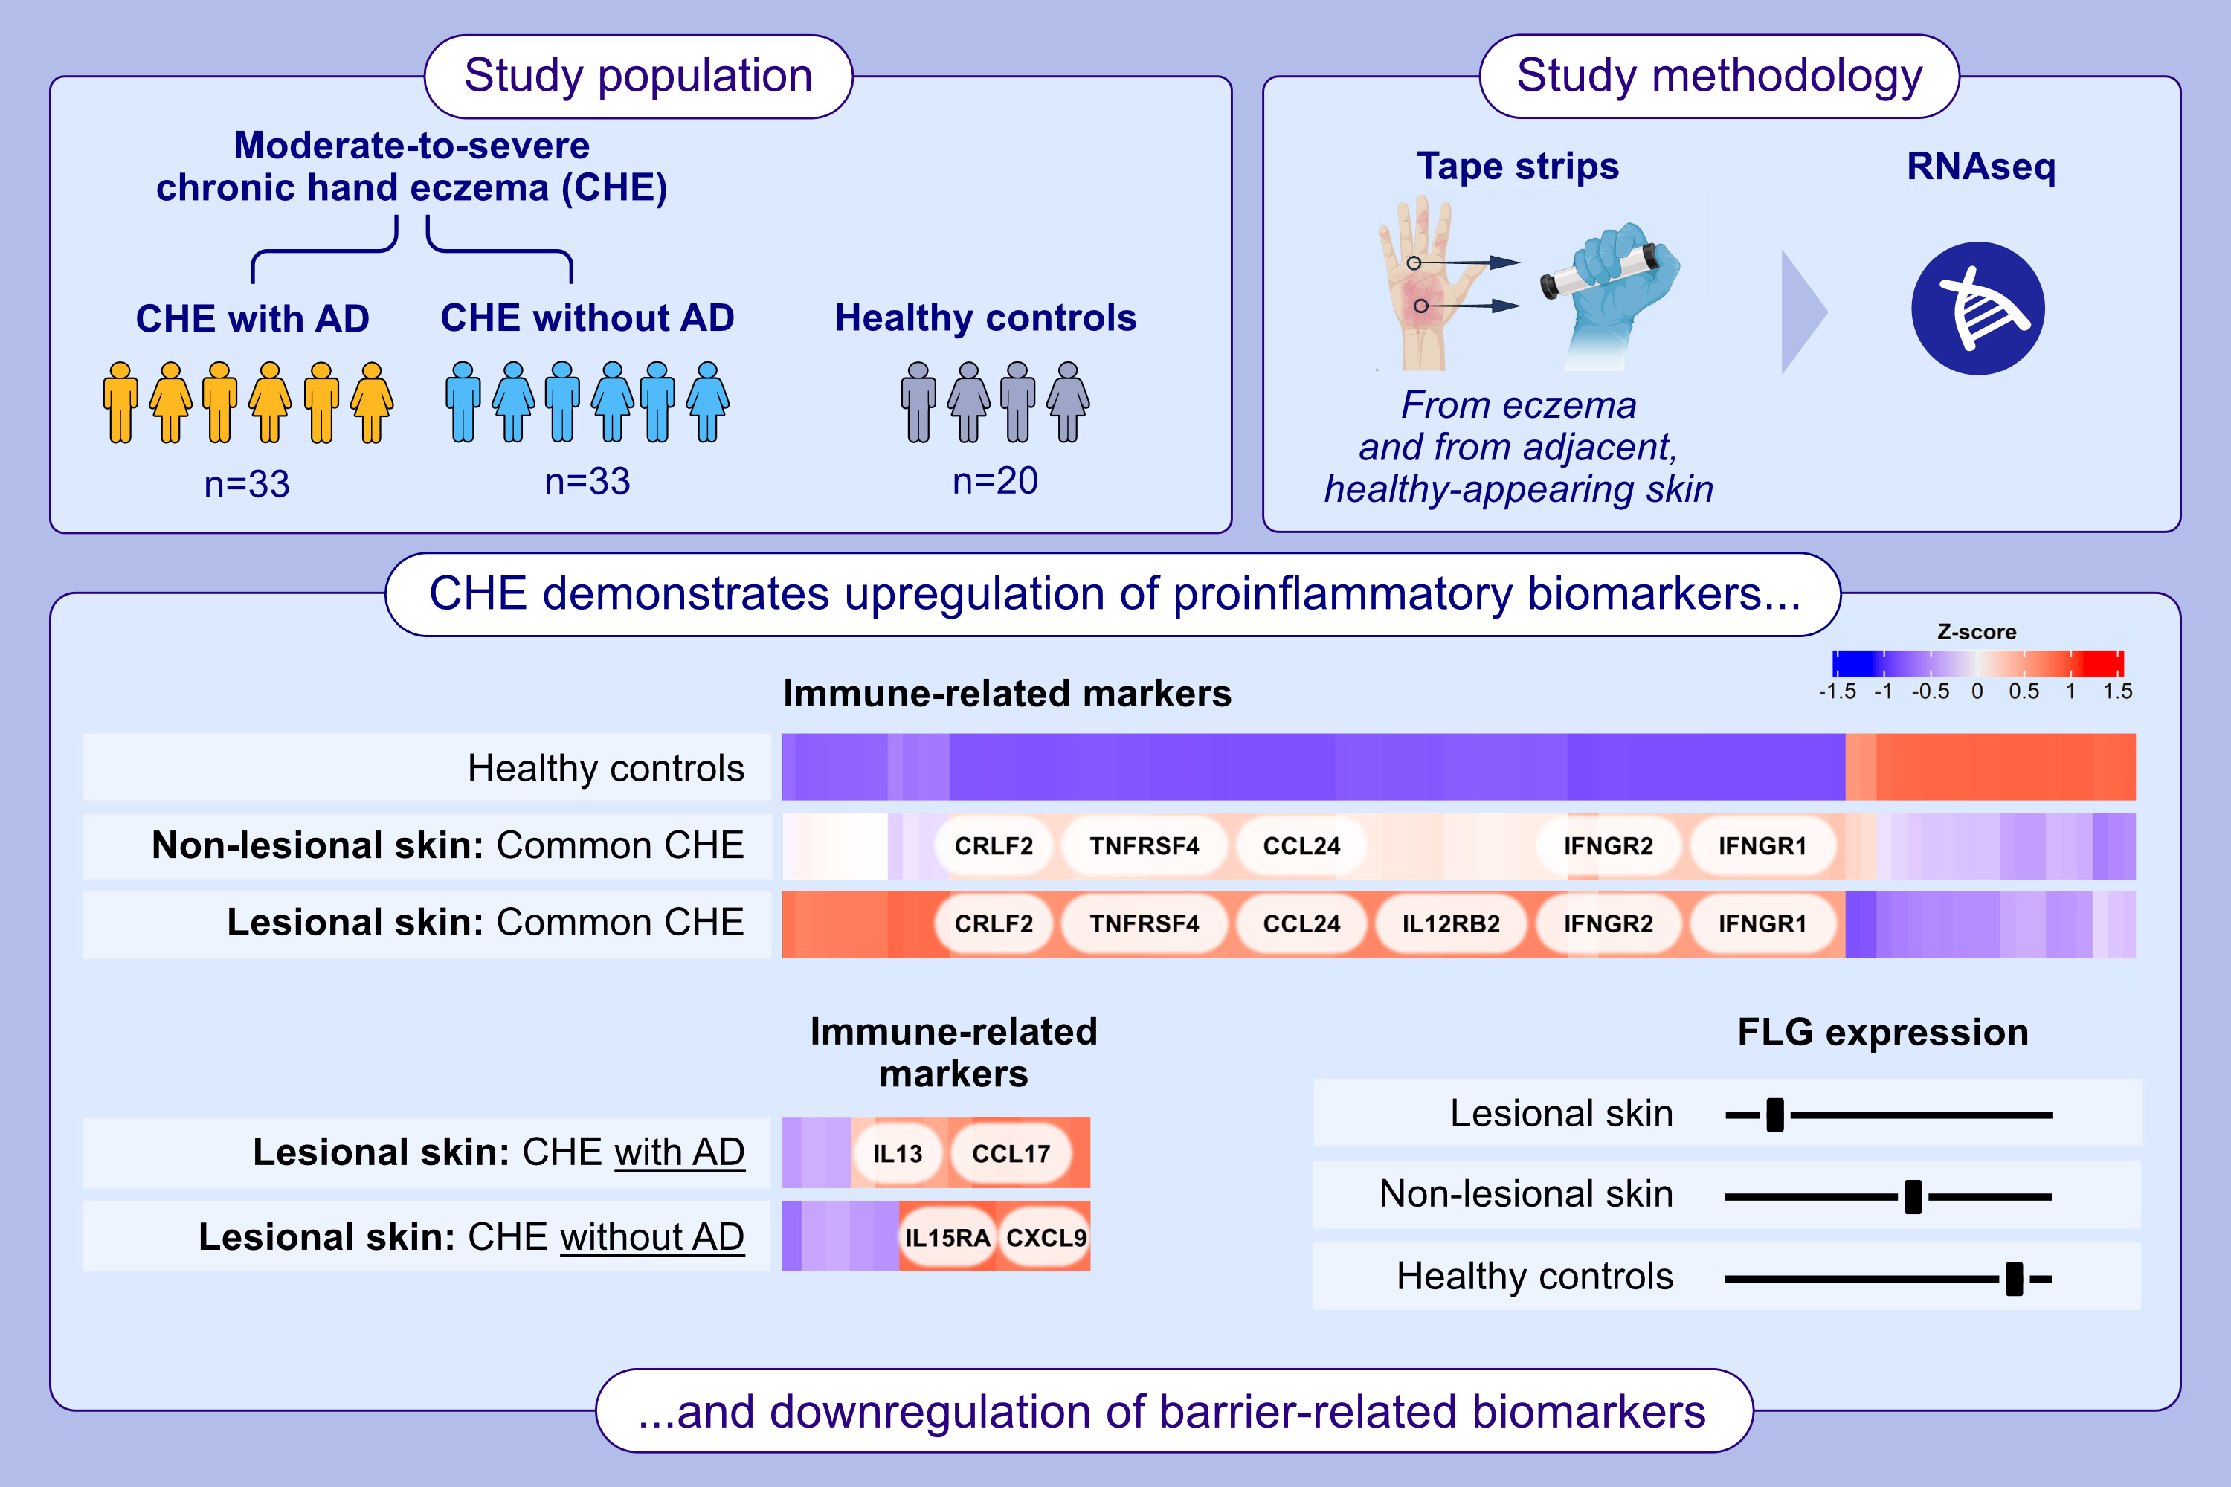
Skin Tape Stripping Reveals Distinct Biomarker Profiles in Chronic Hand Eczema of Patients With and Without Comorbid Atopic Dermatitis
Jonathan Bar, Ester Del Duca, Eden David, Swaroop Bose, Gabriella Chefitz, et al.
Allergy. 2025; pages:2271-2285
https://doi.org/10.1111/all.16466
© 2019 EAACI and John Wiley and Sons A/S. Published by John Wiley and Sons Ltd.
Notes:
HIGHLIGHTS
• Tape strip-based RNA sequencing of 66 chronic hand eczema patients revealed multiple differentially expressed genes, highlighting significant inflammatory and epidermal barrier alterations.
Chronic hand eczema patients with atopic dermatitis background showed a more pronounced type 2 inflammation, unlike the more type 1 skewed inflammation in those without such comorbidity.
Downregulation of filaggrin both in non-lesional and lesional skin, compared to healthy controls, suggests that barrier impairment already exists at the non-lesional CHE level.
.

