Slide 1
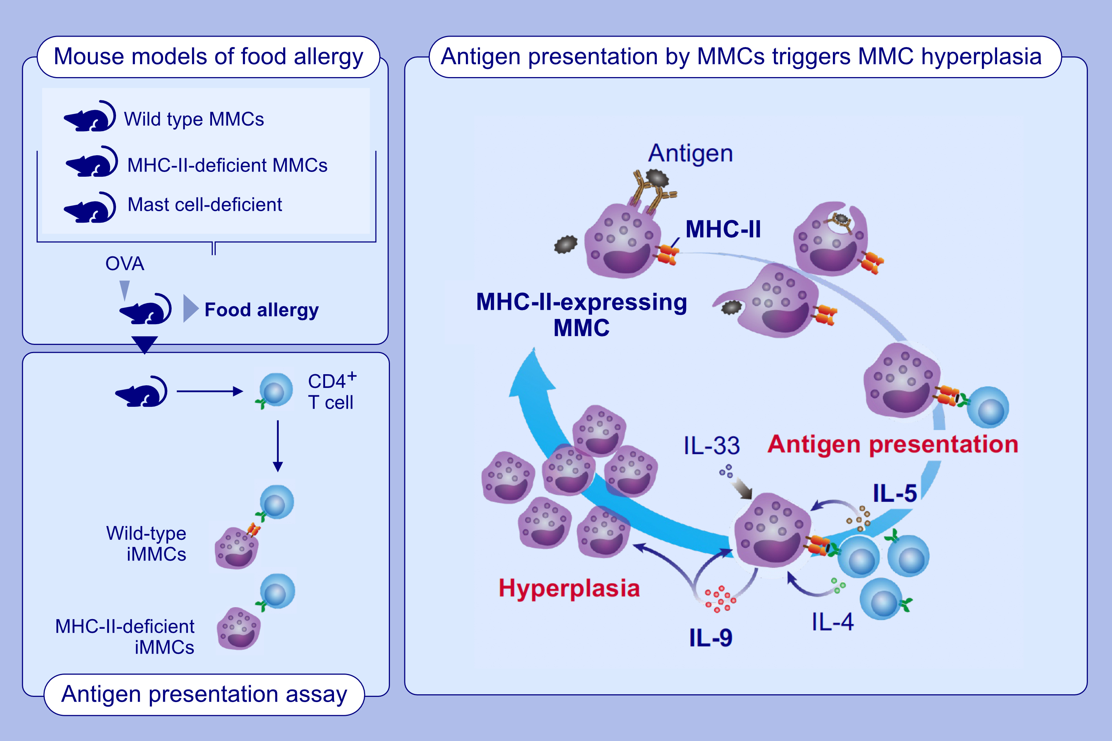
MHC Class II-Expressing Mucosal Mast Cells Promote Intestinal Mast Cell Hyperplasia in a Mouse Model of Food Allergy
Kenji Oishi, Nobuhiro Nakano, Masamu Ota, Eisuke Inage, Kumi Izawa, et al.
Allergy. 2025; pages:2297-2309
https://doi.org/10.1111/all.16477
© 2019 EAACI and John Wiley and Sons A/S. Published by John Wiley and Sons Ltd.
Notes:
HIGHLIGHTS
• MHC class II-expressing MMCs are detected in the intestinal mucosa of a mouse model of IgE-mediated food allergy. •Intestinal MMC hyperplasia associated with food allergy is attenuated in mice with MHC class II-deficient MMCs compared to mice with wild-type MMCs. •IL-4 and IL-5 secreted from CD4+ T cells activated by MMC antigen presentation enhance IL-9 production by MMCs, which leads to intestinal mucosal mast cell hyperplasia. .

