Slide 1
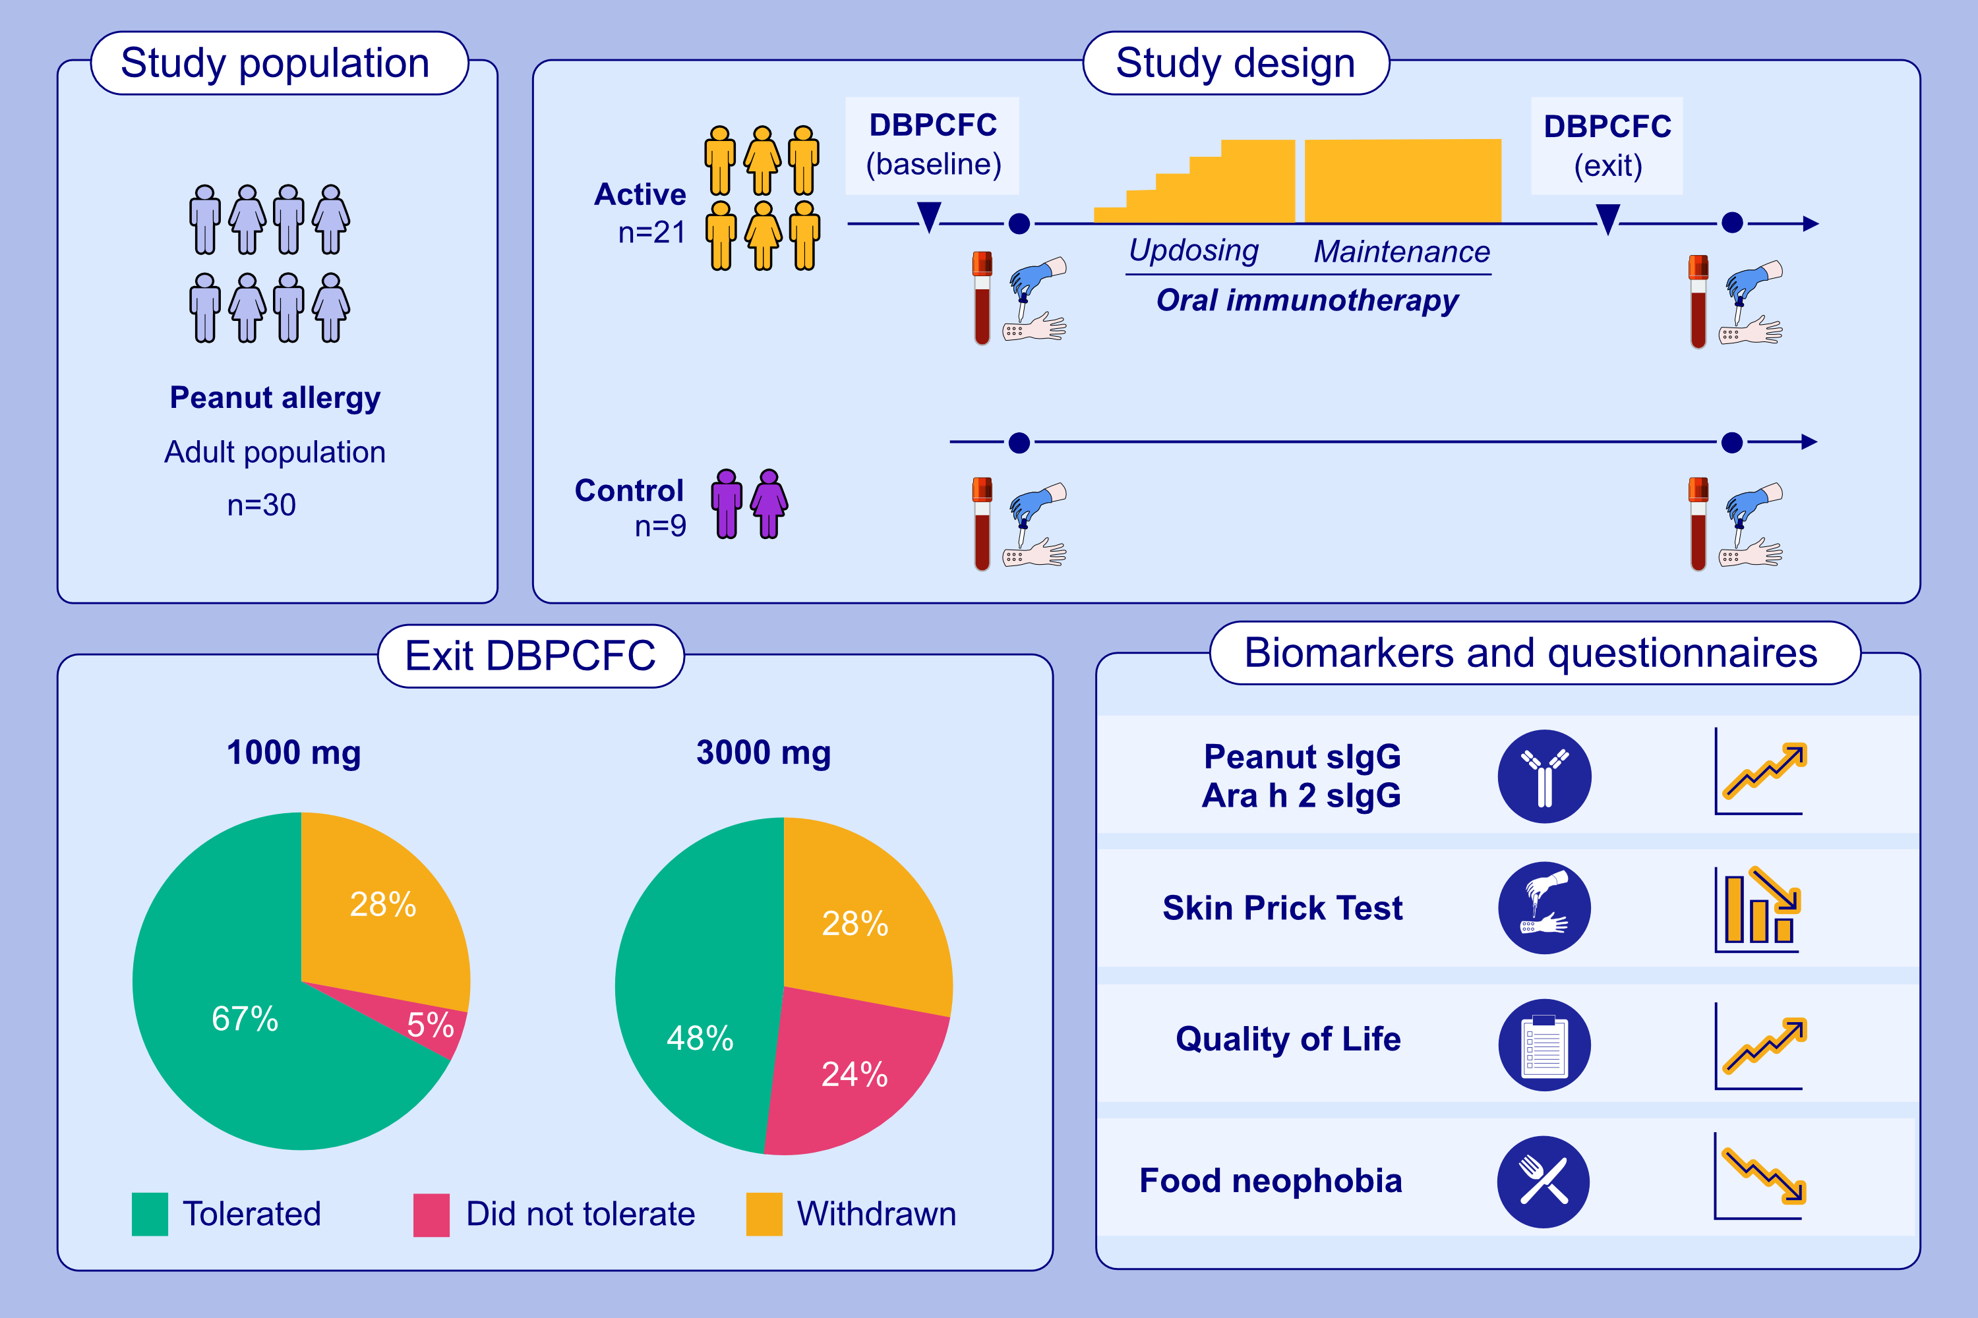
Oral Immunotherapy in Peanut-Allergic Adults Using Real-World Materials
Hannah Hunter, Kok Loong Ue, Victoria Cornelius, Ching Ching Yung, Iason Thomas, et al.
Allergy. 2025; pages:2310-2318
https://doi.org/10.1111/all.16493
© 2019 EAACI and John Wiley and Sons A/S. Published by John Wiley and Sons Ltd.
Notes:
HIGHLIGHTS
• In 21 adults initiated on peanut OIT, 67% tolerated at least 1000mg on exit DBPCFC
Decreases in SPT size and increases in peanut- and Ara h 2-specific IgG occurred in OIT participants but not mechanistic controls (n=9).
• Improvements were seen in FAQLQ-AF and food neophobia scores.
•
Epinephrine was used infrequently; the majority (94.5%) of adverse reactions were mild (grade 1).
•
.

