Slide 1
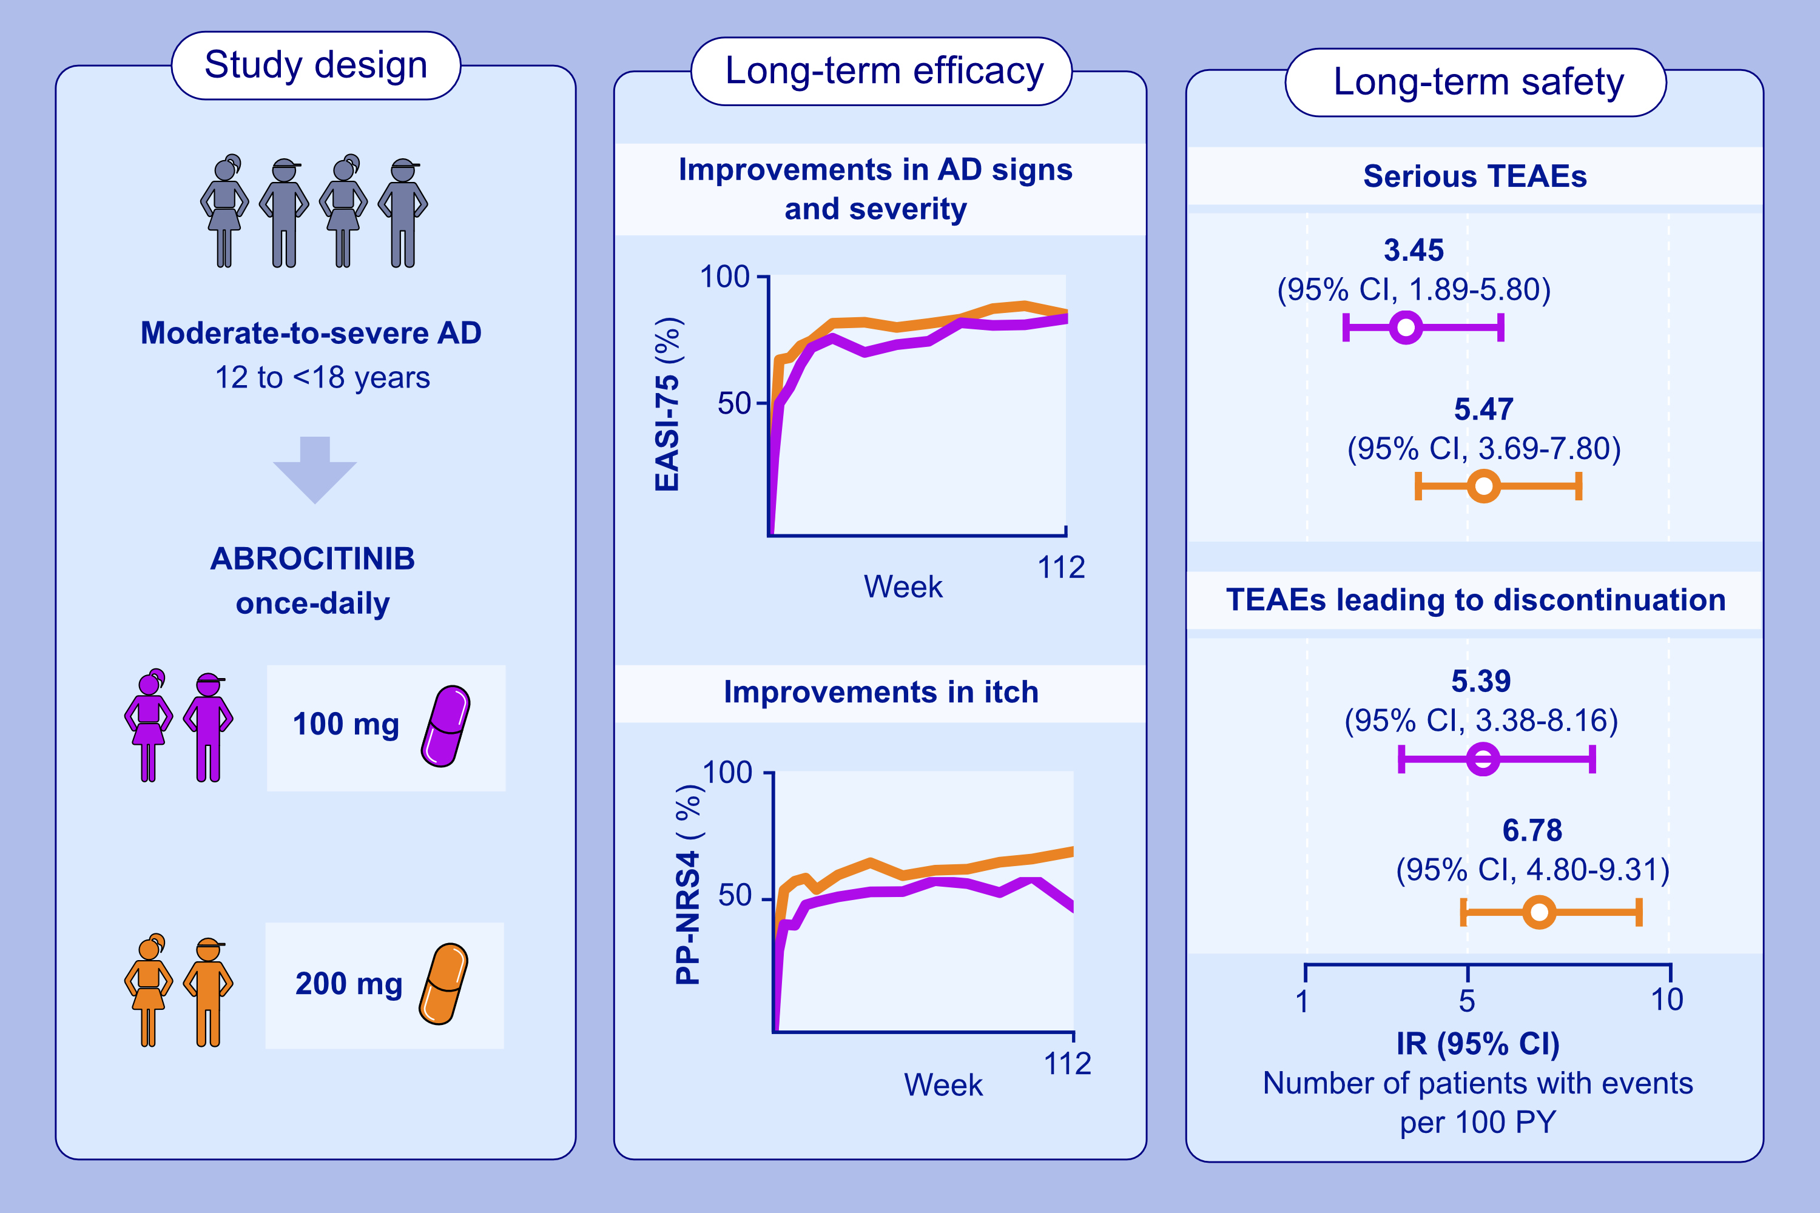
Integrated Efficacy and Safety Analysis of Abrocitinib in Adolescents With Moderate-to-Severe Atopic Dermatitis
Amy S. Paller, Lawrence F. Eichenfield, Alan D. Irvine, Carsten Flohr, Andreas Wollenberg, et al.
Allergy. 2025; Pages:2213-2224
https://doi.org/10.1111/all.16512
© 2019 EAACI and John Wiley and Sons A/S. Published by John Wiley and Sons Ltd.
Notes:
HIGHLIGHTS
• Data were included from adolescents with moderate-to-severe AD treated with the JAK1 inhibitor abrocitinib (200 mg/100 mg) across JADE clinical trials.
Improvements in skin clearance (per EASI-75) and itch (per PP-NRS4) were maintained up to 112 weeks with both abrocitinib doses.
Data up to 4.6 years of abrocitinib treatment support an acceptable long-term safety profile, with no new safety signals.
.

