Slide 1
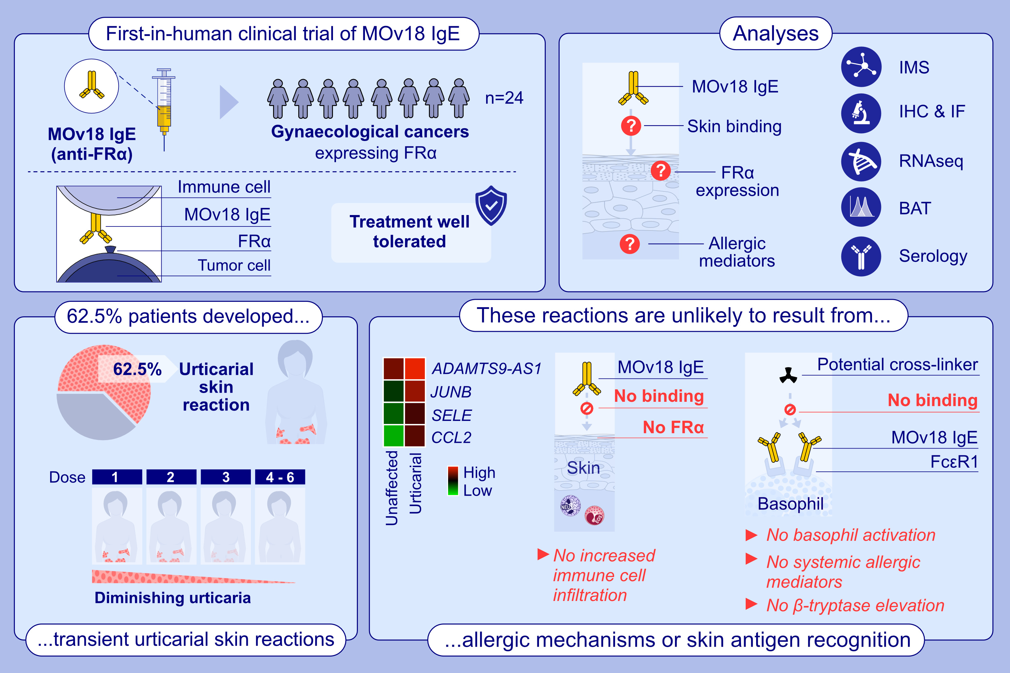
Non-Allergic Urticarial Skin Reactions Associated With MOv18 IgE, a First-In-Class IgE Antibody Recognising Folate Receptor Alpha
Chara Stavraka, Jitesh Chauhan, Silvia Crescioli, Sheila M. McSweeney, Amy Pope, et al.
Allergy. 2025; pages:2225-2239
https://doi.org/10.1111/all.16514
© 2019 EAACI and John Wiley and Sons A/S. Published by John Wiley and Sons Ltd.
Notes:
HIGHLIGHTS
• MOv18 IgE, the first-in-class IgE antibody targeting the cancer antigen Folate Receptor alpha (FR⍺) showed early signs of efficacy and was well tolerated in a first-in-human clinical trial, with transient urticarial skin reactions as the most common toxicity. •This study, investigating the immunological parameters associated with these reactions, found no signs of skin antigen recognition by the antibody, no markers of allergic mechanisms in patient blood or in the urticarial skin of a patient who received the highest antibody dose in the trial.
• These findings support the favourable safety profile of this novel anti-cancer therapy class in the emerging field of AllergoOncology. .

