Slide 1
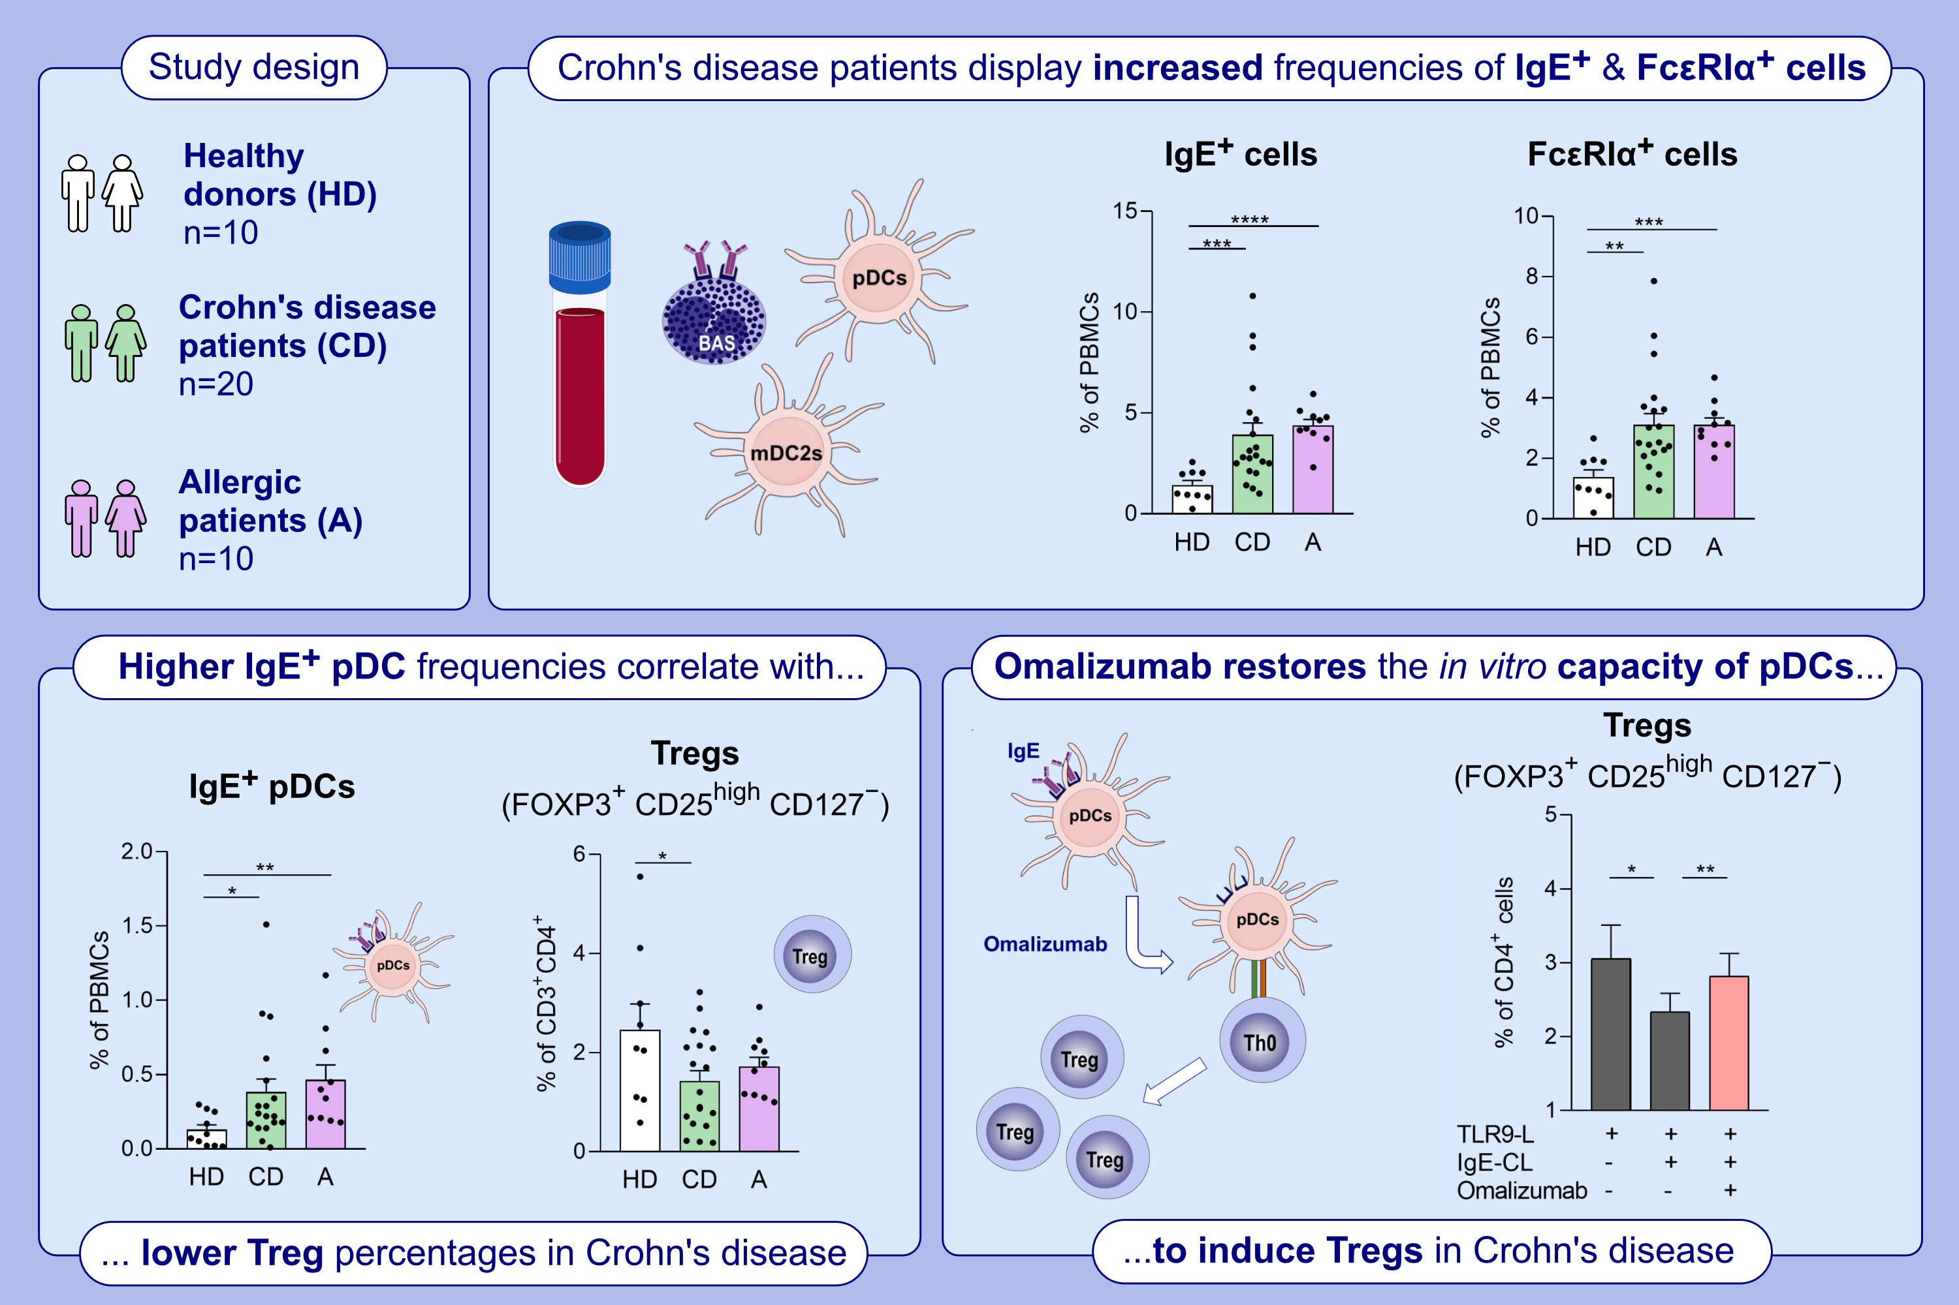
The Role of IgE in Crohn's Disease by Impairing the Capacity of Plasmacytoid Dendritic Cells to Generate FOXP3+ Tregs
Andrés de la Rocha-Muñoz, Cristina Benito-Villalvilla, David Olivares, Sofía Sirvent, Miguel A. García-Brenes, et al.
Allergy. 2025; pages:2319-2331
https://doi.org/10.1111/all.16517
© 2019 EAACI and John Wiley and Sons A/S. Published by John Wiley and Sons Ltd.
Notes:
HIGHLIGHTS
• We uncover an unprecedented role for IgE in CD.
• CD patients, regardless of allergic status and similar to allergic patients, display higher levels of circulating IgE+ and FcεRI+ immune cells, including pDCs, which is concomitant to fewer Tregs.
• In vitro experiments show that the anti-IgE monoclonal antibody omalizumab restores the ability of pDCs from CD patients to generate Tregs. .

