Slide 1
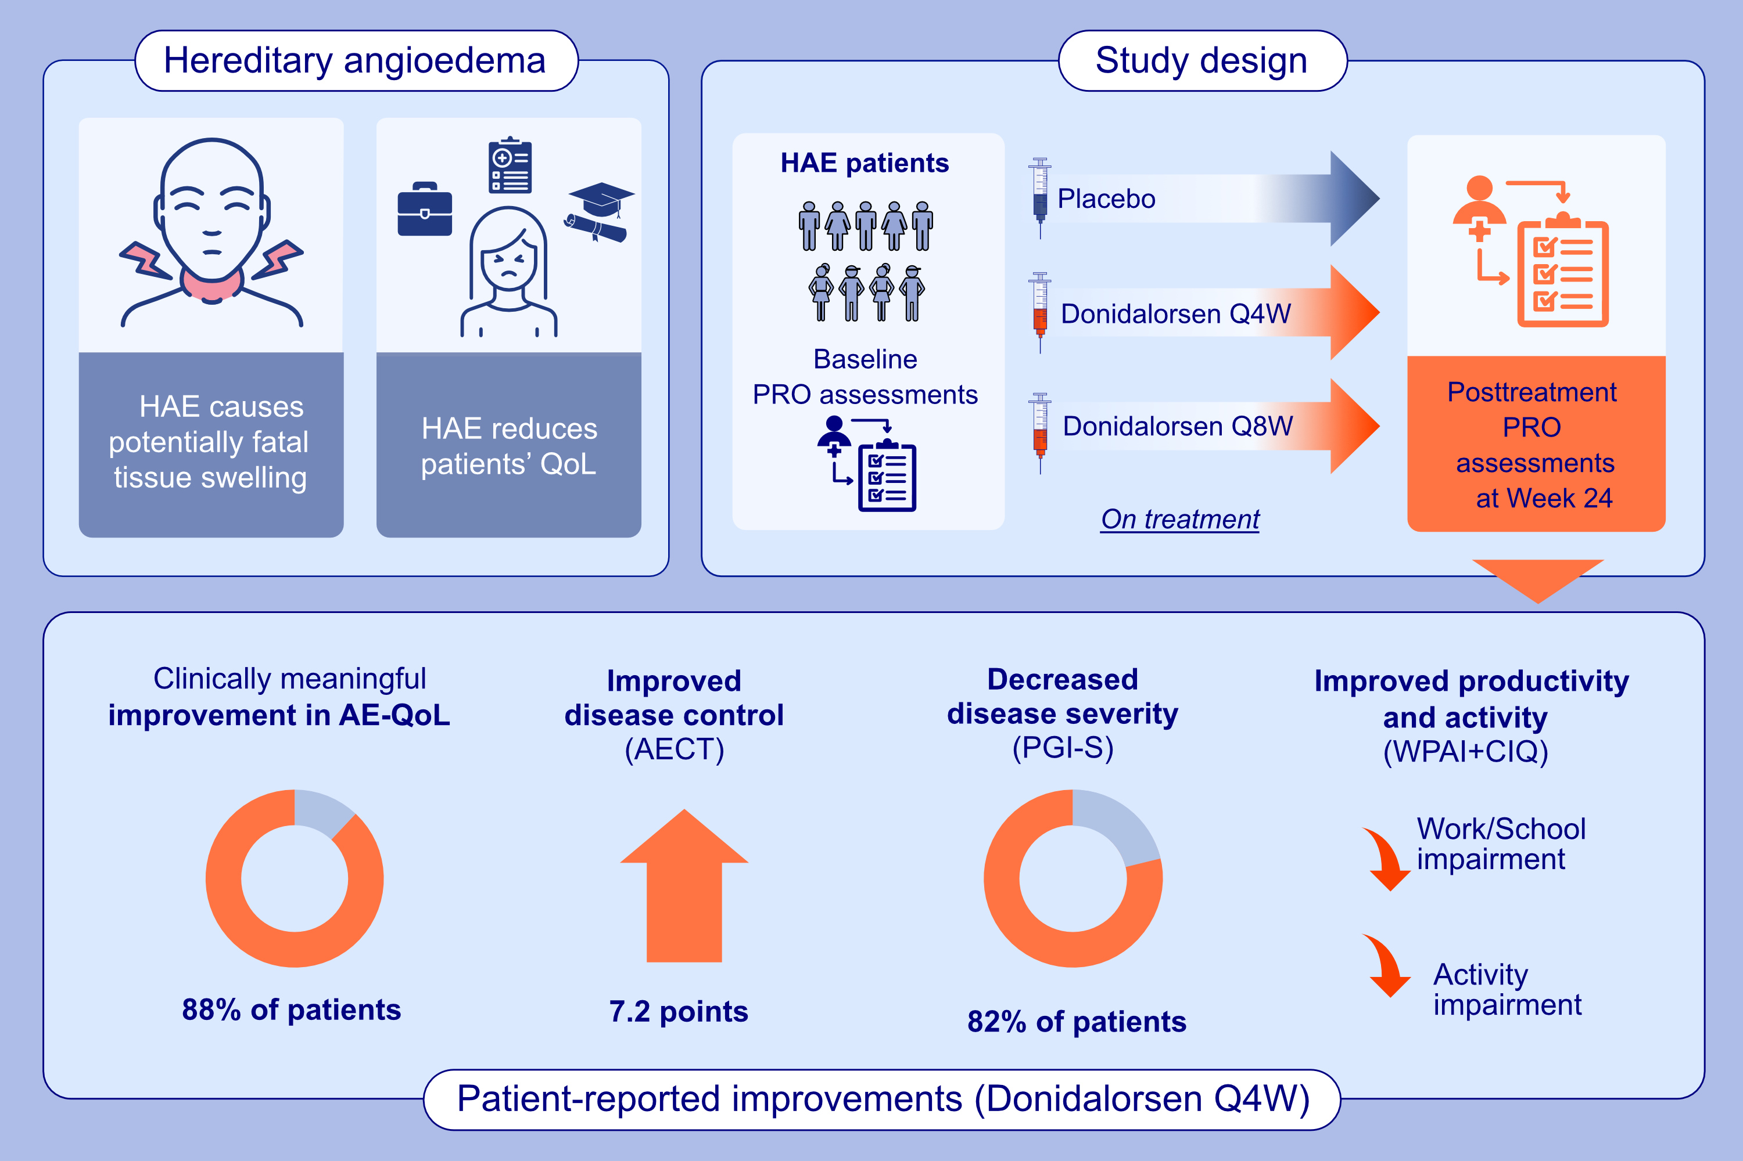
Patient-Reported Outcomes in the Phase III OASIS-HAE Study of Donidalorsen for Hereditary Angioedema
Marc A. Riedl, Aaron Yarlas, Laura Bordone, Sabrina Treadwell, Sophie Wang, et al.
Allergy. 2025; pages: 2361-2368
https://doi.org/10.1111/all.16563
© 2019 EAACI and John Wiley and Sons A/S. Published by John Wiley and Sons Ltd.
Notes:
HIGHLIGHTS
• We report an overview of patients’ self-reported quality of life, disease control, and functioning in daily life while taking donidalorsen for HAE in the 24-week phase 3 OASIS-HAE trial.
• Most patients reported clinically meaningful improvements in quality of life and disease control. • Patients also reported improvements in their ability to participate in work, school, and other normal daily activities. .

