Slide 1
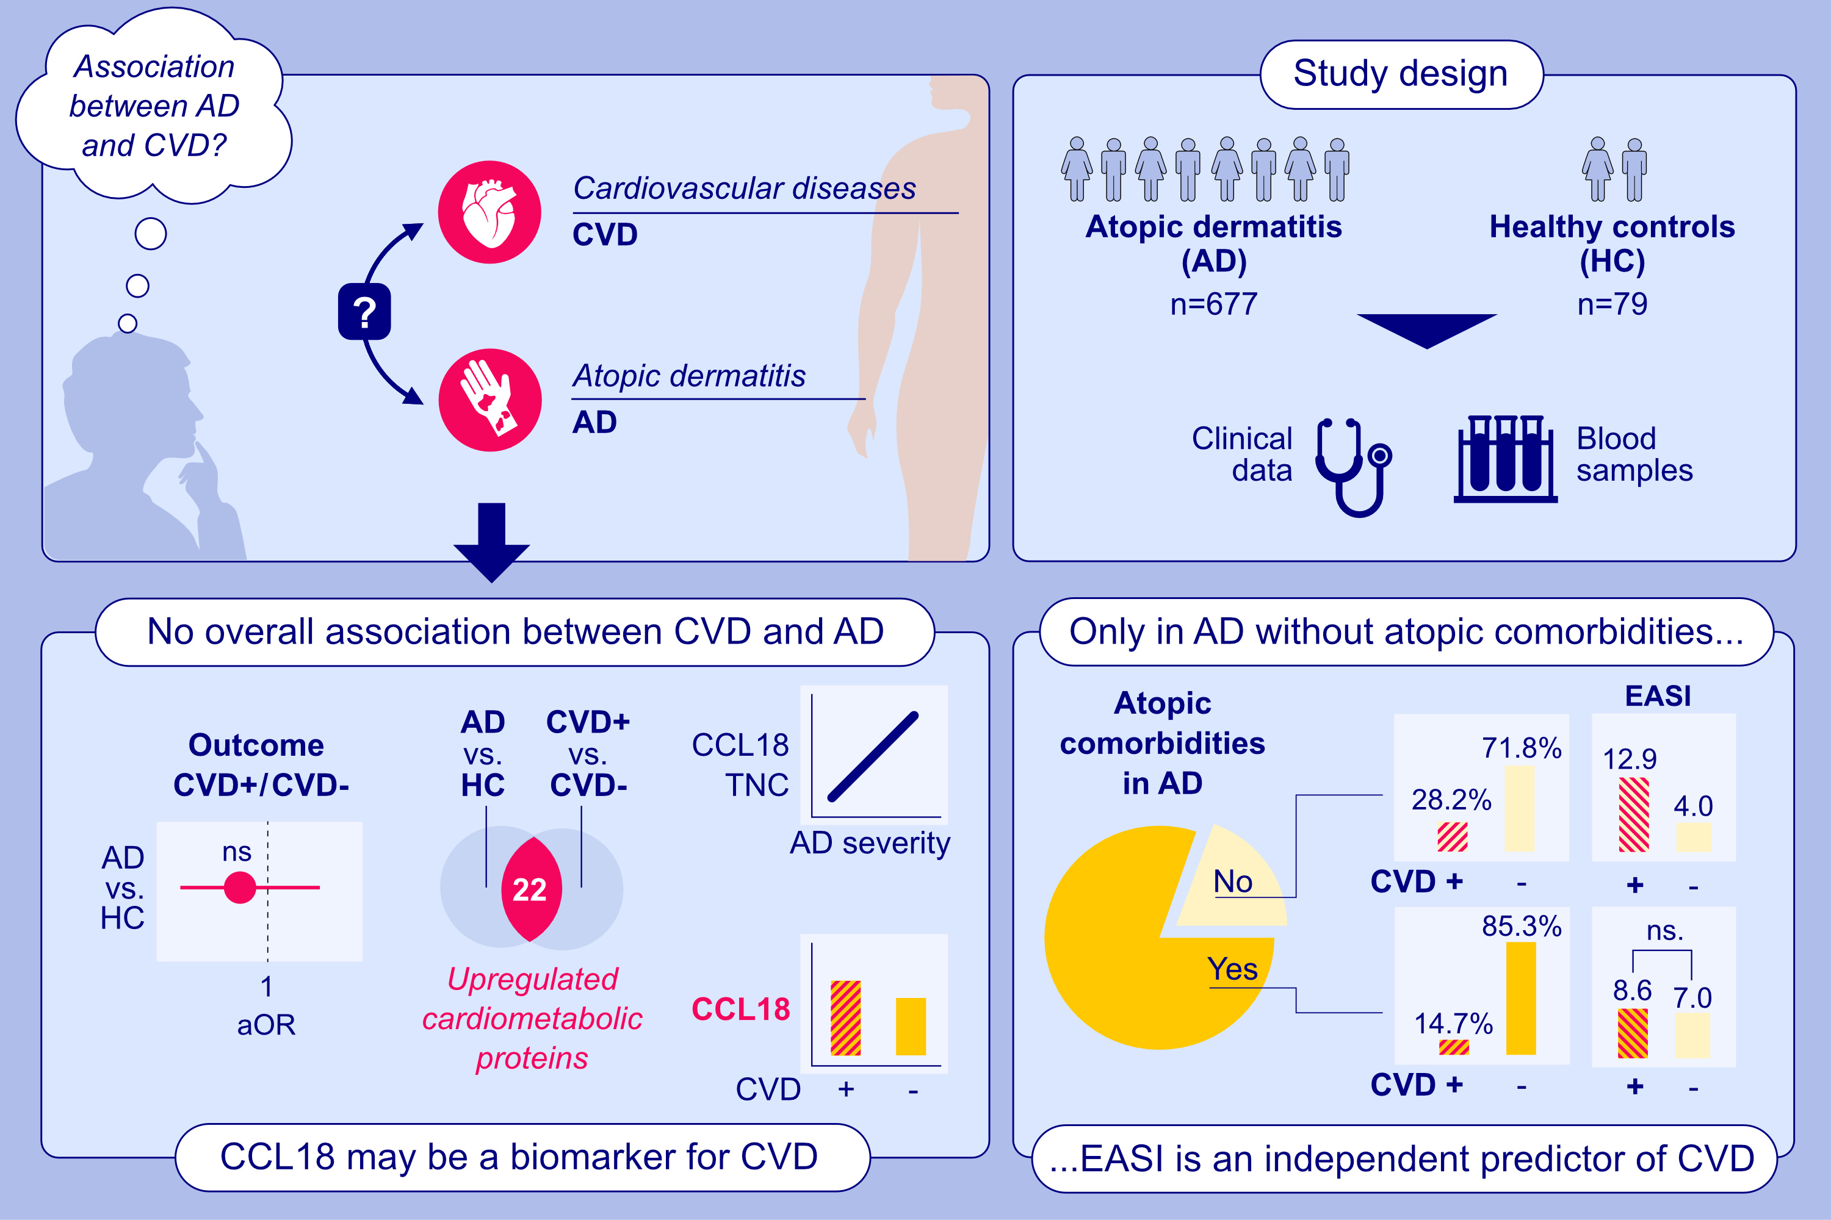
Deciphering the Connection Between Atopic Dermatitis and Cardiovascular Diseases: Analysis of Clinical Associations and Cardiometabolic Proteins
Danielle Fehr, Van Hung Huynh-Tran, Laura Maintz, David Niederseer, Milad Ameri, et al.
Allergy. 2025; pages:2332-2347
https://doi.org/10.1111/all.16588
© 2019 EAACI and John Wiley and Sons A/S. Published by John Wiley and Sons Ltd.
Notes:
HIGHLIGHTS
• The presence of AD is not an independent risk factor for CVD.
Only in pure AD (without atopic comorbidities), EASI is an independent predictor of the presence of CVD.
• 22 cardiometabolic proteins are upregulated in both AD and CVD.CCL18 and TNC are both associated with the presence and the severity of AD.
• CCL18 is also associated with the presence of CVD.
.

