Slide 1
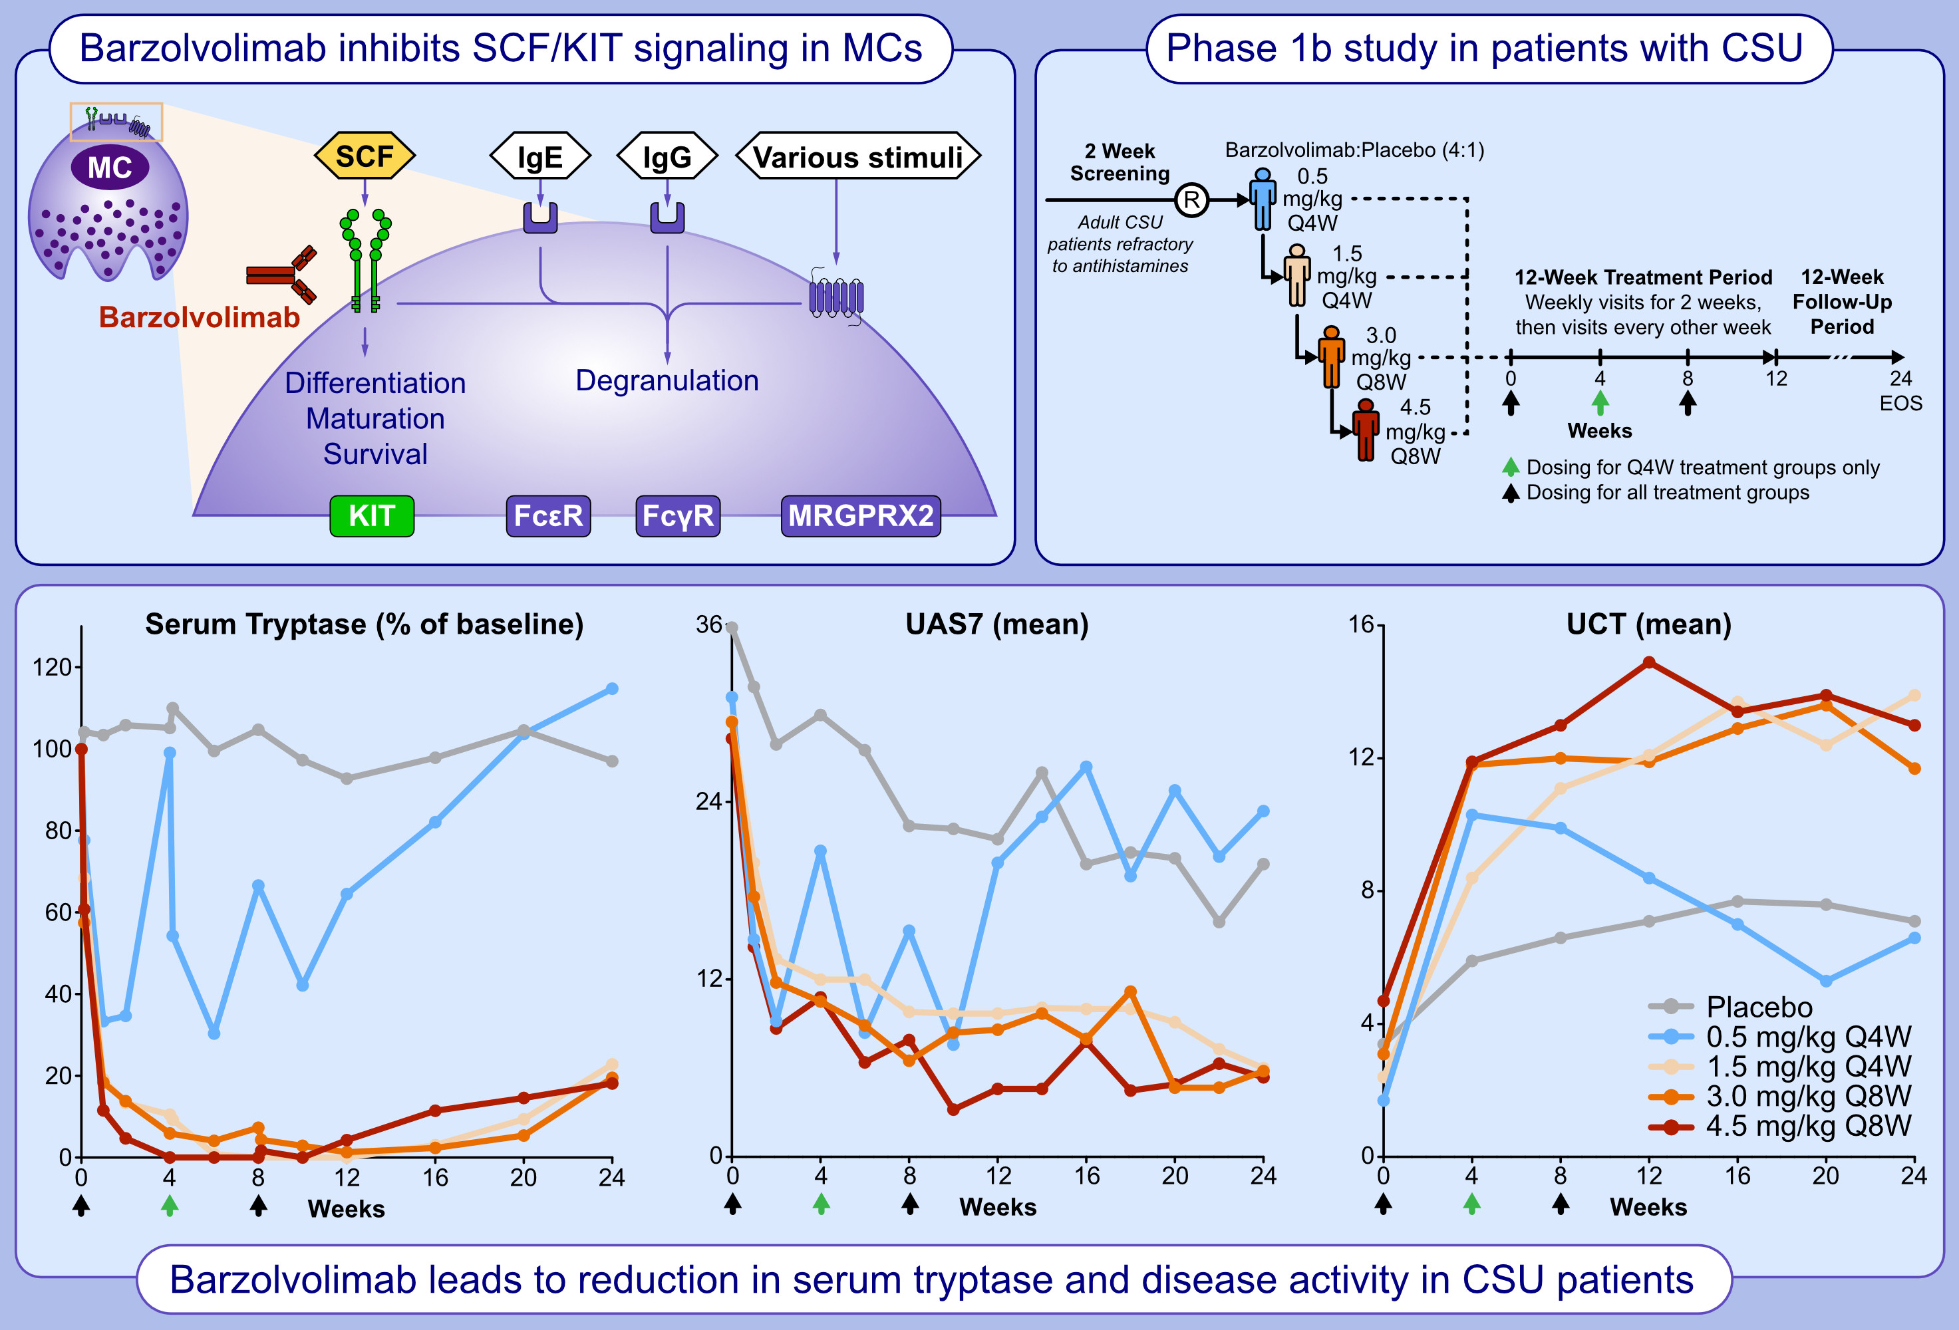
Anti-KIT Barzolvolimab for Chronic Spontaneous Urticaria
Marcus Maurer, Martin Metz, John Anderson, Neetu Talreja, Diane Young, et al.
Allergy. 2025; pages:2178-2186
https://doi.org/10.1111/all.16598
© 2019 EAACI and John Wiley and Sons A/S. Published by John Wiley and Sons Ltd.
Notes:
HIGHLIGHTS
• We compared the efficacy and safety of four doses of barzolvolimab compared to placebo in reducing symptoms of chronic spontaneous urticaria in a randomized, controlled trial. Across barzolvolimab doses, rapid symptom reduction within 1 week was observed and sustained during 12 weeks. The kinetics of disease activity paralleled tryptase suppression, indicative of mast cell inhibition. .

