Slide 1
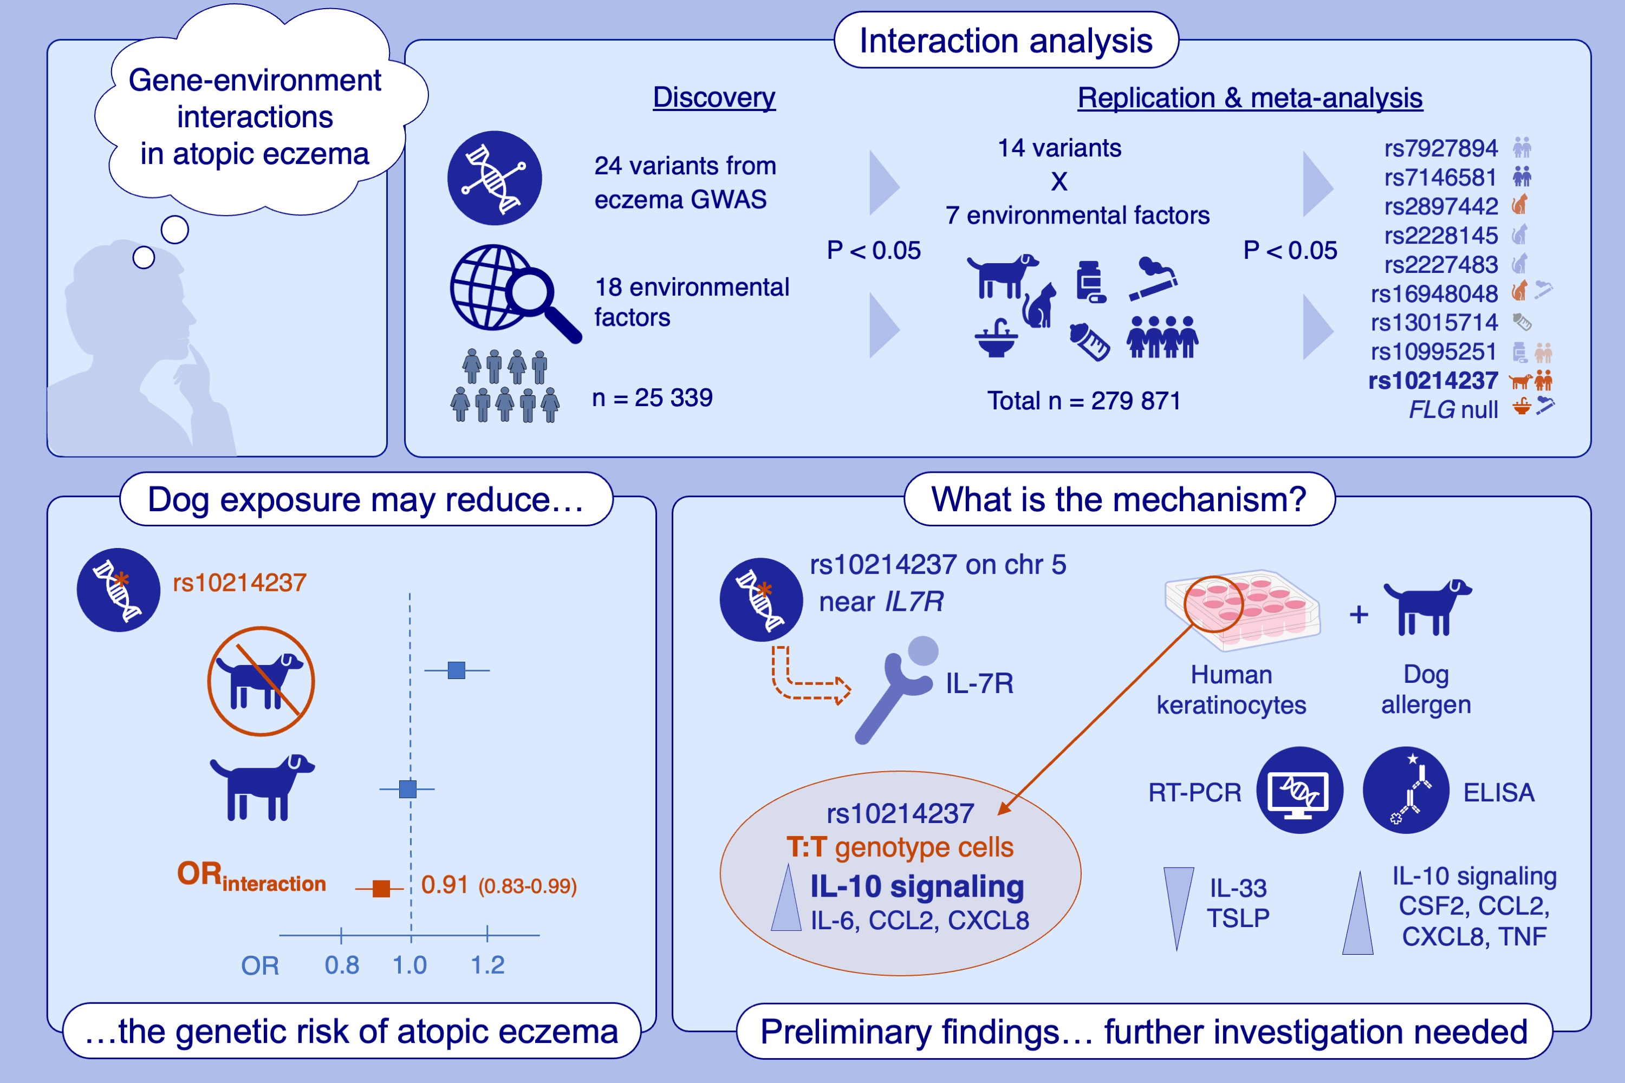
Gene–Environment Interaction Affects Risk of Atopic Eczema: Population and In Vitro Studies
Marie Standl, Ashley Budu-Aggrey, Luke J. Johnston, Martina S. Elias, S. Hasan Arshad, et al.
Allergy. 2025; pages:2187-2200
https://doi.org/10.1111/all.16605
© 2019 EAACI and John Wiley and Sons A/S. Published by John Wiley and Sons Ltd.
Notes:
HIGHLIGHTS
• Atopic eczema is a complex trait resulting from multiple genetic and environmental factors. •This study investigated evidence for interaction between 24 established eczema genetic risk variants and 18 environmental factors. •One variant-environmental pair showed nominally significant interaction in discovery, replication and meta-analyses: early-life dog exposure modulates the increased risk of rs10214237 and preliminary work suggests a mechanistic effect via IL-7R. .

