Slide 1
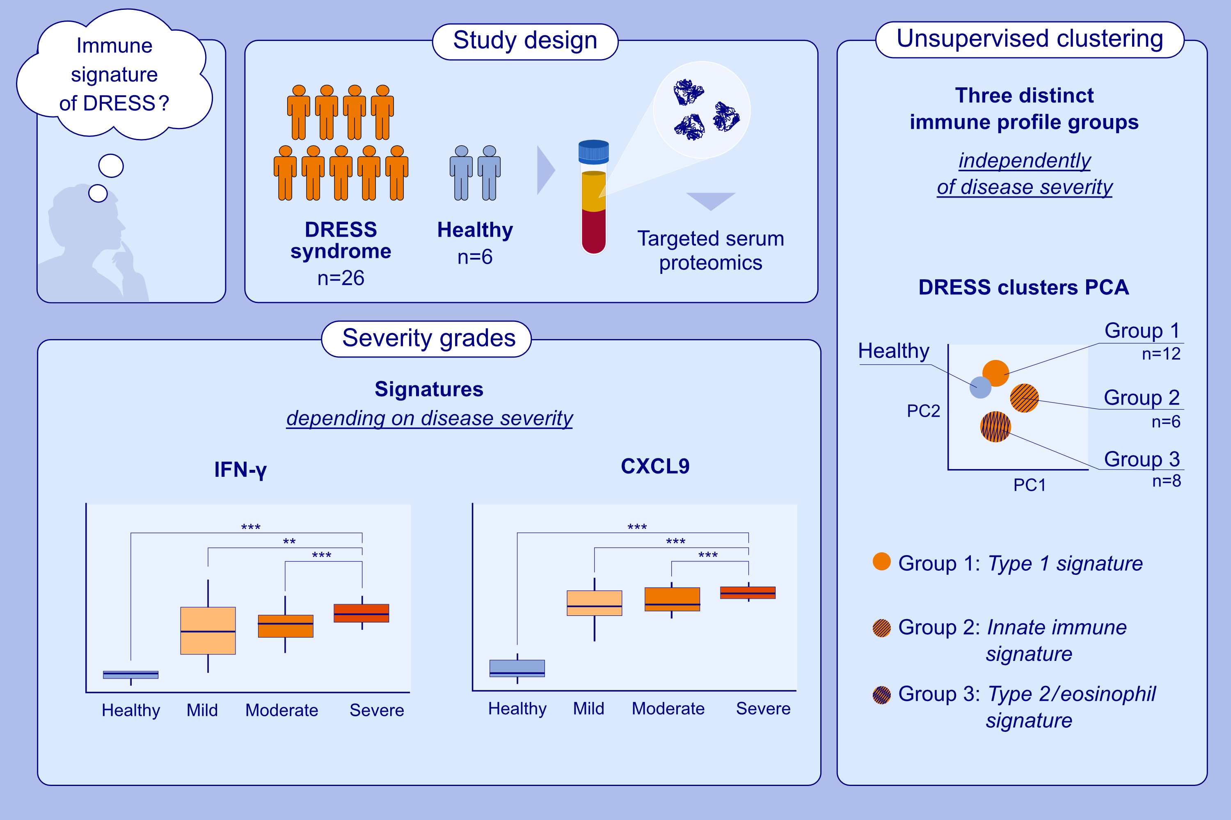
Deciphering Immune Endotypes Within Drug Reaction With Eosinophilia and Systemic Symptoms (DRESS) Syndrome
Camilla von Wachter, Milad Ameri, Tafadzwa Chimbetete, Sarah Pedretti, Reihane Ziadlou, et al.
Allergy. 2025;pages:2332-2347
https://doi.org/10.1111/all.16615
© 2019 EAACI and John Wiley and Sons A/S. Published by John Wiley and Sons Ltd.
Notes:
HIGHLIGHTS
• This multicentric study provides new insights into the systemic immune response in DRESS and its distinct facets. • Systemic immune activation with distinct inflammatory signatures was uncovered in DRESS patients, revealing three subgroups characterized by type 2/eosinophil, type 3/Th17-, or mixed immune profiles.
• These findings suggest patient stratification may improve clinical management. .

