Slide 1
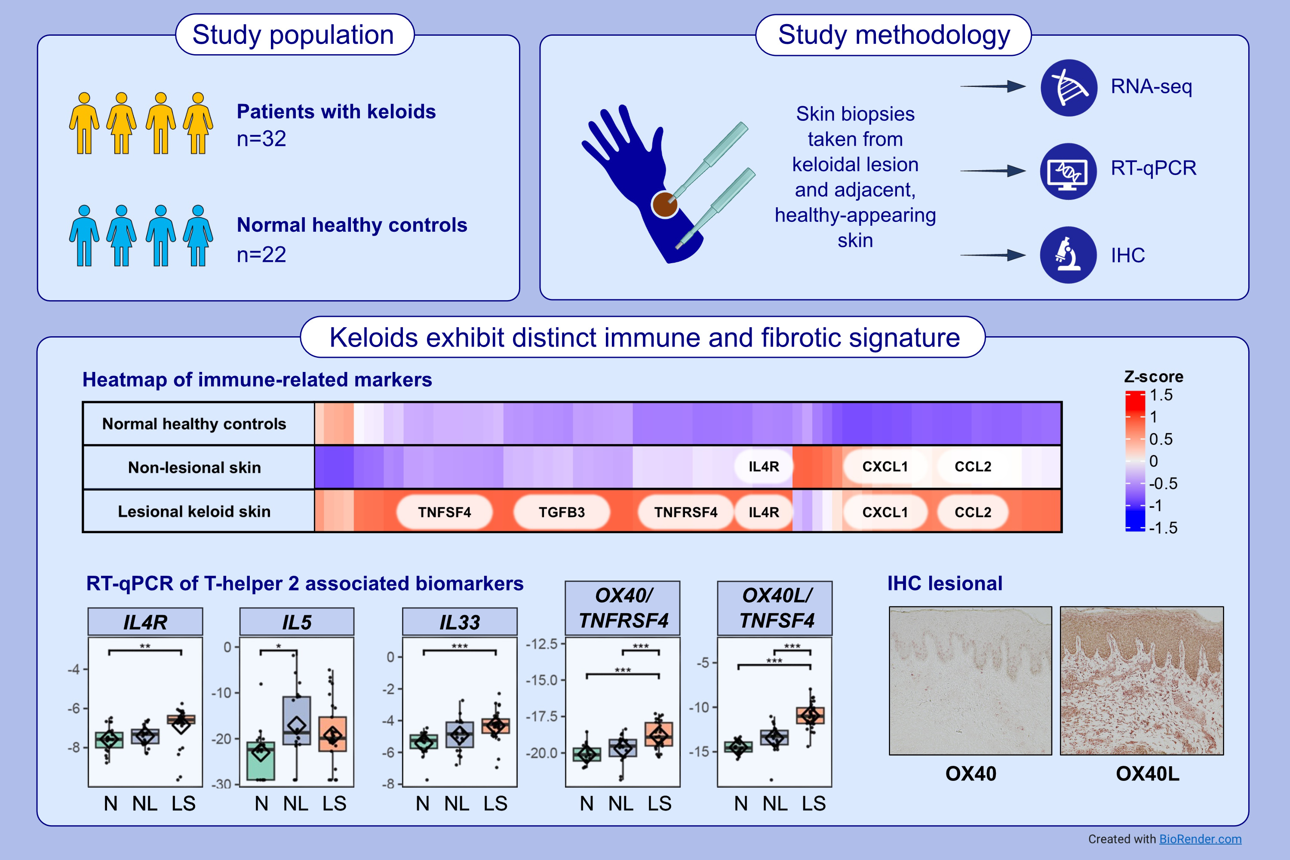
OX40 and Regulatory Marker Alterations in Lesional and Non-Lesional Keloid Tissues
Jonathan Bar, Eden David, Ester Del Duca, Sophie Guenin, Curtis Tam, et al.
Allergy. 2025; pages:2240-2257
https://doi.org/10.1111/all.16628
© 2019 EAACI and John Wiley and Sons A/S. Published by John Wiley and Sons Ltd.
Notes:
HIGHLIGHTS
• We conducted a transcriptomic, molecular, and histological analysis of lesional and non-lesional skin from keloid patients, compared to matched healthy controls. •Both lesional and non-lesional keloid skin exhibited distinct immune and fibrotic signatures, with upregulation of Th1, Th2, and Th17/22 pathways, as well as fibrosis-related genes. •Several immune biomarkers, including CCL2, CXCL1, and S100A7, significantly correlated with clinical severity, underscoring inflammation’s role in keloid pathogenesis and revealing potential therapeutic targets. .

