Slide 1
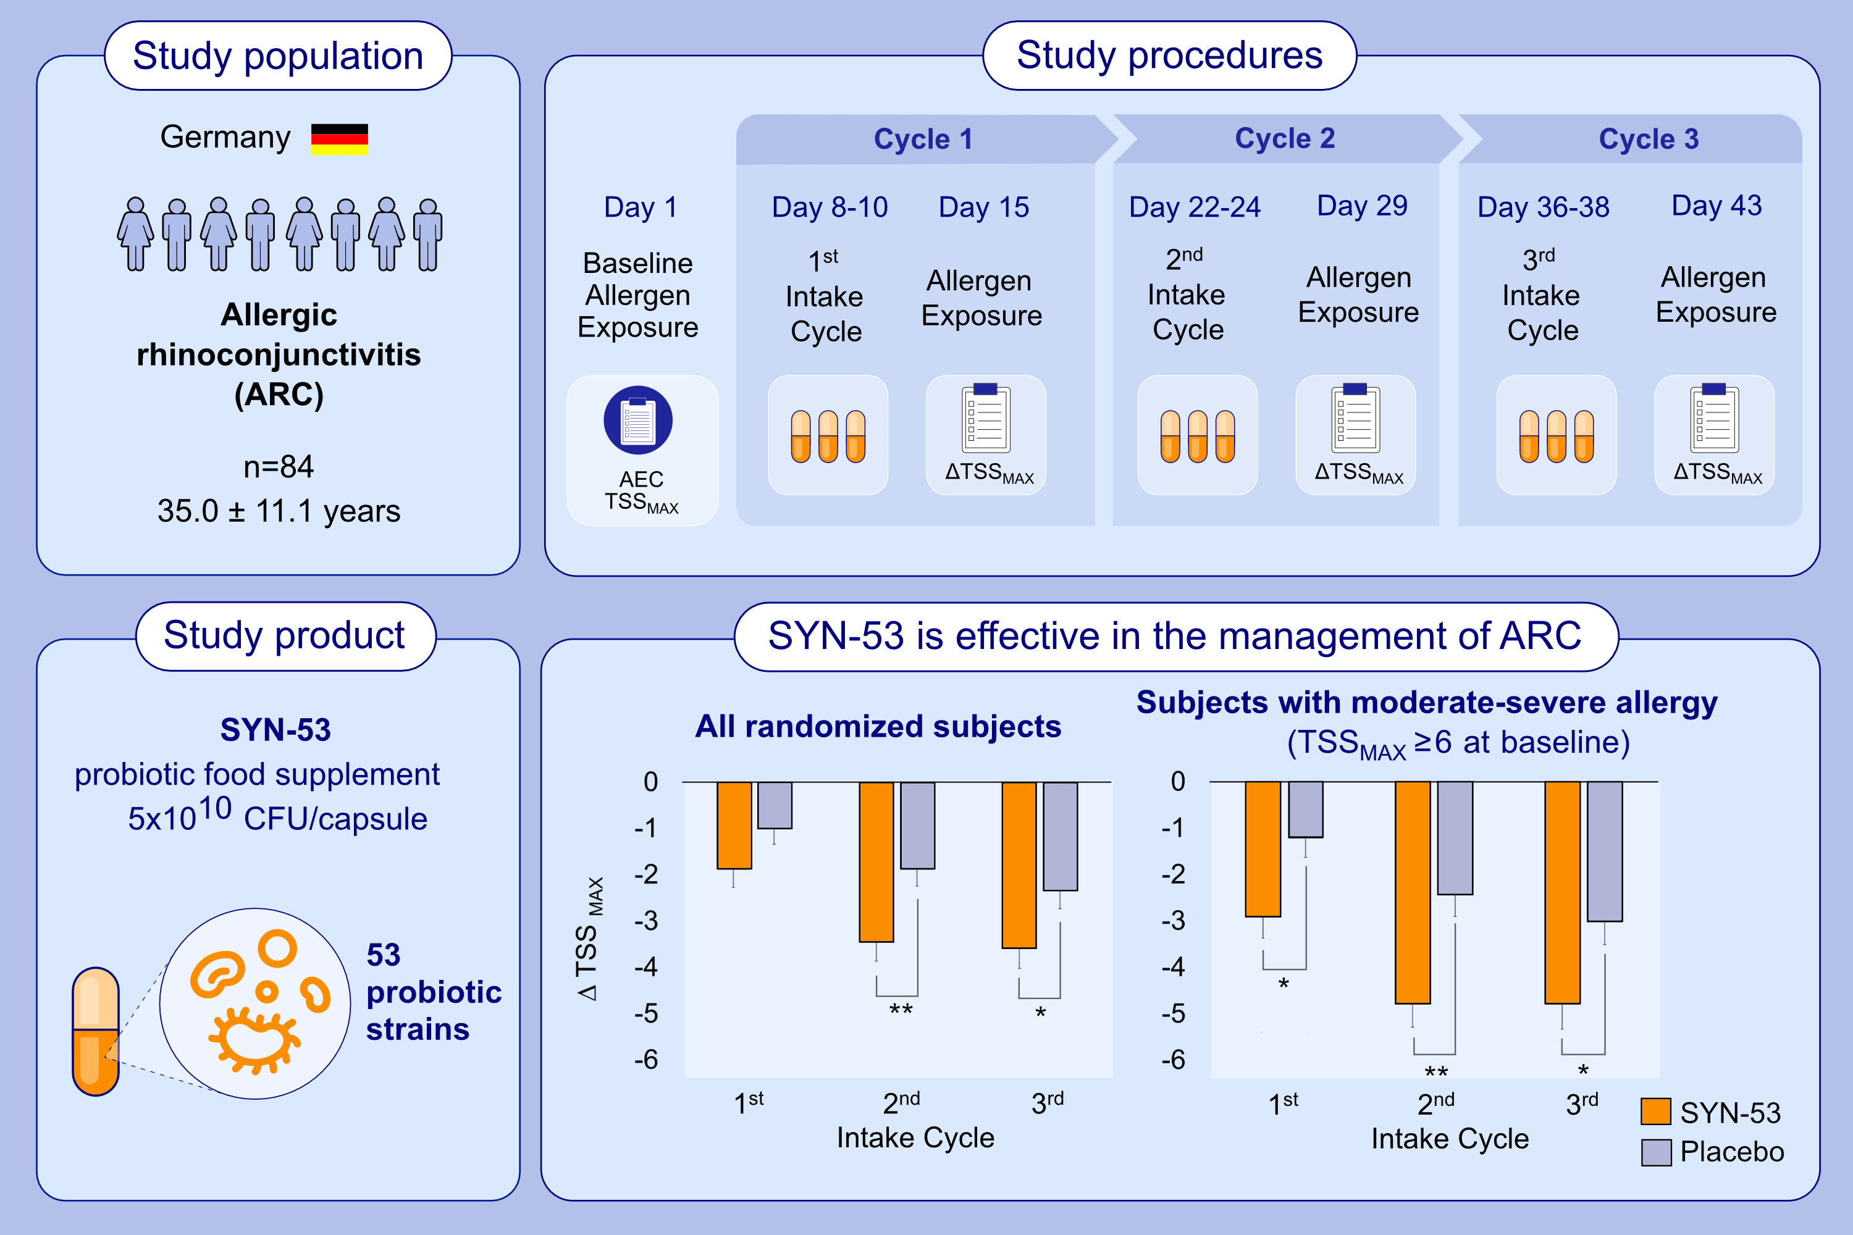
Effect of the Multi-Strain Probiotic SYN-53 in the Management of Allergic Rhinoconjunctivitis
Karl-Christian Bergmann, Torsten Zuberbier
Allergy. 2025; pages:2158-2166
https://doi.org/10.1111/all.16634
© 2019 EAACI and John Wiley and Sons A/S. Published by John Wiley and Sons Ltd.
Notes:
HIGHLIGHTS
• Allergic rhinoconjunctivitis has previously been linked to gut dysbiosis.
A double-blind, placebo-controlled, randomized clinical trial with the multi-strain probiotic food supplement SYN-53 was conducted.
• 84 subjects affected by allergic rhinoconjunctivitis were exposed to grass pollen in an allergen exposure chamber to assess safety and efficacy of SYN-53.
• SYN-53 demonstrated significant superiority to placebo in the management of allergic rhinoconjunctivitis.
.

