Slide 1
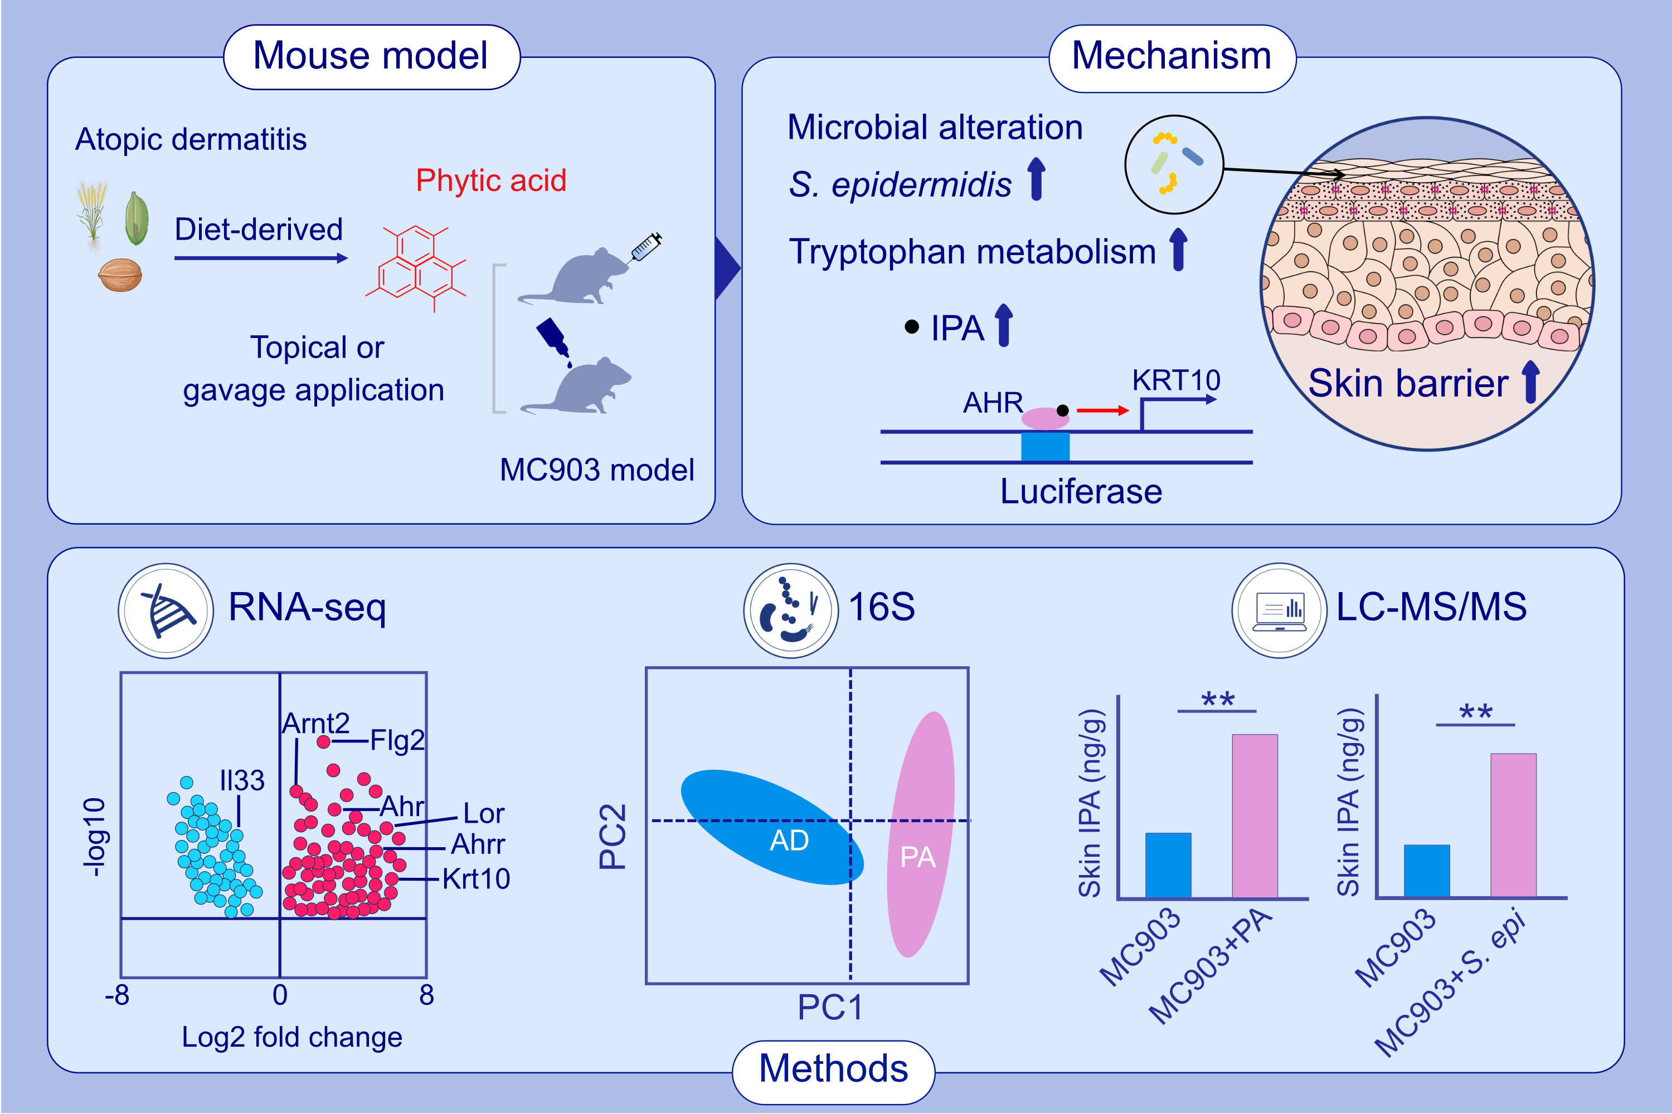
Phytic Acid Improves the Skin Barrier Function in Murine Models of Atopic Dermatitis Through Skin Microbiota-Derived Indole-3-Propionic Acid
Piao Wang, Lan Yang, Lu Chen, Xinyu Huang, Zhen Lin, et al.
Allergy. 2025; pages:2258-2270
https://doi.org/10.1111/all.16644
© 2019 EAACI and John Wiley and Sons A/S. Published by John Wiley and Sons Ltd.
Notes:
HIGHLIGHTS
• Diet-derived PA improved the barrier function of AD. • PA reshaped the skin microbiota and upregulated skin microbiota-derived tryptophan metabolite IPA, thus activating AHR to promote the transcription of KRT10. • Alleviation of AD via skin microbiota and its metabolites may be a novel therapeutic strategy for the treatment of AD. .

