Slide 1
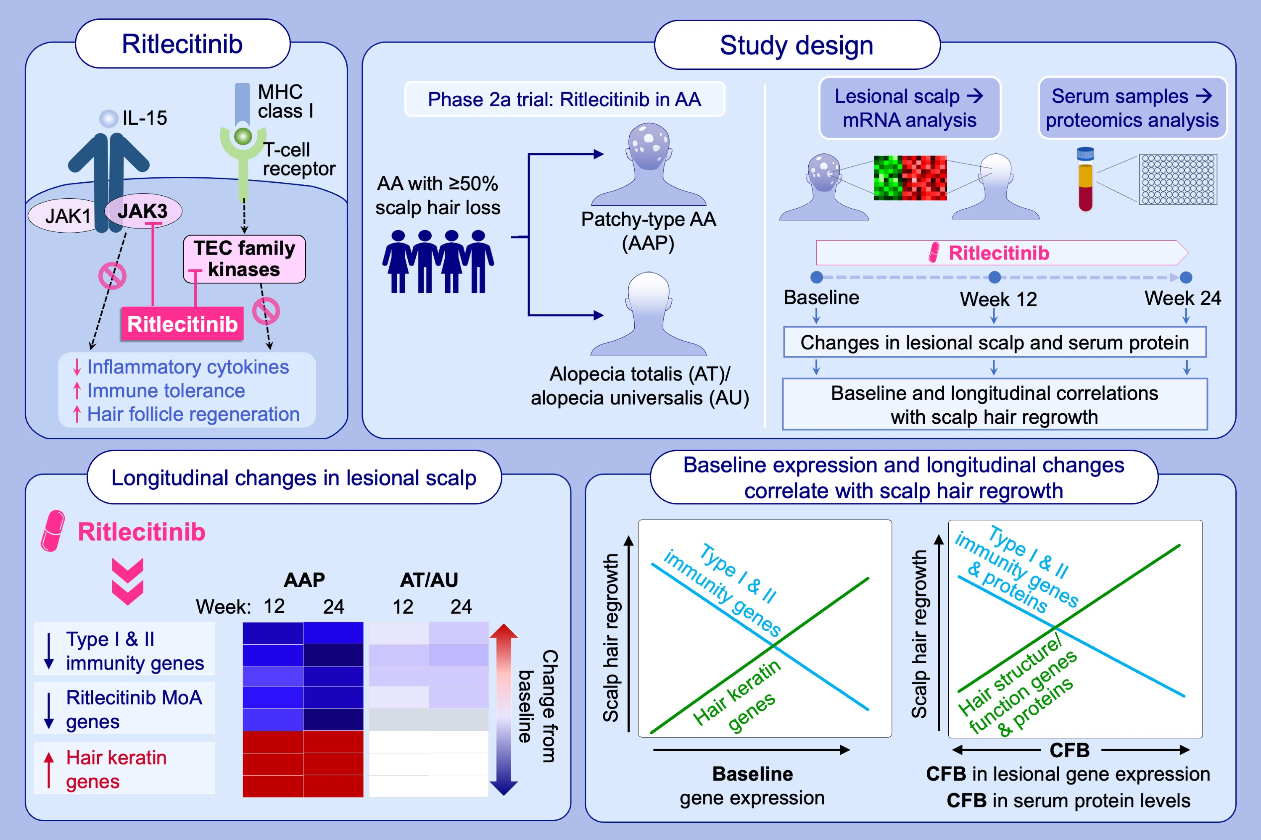
Multiomics Analysis of the Response to Ritlecitinib in Alopecia Areata Subtypes and Correlation With Efficacy
Li Xi, Elena Peeva, Yuji Yamaguchi, Zhan Ye, Alexandre Lejeune, et al.
Allergy. 2025; pages: 2348-2360
https://doi.org/10.1111/all.16659
© 2019 EAACI and John Wiley and Sons A/S. Published by John Wiley and Sons Ltd.
Notes:
HIGHLIGHTS
Ritlecitinib modulated Type I/II immunity genes (CCL5, CD8A, GZMB, CCL13, CCL18, IL13RA1), MoA genes (JAK3, ITK, BTK), and upregulated hair keratins, with stronger effects in AAP than AT/AU.
Baseline and longitudinal scalp and serum protein changes correlated with hair regrowth and disease improvement.
Findings support ritlecitinib’s role in immune modulation and hair regrowth in both AAP and AT/AU.

