Slide 1
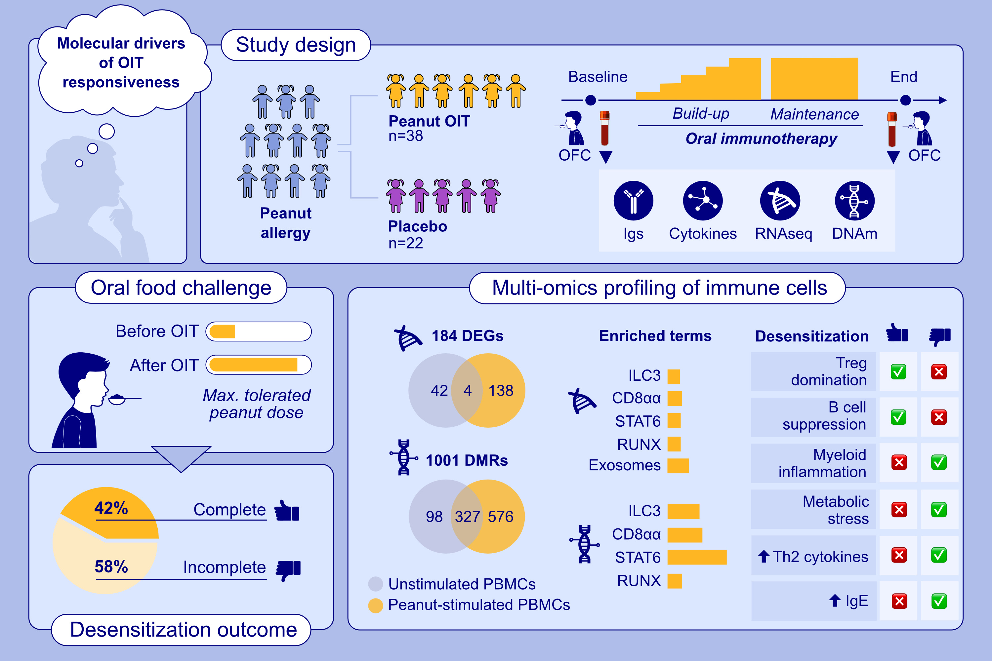
Understanding the Variability of Peanut-Oral Immunotherapy Responses by Multi-Omics Profiling of Immune Cells
Aleix Arnau-Soler, Sarah E. Ashley, Ahla Ghauri, Alexander C. S. N. Jeanrenaud, Ingo Marenholz, et al.
Allergy. 2025; pages: 3342-3358
https://doi.org/10.1111/all.16627
© 2019 EAACI and John Wiley and Sons A/S. Published by John Wiley and Sons Ltd.
Notes:
HIGHLIGHTS
• This study analyses molecular drivers of OIT responsiveness.
• Multi-omics profiling of peanut-stimulated PBMCs in a controlled peanut-OIT trial identifies immune, transcriptomic, and epigenetic changes distinguishing complete responders from incomplete responders.
• Key findings highlight gastrointestinal immune mechanisms, including extracellular exosome processes, and imbalanced immune responses: regulatory T-cell dominance and B-cell suppression in responders, versus myeloid inflammation, metabolic stress, and elevated Th2 cytokines and IgE in non-responders. .

