Slide 1
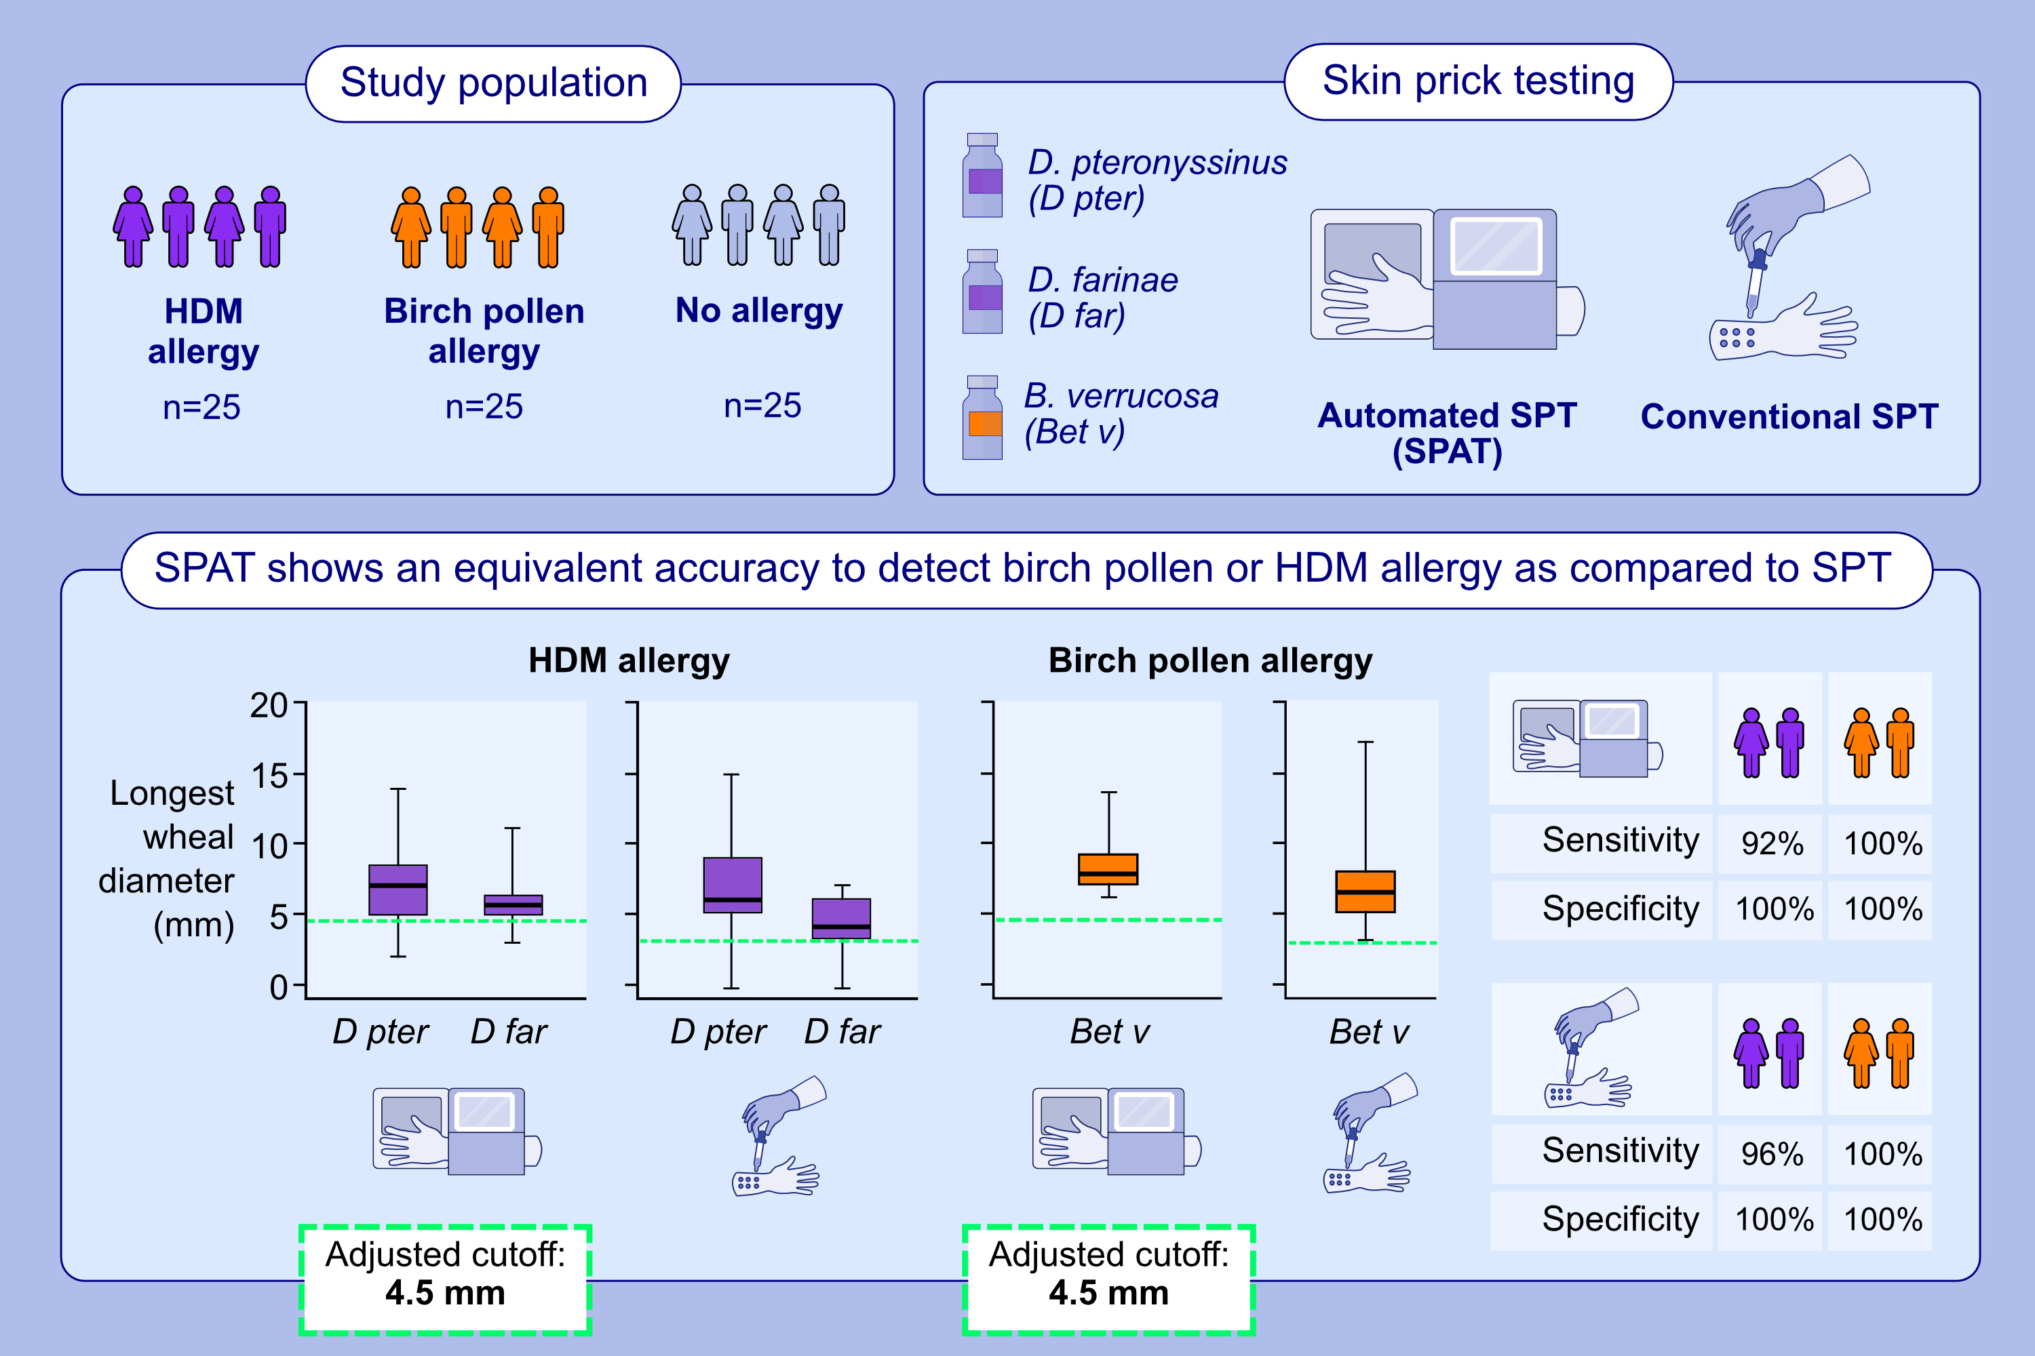
Validation of the Skin Prick Automated Test (SPAT) Cut-Off Value in Birch Pollen and House Dust Mite Allergic Rhinitis Patients
Sven F. Seys, Alina Gherasim, Florian Odul, Frank Dietsch, Zuzana Diamant, et al.
Allergy. 2025; pages: 3302-3309
https://doi.org/10.1111/all.16645
© 2019 EAACI and John Wiley and Sons A/S. Published by John Wiley and Sons Ltd.
Notes:
HIGHLIGHTS
• We investigated the accuracy of a novel skin prick automated test device with the conventional SPT in birch pollen and house dust mite allergic rhinitis patients confirmed by a nasal allergen challenge.
• The adjusted SPAT cutoff of 4.5 mm to define allergic sensitisation to common inhalant allergens was confirmed.
• SPAT showed equivalent accuracy to conventional SPT, with the SPAT web viewer as an easy and effective tool for digital wheal measurement. .

