Slide 1
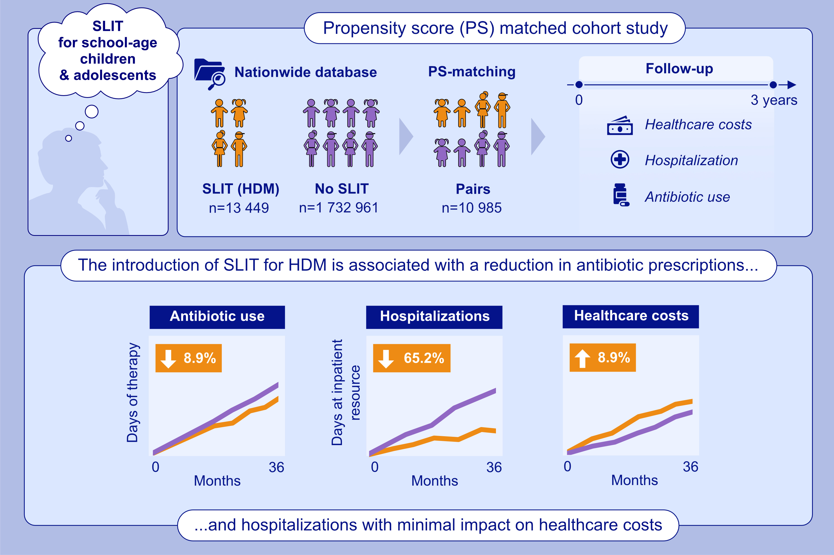
Real-World Effectiveness for Sublingual Allergen Immunotherapy Among School-Aged Children and Adolescents
Yusuke Okubo, Yu Kuwabara, Sakura Sato, Masafumi Sakashita, Hideaki Morita et al.
Allergy. 2025; pages: 3342-3358
https://doi.org/10.1111/all.16646
© 2019 EAACI and John Wiley and Sons A/S. Published by John Wiley and Sons Ltd.
Notes:
HIGHLIGHTS
• This study used a nationwide database to investigate the associations between SLIT introduction and clinical outcomes among children over 5 years of age.
• The PS-matching procedure created 10,985 pairs and followed them for three years. The introduction of SLIT associated with an 8.9% reduction in antibiotic use and a 65.2% reduction in hospitalizations with minimal impact on overall healthcare costs (+8.9%) over the three-year follow-up period. .

