Slide 1
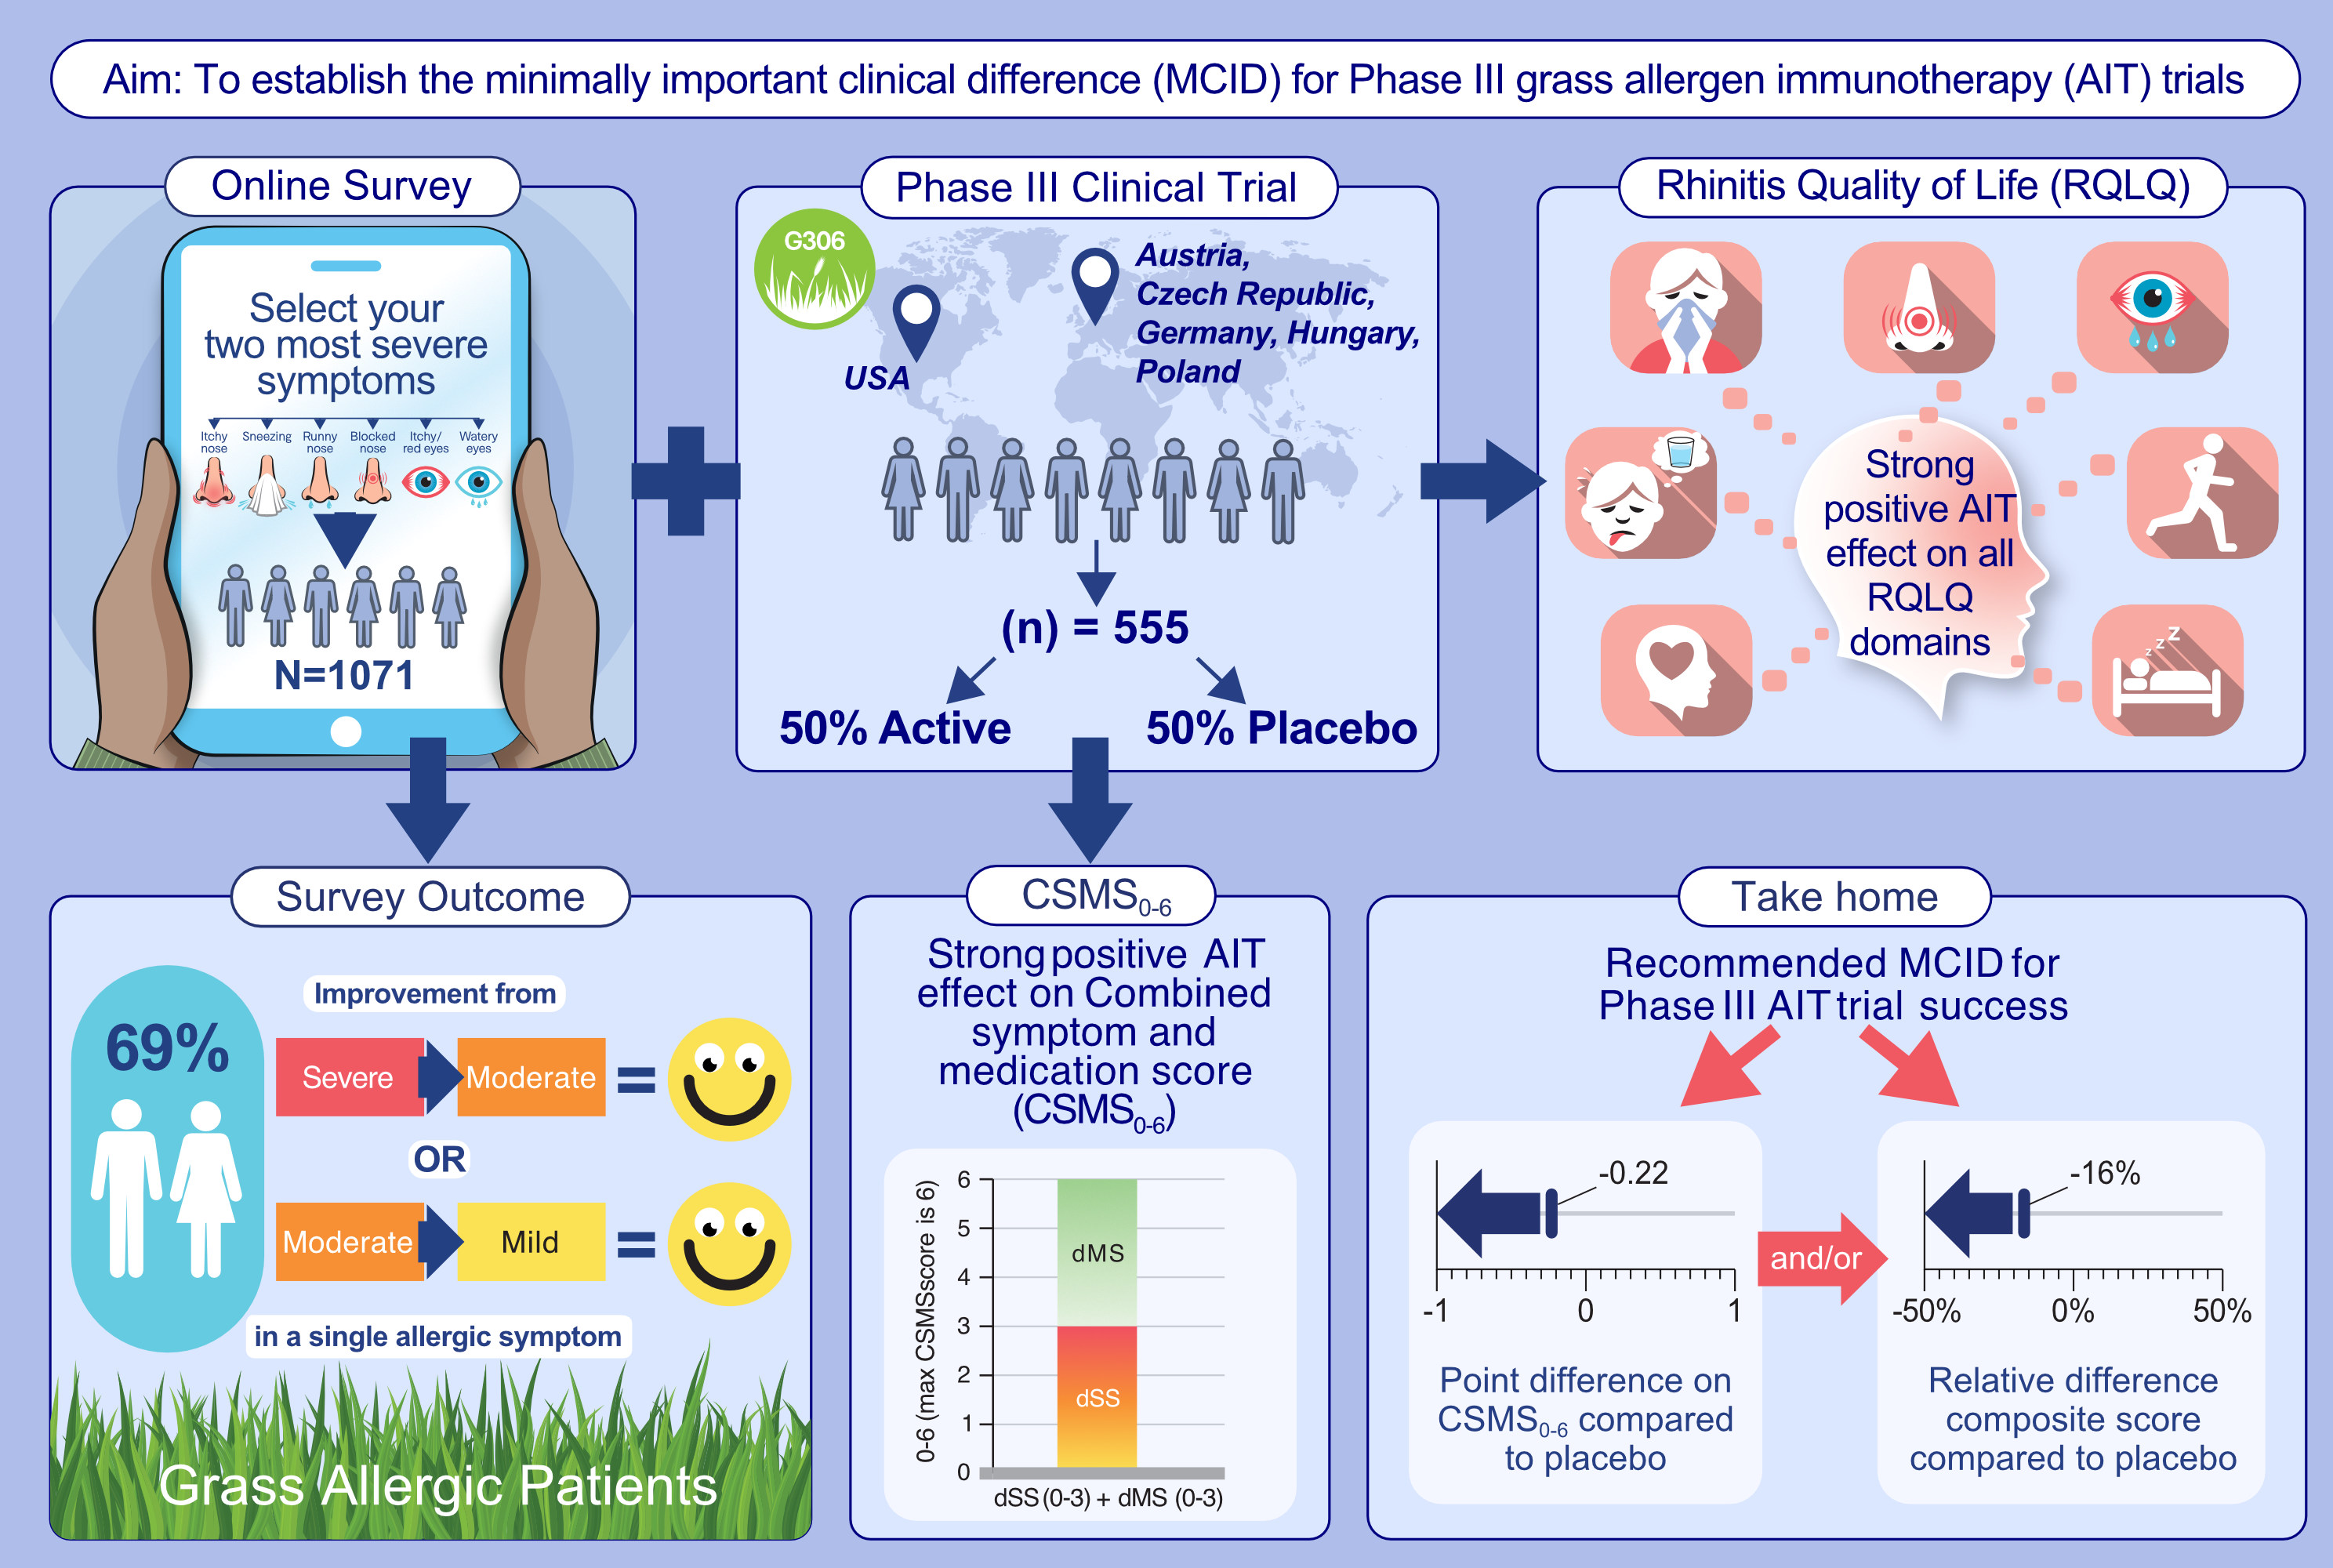
The Minimal Clinically Important Difference in Allergen Immunotherapy: An Evidence-Based Approach
Oliver Pfaar, Ralph Mösges, Michael S. Blaiss, Sven Becker, Lawrence DuBuske, et al.
Allergy. 2025; pages: 3369-3376
https://doi.org/10.1111/all.16654
© 2019 EAACI and John Wiley and Sons A/S. Published by John Wiley and Sons Ltd.
Notes:
HIGHLIGHTS
• The MCID for CSMS0-6 was derived via a questionnaire (N=1071) and by applying a justified threshold for the validated RQLQ(S) score as an anchor to RESONATE Phase III (G306) data.
• The outcome of a Phase III AIT is positive when statistical significance is achieved in combination with a difference of at least -0.22 points (CSMS0-6) and/or -16% (composite endpoint scale).
.

