Slide 1
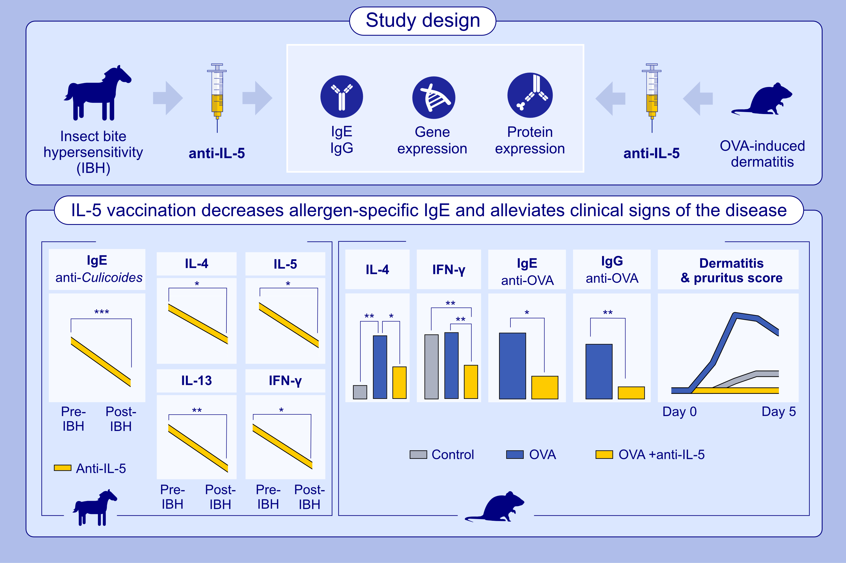
Anti-IL-5 Vaccination Dampens Allergen-Specific IgE Levels and Modulates IL-4 and IL-5 Th2 Cytokines in Skin Allergy of Mice and Horses
Fadi Jebbawi, Florian Olomski, Victoria Inversini, Giulia Keller, Tanya Rhiner, et al.
Allergy. 2025; pages: 3377-3390
https://doi.org/10.1111/all.70020
© 2019 EAACI and John Wiley and Sons A/S. Published by John Wiley and Sons Ltd.
Notes:
HIGHLIGHTS
• This study investigates the effect of IL-5 vaccination on allergen-specific IgE levels, as well as mRNA and protein expression of Th1/Th2-associated cytokines using a murine OVA skin allergy model and the naturally occurring skin allergy IBH in horses.
• IL-5-vaccination significantly decreases allergen-specific IgE levels, together with Th1/Th2 cytokines, such as IL-4 and IFN-γ.
• Targeting IL-5 with vaccination proves to be both effective and safe over the long term and show a big potential to be used for a prophylactic effect on exported horses to Culicoides infested areas.
.

