Slide 1
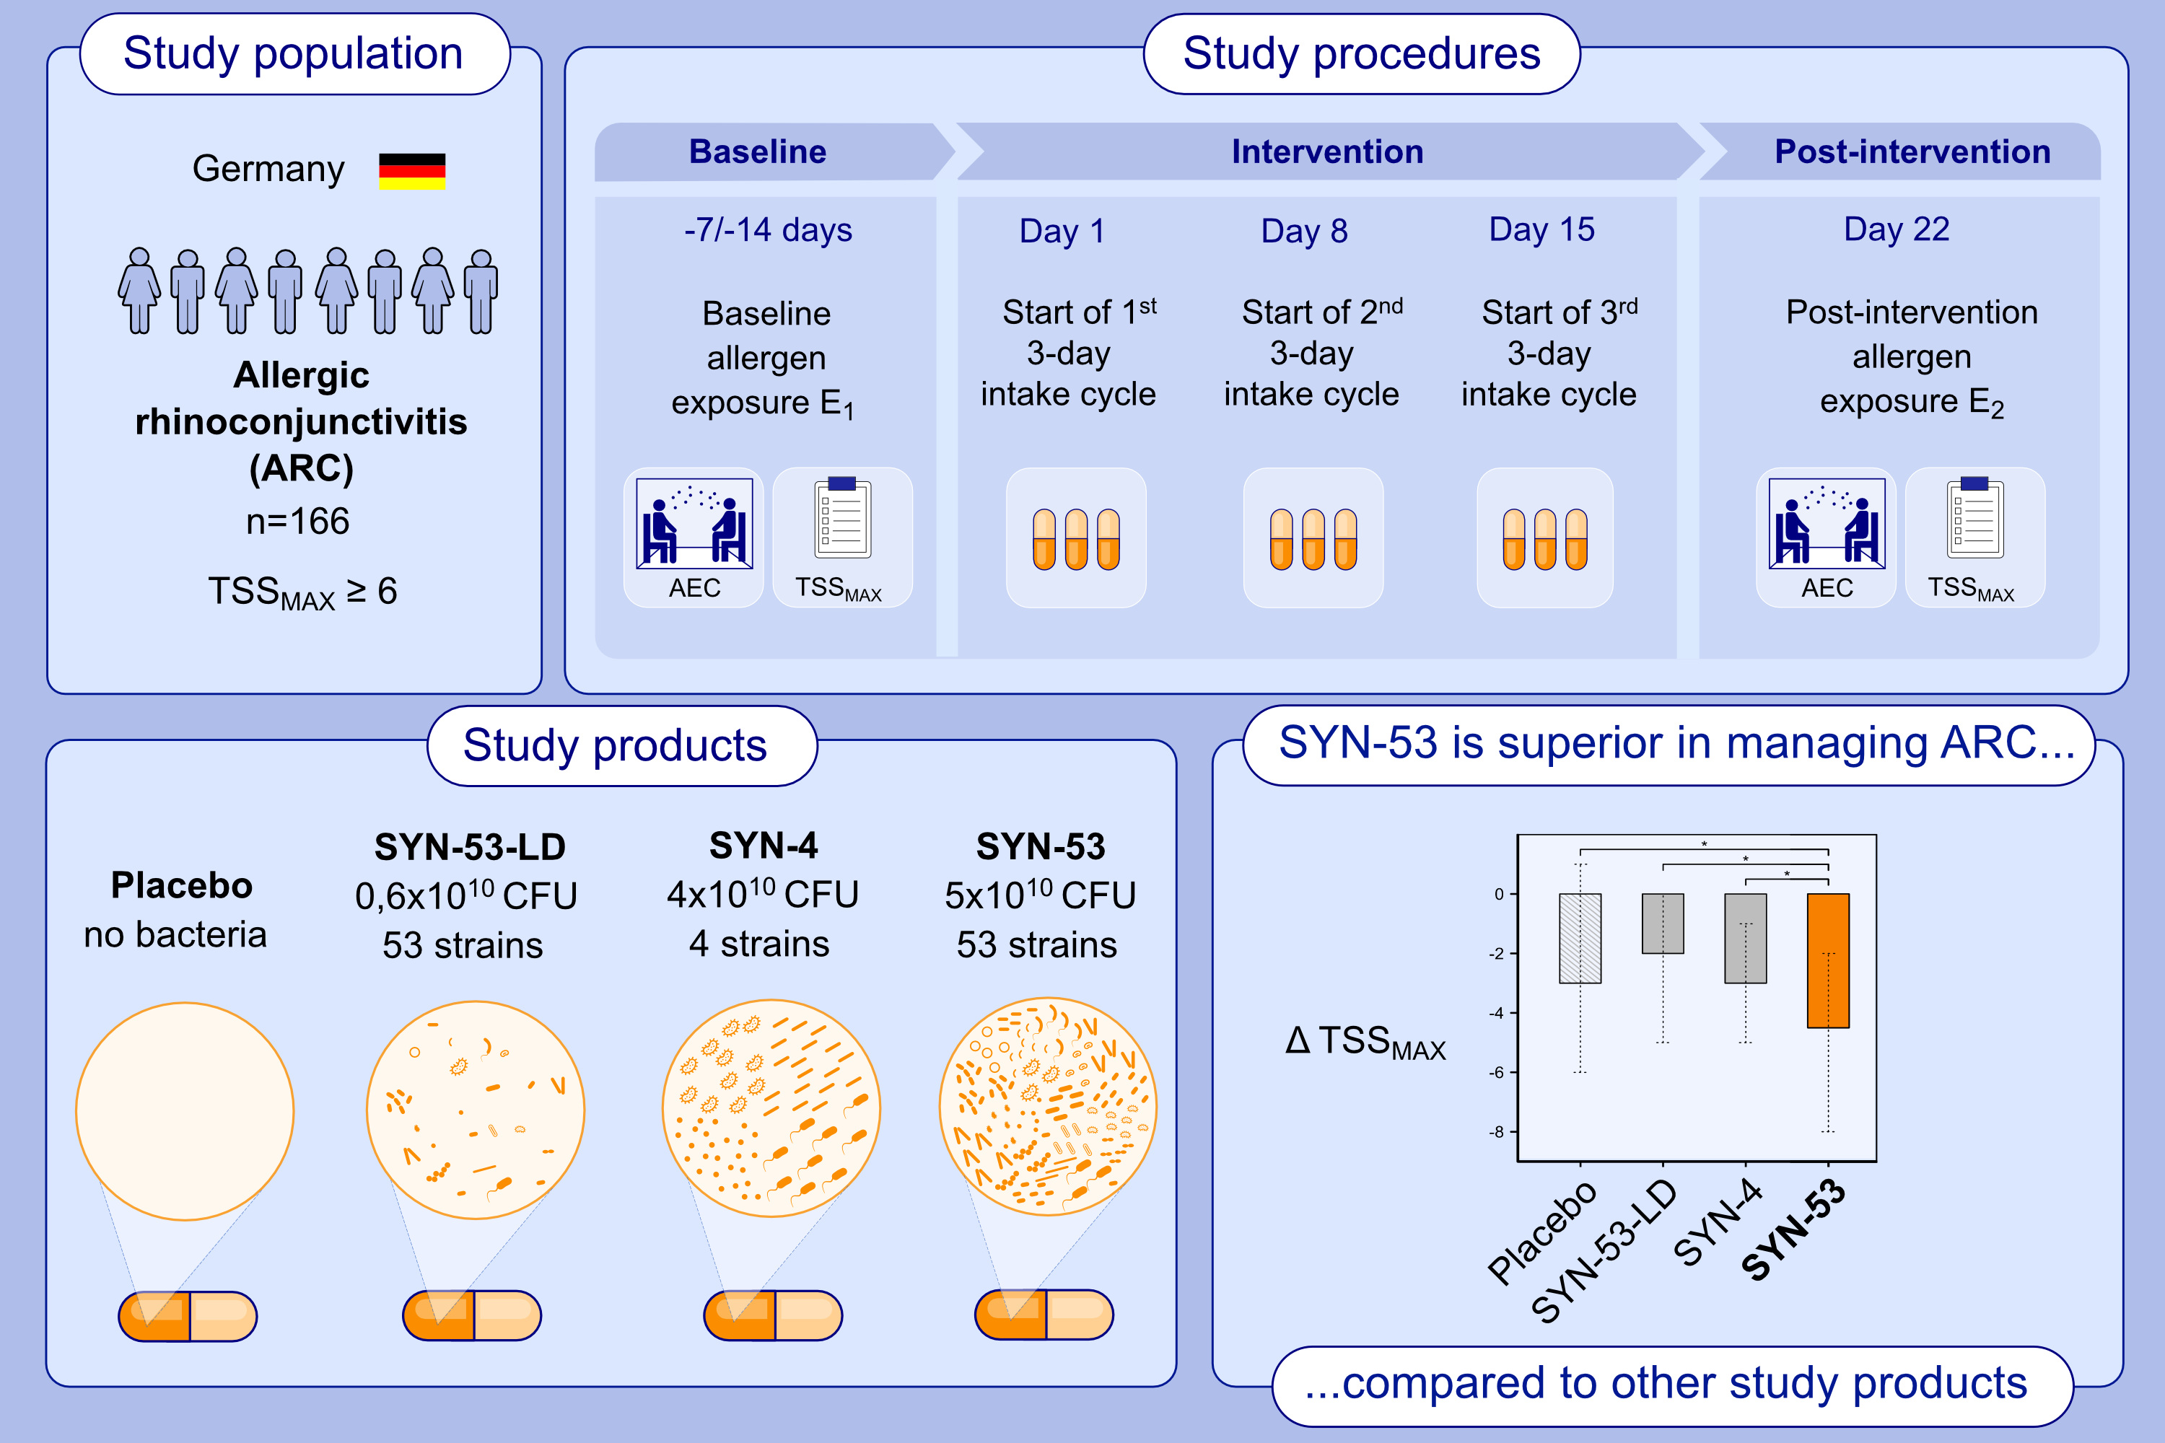
Diversity and Dosage Determine the Efficacy of the Probiotic SYN-53 in Allergic Rhinoconjunctivitis: A Randomized, Double-Blind, Placebo-Controlled Trial
Karl-Christian Bergmann, Torsten Zuberbier
Allergy. 2025; pages: 3310-3318
https://doi.org/10.1111/all.70045
© 2019 EAACI and John Wiley and Sons A/S. Published by John Wiley and Sons Ltd.
Notes:
HIGHLIGHTS
• The probiotic food supplement SYN-53 has previously shown efficacy in managing allergic rhinoconjunctivitis (ARC), with its high bacterial diversity and dosage hypothesized as key drivers.
• This study on 166 subjects aimed to confirm this hypothesis by comparing the effects of SYN-53, a low dose variant (SYN-53-LD), a low diversity variant (SYN-4), and a placebo on ARC in an allergen exposure chamber.
• SYN-53 demonstrated significant superiority over all variants and placebo in reducing symptoms of ARC, confirming that its effectiveness is intricately linked to high bacterial diversity and dosage.
• .

