Slide 1
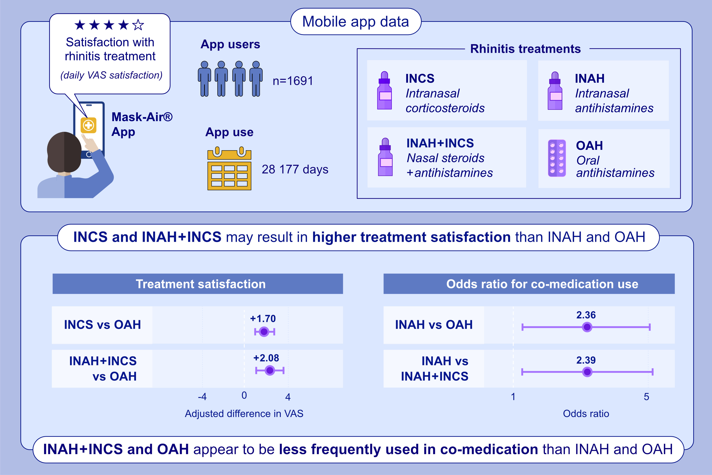
Comparison of Allergic Rhinitis Treatments on Patient Satisfaction: A MASK-air and EAACI Methodological Committee Report
Bernardo Sousa-Pinto, Rafael José Vieira, Antonio Bognanni, Matteo Martini, Michal Ordak, et al.
Allergy. 2025; pages: 3319-3330
https://doi.org/10.1111/all.70055
© 2019 EAACI and John Wiley and Sons A/S. Published by John Wiley and Sons Ltd.
Notes:
HIGHLIGHTS
• This study compares different medications for allergic rhinitis on patients’ satisfaction and co-medication use frequency.
• mHealth data suggests that intranasal corticosteroids and fixed combinations of intranasal antihistamines + corticosteroids are associated with higher treatment satisfaction than oral antihistamines.
• Fixed combinations of intranasal antihistamines + corticosteroids and oral antihistamines are less frequently used in co-medication than intranasal corticosteroids.
.

