Slide 1
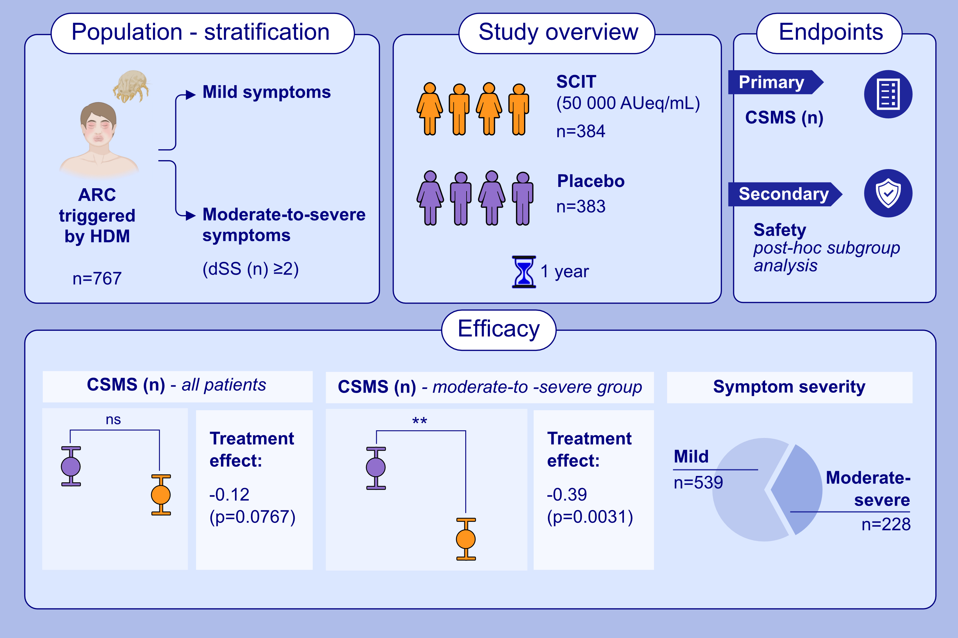
Subcutaneous Allergen Immunotherapy in Adults Allergic to House Dust Mites: A Phase 3 Randomized Controlled Trial
Claus Bachert, Hans Hoogeveen, Rimko ten Have, Donghui Yu, Margitta Worm, et al.
Allergy. 2025; pages: 3391-3400
https://doi.org/10.1111/all.70063
© 2019 EAACI and John Wiley and Sons A/S. Published by John Wiley and Sons Ltd.
Notes:
HIGHLIGHTS
• SCIT at 50,000 AUeq/ml is safe and demonstrates clinically meaningful efficacy in patients with moderate-to-severe HDM-induced allergic rhino-conjunctivitis.
• Clinically relevant efficacy was observed in the moderate-to-severe group, but not in the overall study population, likely due to the inclusion of many patients with only mild symptoms.
• Safety and tolerability were consistent across all symptom severities, with no new concerns observed. .

