Slide 1
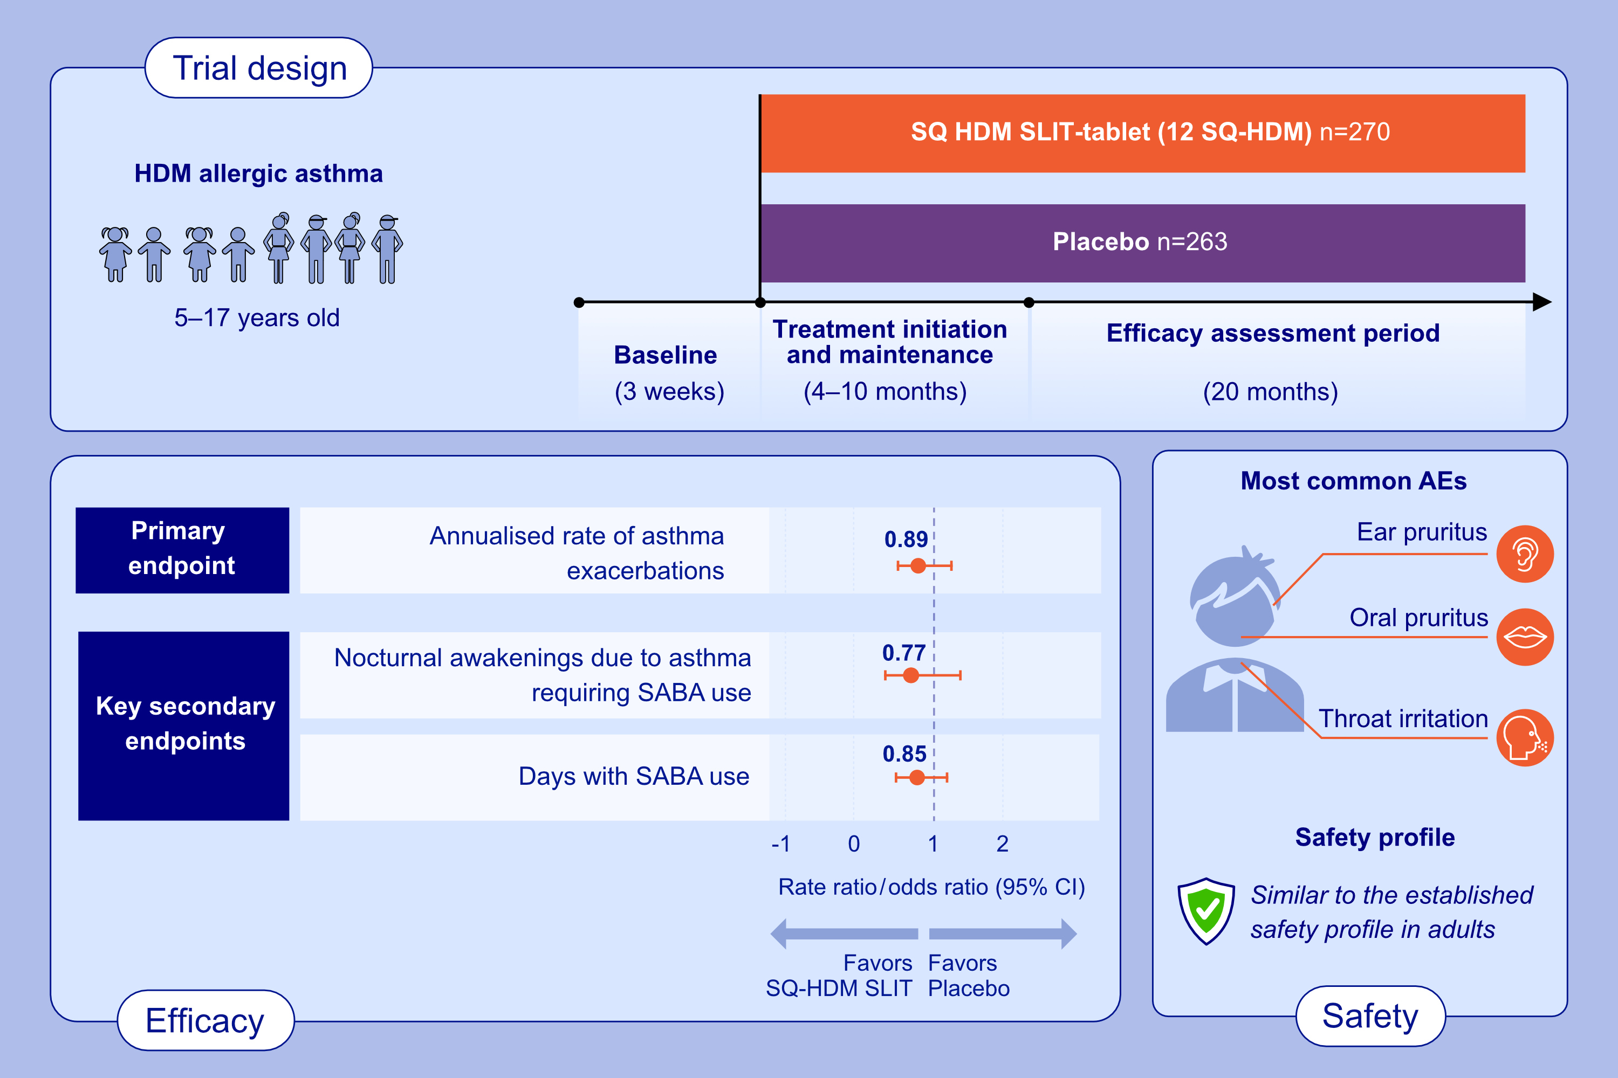
SQ House Dust Mite Sublingual Immunotherapy Tablet in Children With Allergic Asthma: A Randomised Phase III Trial
Graham Roberts, Jocelyne Just, Hendrik Nolte, Ole Holm Hels, Andrzej Emeryk, et al.
Allergy. 2025; pages: 3401-3411
https://doi.org/10.1111/all.70073
© 2019 EAACI and John Wiley and Sons A/S. Published by John Wiley and Sons Ltd.
Notes:
HIGHLIGHTS
• Phase III trial investigating the efficacy and safety of SQ HDM SLIT-tablet in children (5–17 years) with inadequately-controlled HDM allergic asthma.
• Novel paediatric data showing that the safety profile of SQ HDM SLIT-tablet is similar to that established in adults.
• There was no increased risk of asthma-related adverse events, and few children discontinued treatment due to adverse events. .

