Slide 1
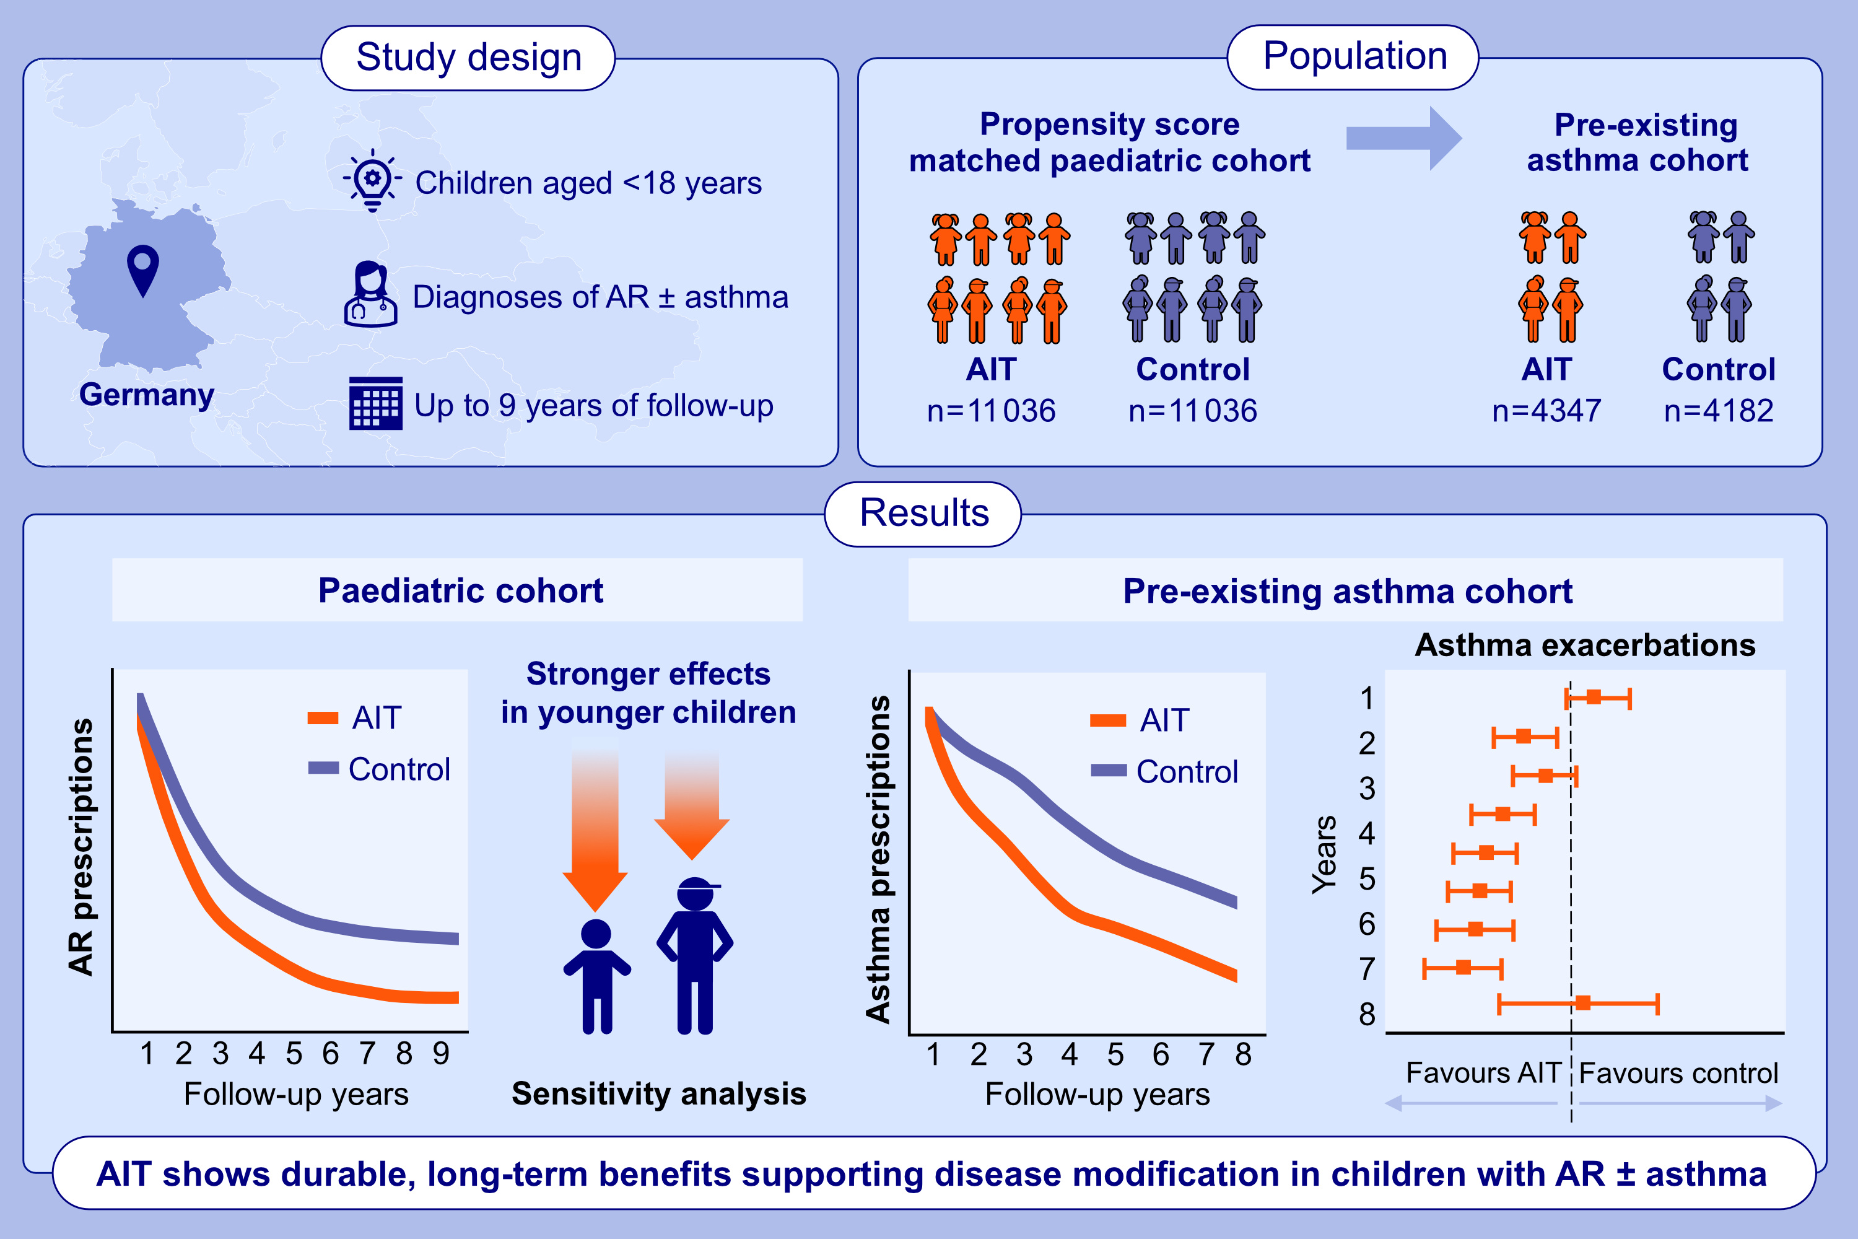
Long-Term, Real-World Effectiveness of Allergen Immunotherapy in Children and Adolescents With Allergic Rhinitis and Asthma
Christian Woehlk, Thomas Stranzl, Marco Contoli, Nick Freemantle, Andreas Kallsoy Slaettanes, et al.
Allergy. 2025; pages: 3331-3341
https://doi.org/10.1111/all.70085
© 2019 EAACI and John Wiley and Sons A/S. Published by John Wiley and Sons Ltd.
Notes:
HIGHLIGHTS
• Pre-defined, propensity score–matched paediatric cohort from REACT evaluating the long-term effectiveness of AIT in children with AR, with or without asthma.
• AIT-treated children showed greater reductions in AR medication use, asthma medication use, severe asthma exacerbations, and new oral corticosteroid prescriptions versus controls over 9 years.
• Data indicate the disease-modifying potential of AIT use in early childhood.
• .

