Slide 1
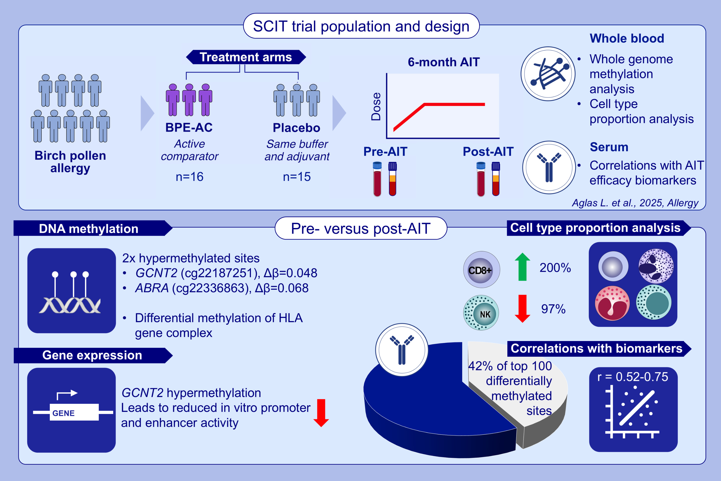
Genome-Wide Blood DNA Methylation Profiling in Birch Pollen Allergic Patients Undergoing Allergen-Specific Immunotherapy
Angelika Lahnsteiner, Victoria Ellmer, Mengzhen Hao, Line Kring Tannert, Serge A. Versteeg, et al.
Allergy. 2025; pages: 3412-3423
https://doi.org/10.1111/all.70094
© 2019 EAACI and John Wiley and Sons A/S. Published by John Wiley and Sons Ltd.
Notes:
HIGHLIGHTS
• Whole genome-wide DNA methylation analysis of whole blood of patients undergoing 6 months of birch pollen subcutaneous allergen immunotherapy revealed epigenetic changes linked to allergen immunotherapy.
• Birch pollen AIT decreases methylation in HLA genes and induces methylation in genes associated with Th2 and TGF-β pathways, increases CD8+ T cell population and decreases NK cells.
• 42% of the top 100 differentially methylated positions correlate with AIT serum biomarkers (e.g.

