Slide 1
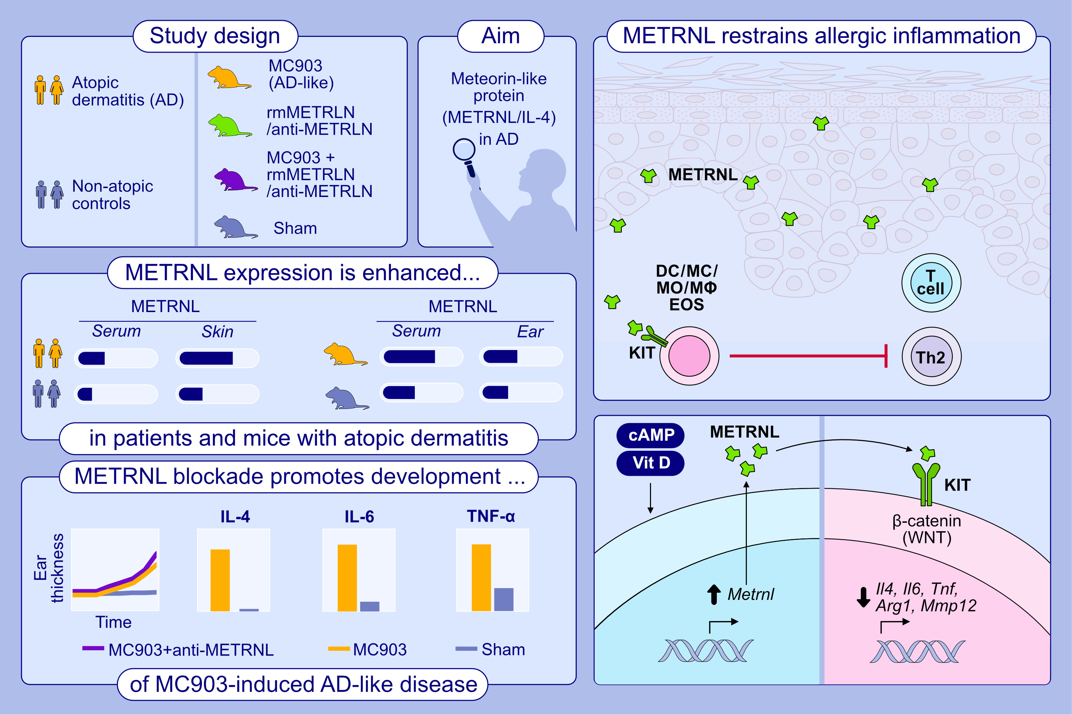
Meteorin-like protein/METRNL/Interleukin-41 ameliorates atopic dermatitis-like inflammation
Danqi Huang, Xiuting Liu, Xun Gao, Chun Kit Choi, Giovanni Giglio, et al.
Allergy. 2025; pages: 474-488
https://doi.org/10.1111/all.16150
© 2019 EAACI and John Wiley and Sons A/S. Published by John Wiley and Sons Ltd.
Notes:
HIGHLIGHTS
• METRNL was significantly upregulated in lesions and serum of patients with dermatitis compared to healthy controls.
• Administration of rmMETRNL reduced allergic skin inflammation and hallmarks of AD in mice, whereas blocking of METRNL signaling led to the opposite.
• METRNL enhanced -Catenin activation, limited the expression of Th2-related molecules that attracted the accumulation of Arg1hi-macrophages, dendritic cells, and activated mast cells. .

