Slide 1
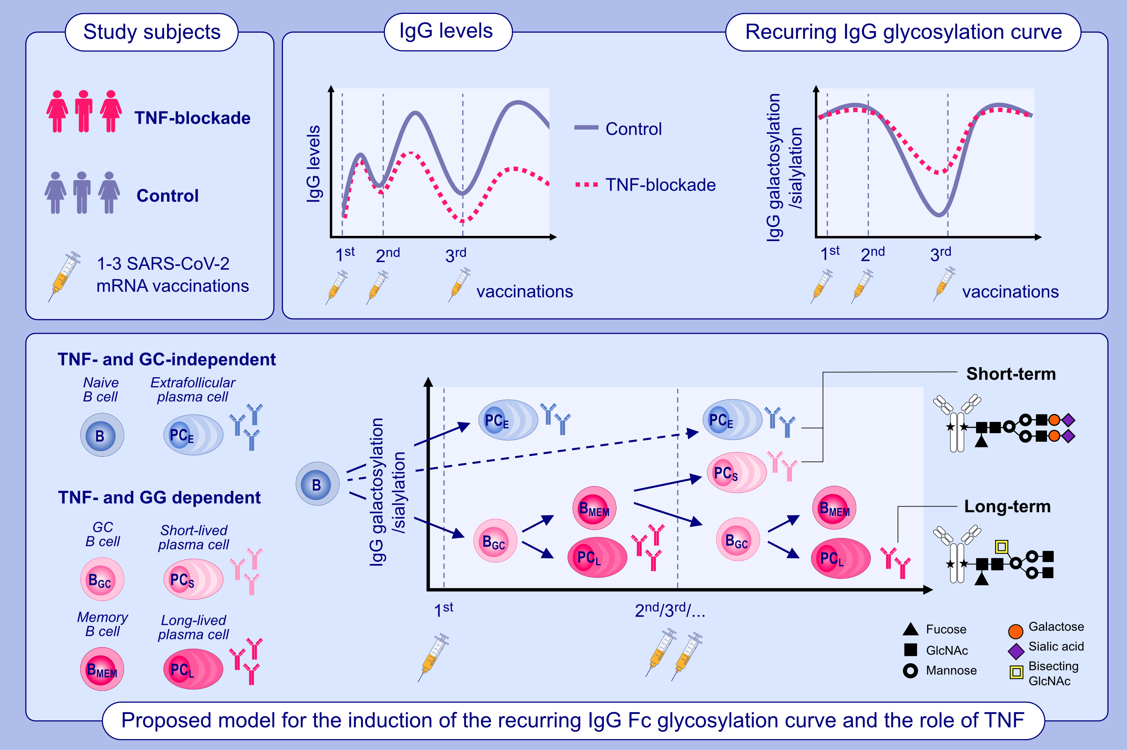
Anti-TNF therapy impairs both short- and long-term IgG responses after repeated vaccination
Jana Sophia Buhre, Tamas Pongracz, Ulf Martin Geisen, Mareike Schubert, Wenjun Wang, et al.
Allergy. 2025; pages:423-439
https://doi.org/10.1111/all.16241
© 2019 EAACI and John Wiley and Sons A/S. Published by John Wiley and Sons Ltd.
Notes:
HIGHLIGHTS
• Human vaccination study discovers that booster vaccinations induce a recurring IgG antibody Fc glycosylation curve across all IgG subclasses.
• Proposed model: initial extrafollicular B cell activation as well as re-activation of GC-derived IgG+ memory B cells generate short-lived PCs that produce highly galactosylated and sialylated short-term IgG, whereas GC-derived long-lived PCs produce low galactosylated and sialylated long-term IgG.
• Anti-TNF therapy reduces both GC-derived pathways, thereby reducing the benefit of repeated booster vaccinations in both the short and long term.
.

