Slide 1
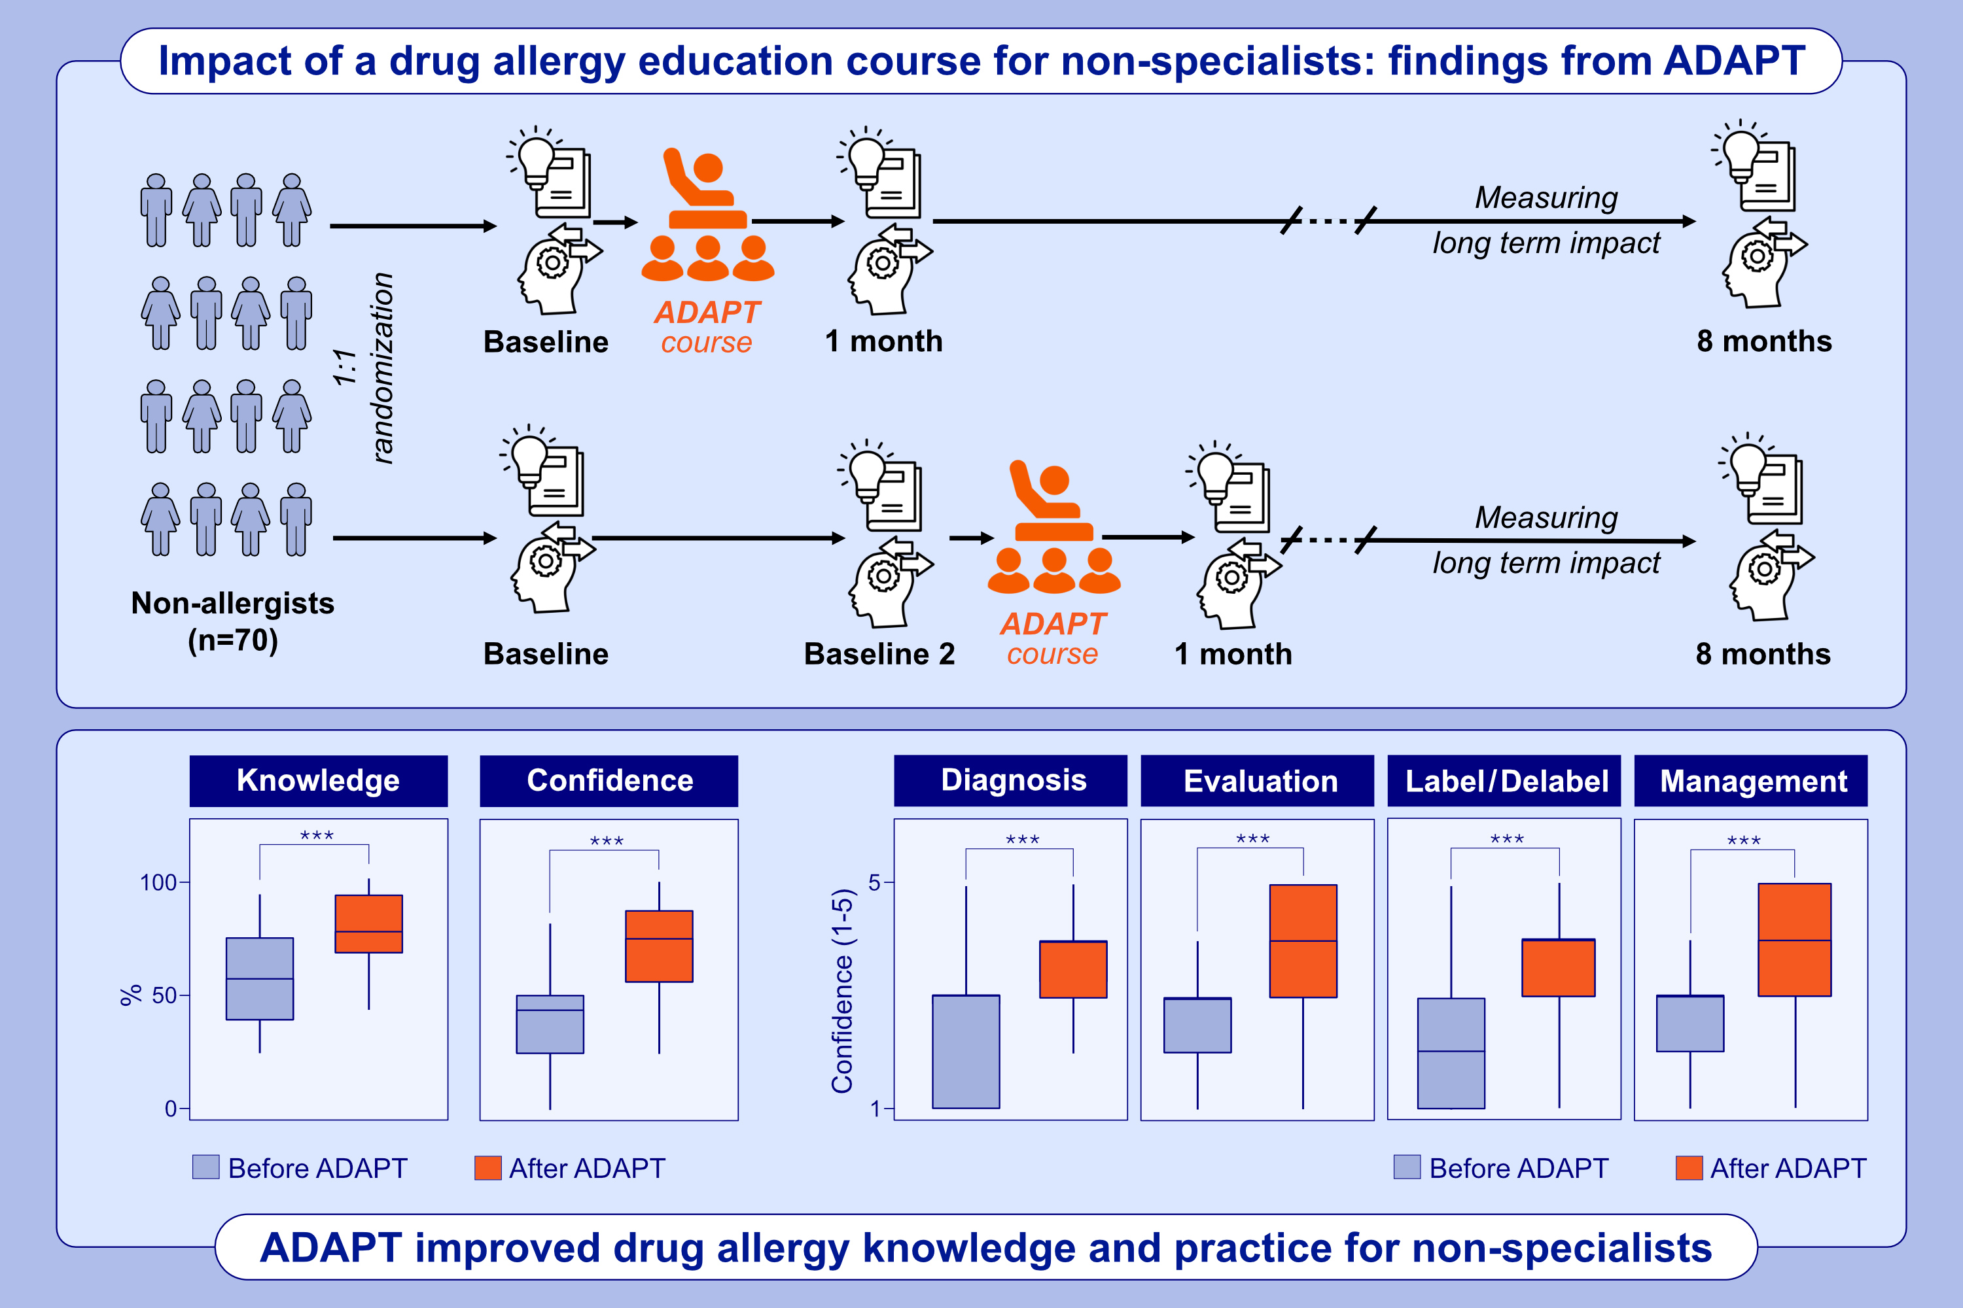
Impact of a drug allergy education course for non-specialists: Findings from ADAPT—A randomized crossover trial
Michaela Lucas, Hugo W. F. Mak, Jasmine T. Y. Lee, Rishabh Kulkarni, Sophia S. C. Chan, et al.
Allergy. 2025; pages: 525-533
https://doi.org/10.1111/all.16270
© 2019 EAACI and John Wiley and Sons A/S. Published by John Wiley and Sons Ltd.
Notes:
HIGHLIGHTS
• Drug allergy is often a neglected topic and many non-specialists lack knowledge or confidence in managing this common condition.
• This randomized clinical trial investigates the effectiveness and impact of a dedicated educational course (ADAPT) designed for non-allergist physicians and nurses to enhance drug allergy knowledge and practice in accordance to recommendations in Asia.
• We show that an intensive drug allergy educational course was effective in improving knowledge and practice for non-specialists in Hong Kong. .

