Slide 1
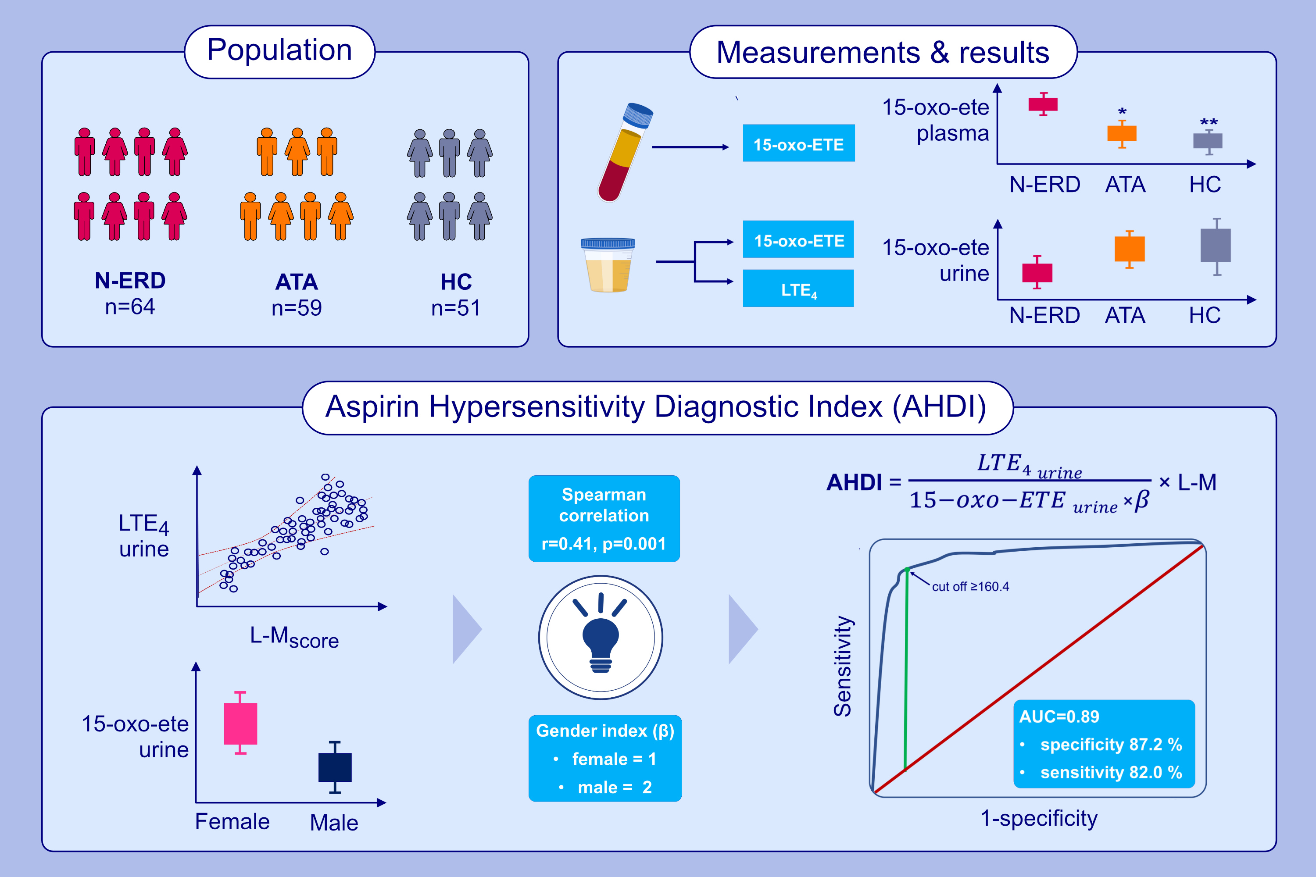
Aspirin hypersensitivity diagnostic index (AHDI): In vitro test for diagnosing of N-ERD based on urinary 15-oxo-ETE and LTE4 excretion
Lucyna Mastalerz, Gabriela Trąd, Piotr Szatkowski, Adam Ćmiel, Anna Gielicz, et al.
Allergy. 2025; pages: 534-544
https://doi.org/10.1111/all.16281
© 2019 EAACI and John Wiley and Sons A/S. Published by John Wiley and Sons Ltd.
Notes:
HIGHLIGHTS
• Plasma 15-oxo-ETE is higher in N-ERD than in aspirin-tolerant asthmatics or healthy subjects.
• Urinary LTE4 positively correlates with the Lund-Mackay score in N-ERD.
• Urinary 15-oxo-ETE is higher in women than in men.
• An index (AHDI) based on urinary LTE4 to 15-oxo-ETE ratio corrected for sex and Lund-Mackay score predicts N-ERD with sensitivity 82% and a specificity of 87.2%.

