Slide 1
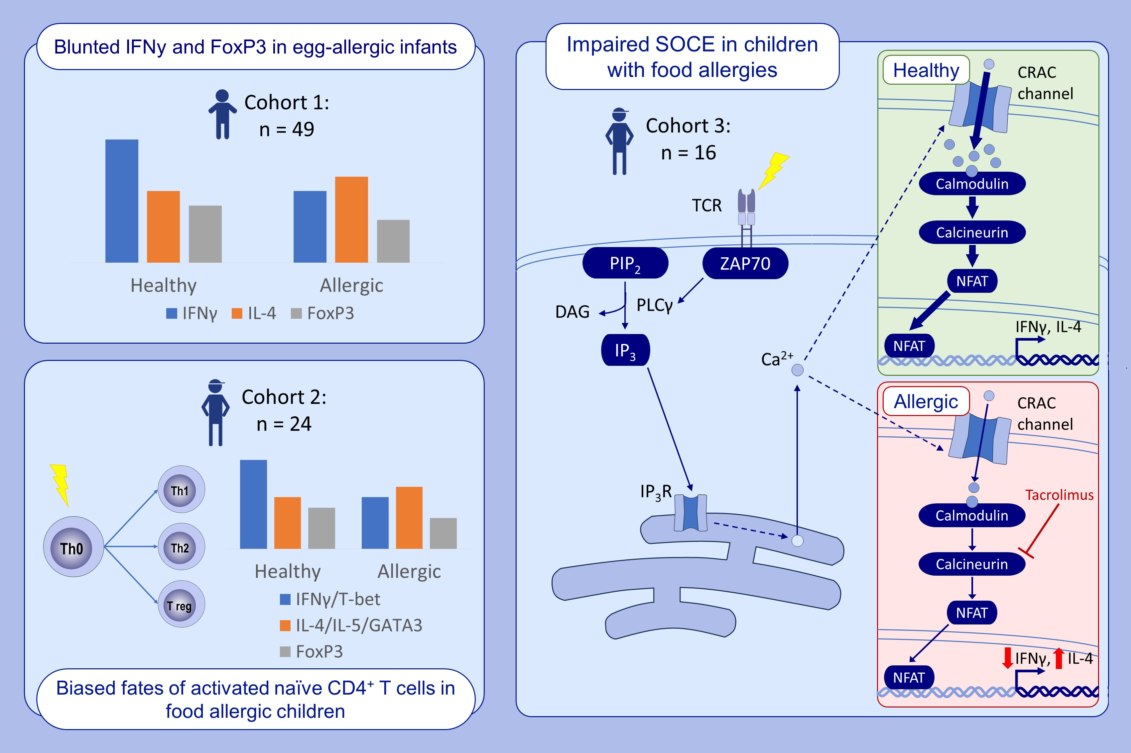
Impaired calcium influx underlies skewed T helper cell differentiation in children with IgE-mediated food allergies
C. L. Lai, B. Santner-Nanan, P. J. Maltese, C. K. S. Ong, D. J. Palmer, et al.
Allergy. 2025; pages: 513-524
https://doi.org/10.1111/all.16310
© 2019 EAACI and John Wiley and Sons A/S. Published by John Wiley and Sons Ltd.
Notes:
HIGHLIGHTS
• Naïve CD4 T cells in food allergic children are intrinsically biased away from Th1 and Treg development.
• This bias may be driven by impaired SOCE shown in naïve CD4 T cells of food allergic children, as inhibition of calcineurin by tacrolimus downstream of SOCE leads to a Th2 bias in T cell differentiation.
• The SOCE/calcineurin/NFAT pathway may be important for determining T helper cell fates in immune dysregulatory states such as allergy. .

