Slide 1
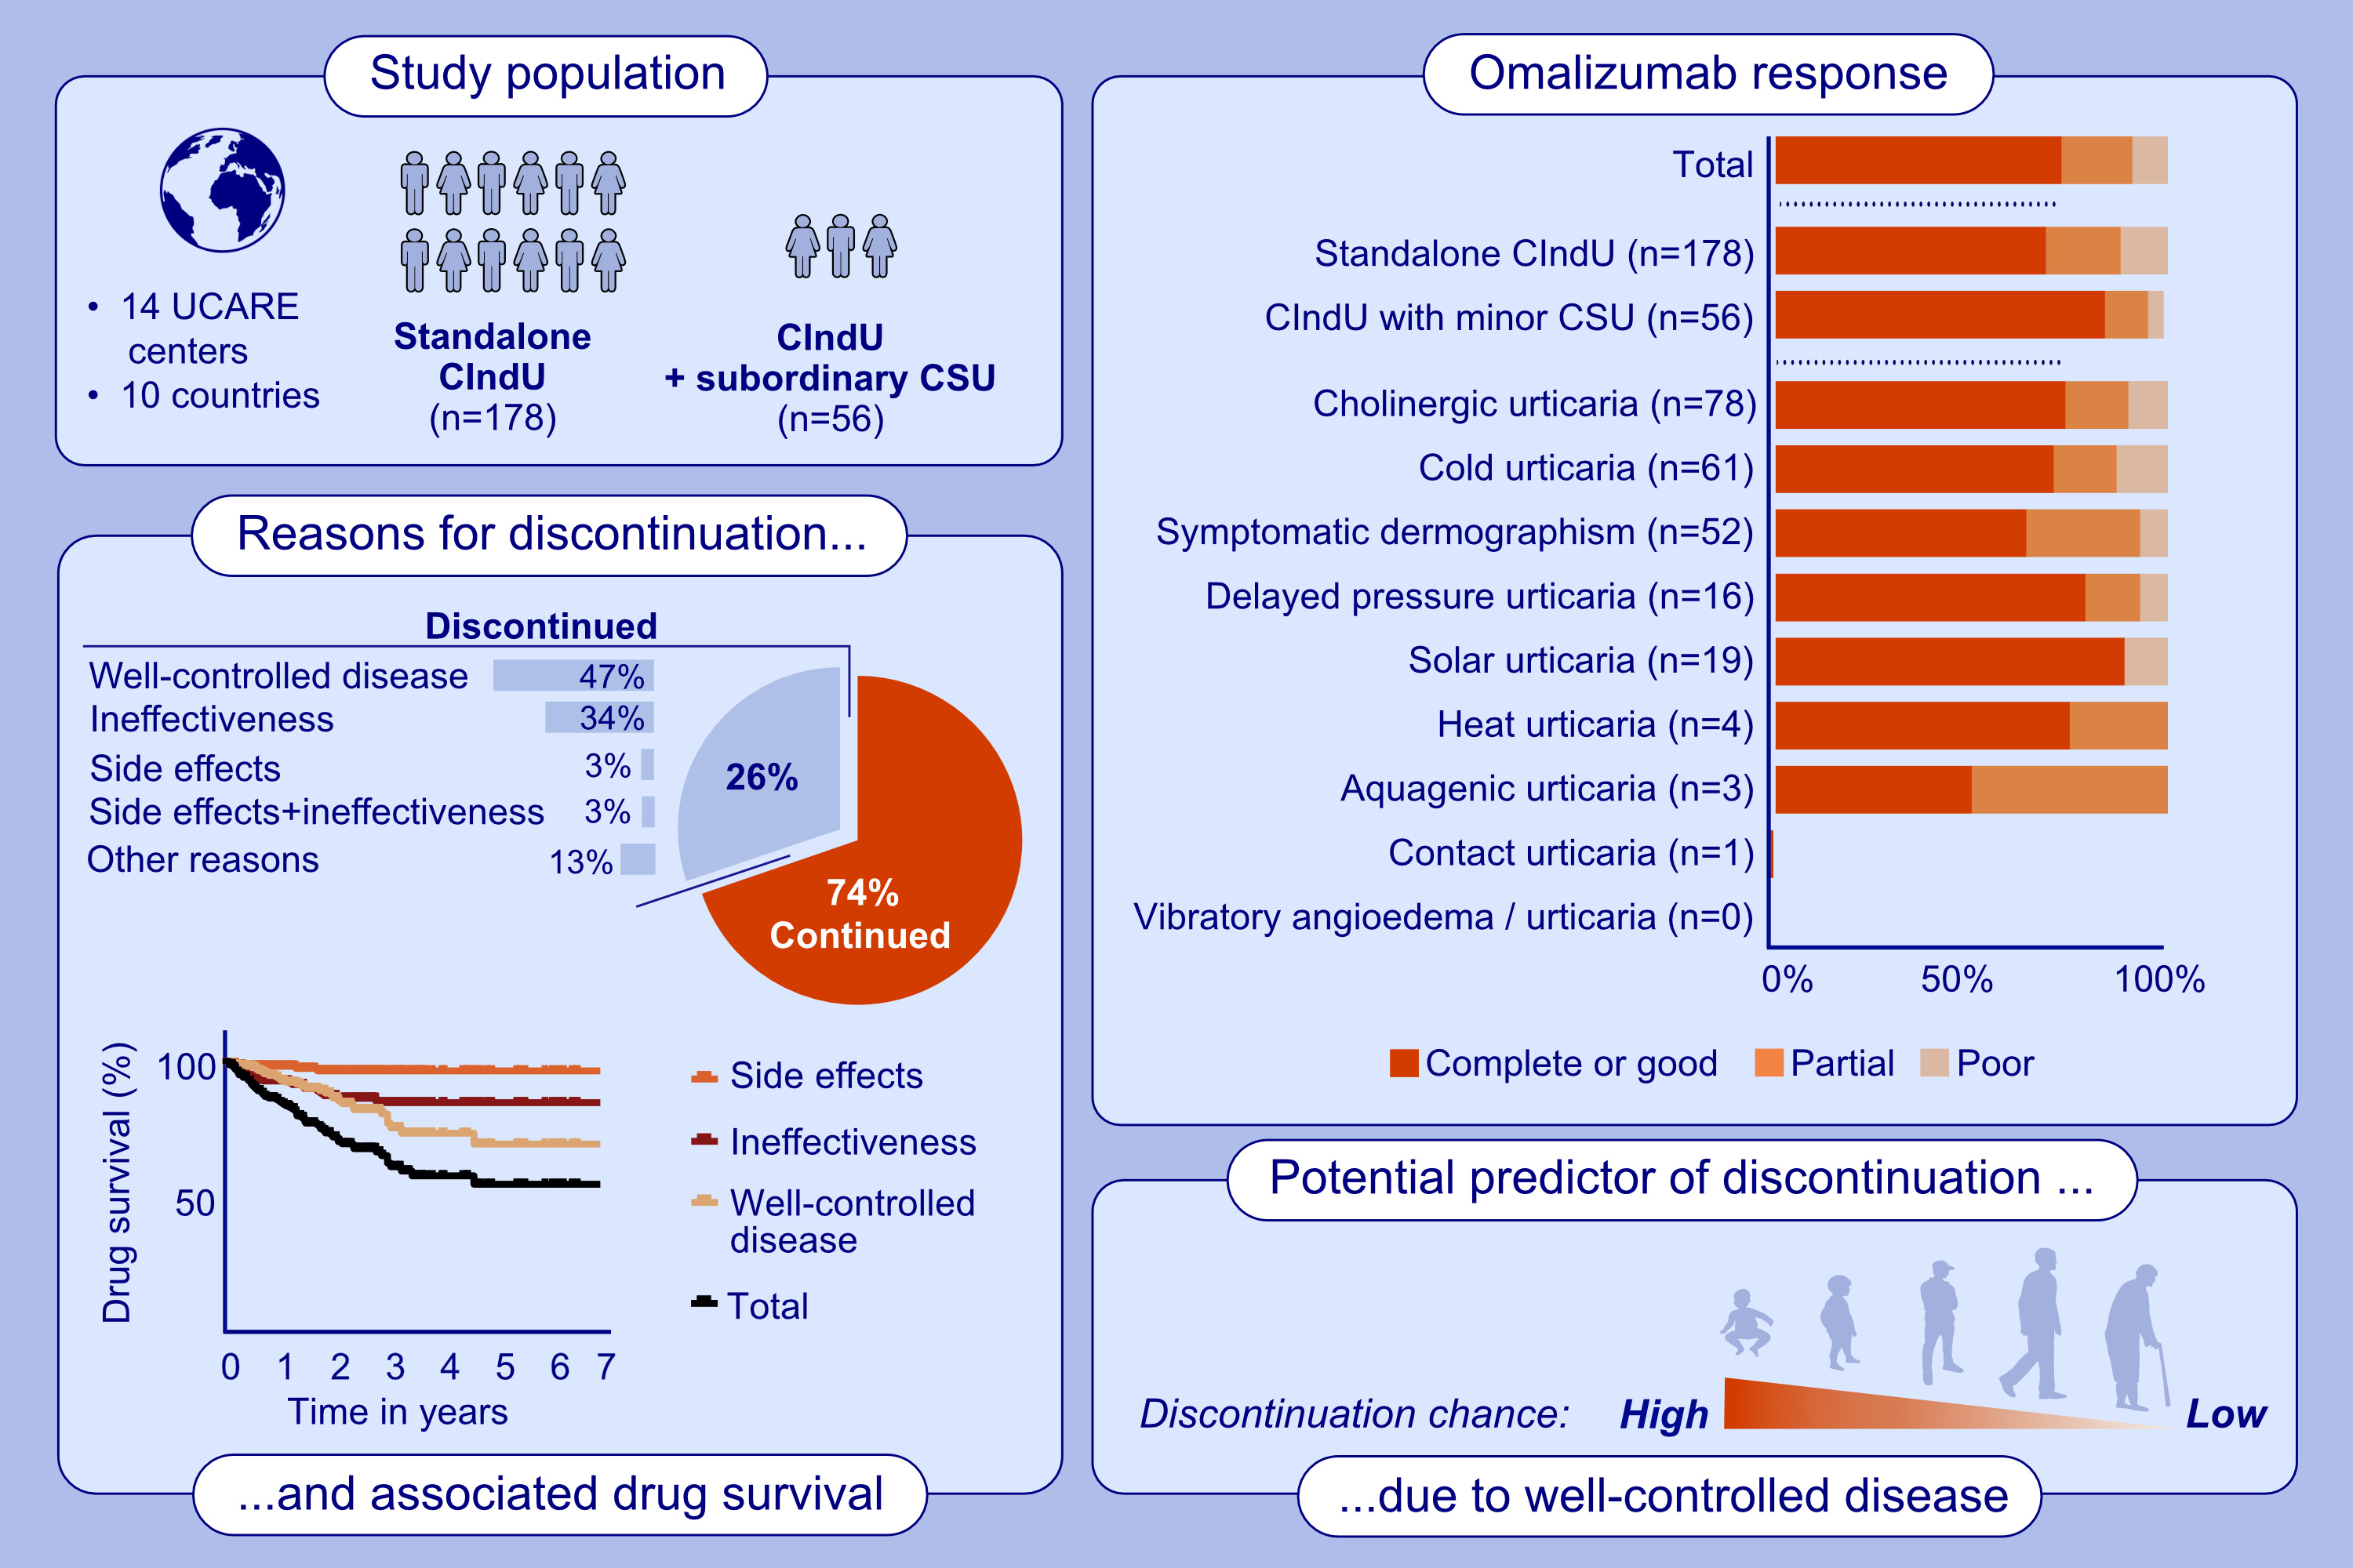
Omalizumab is effective and safe in chronic inducible urticaria (CIndU): Real-world data from a large multi-national UCARE study
R. Soegiharto, M. Alizadeh Aghdam, J. A. Sørensen, E. van Lindonk, F. Bulut Demir, et al.
Allergy. 2025; pages: 489-499
https://doi.org/10.1111/all.16334
© 2019 EAACI and John Wiley and Sons A/S. Published by John Wiley and Sons Ltd.
Notes:
HIGHLIGHTS
• Among 234 CIndU patients, 73% had complete/good response to omalizumab, without significant differences between CIndU subtypes.
Twenty-six percent of CIndU patients discontinued omalizumab, mostly due to well-controlled disease and ineffectiveness, resulting in an estimated omalizumab treatment duration exceeding 5 years.
• Higher age predicted lower chance of discontinuation due to well-controlled disease; CIndU subtype and presence of minor CSU were not associated with omalizumab discontinuation.
.

