Slide 1
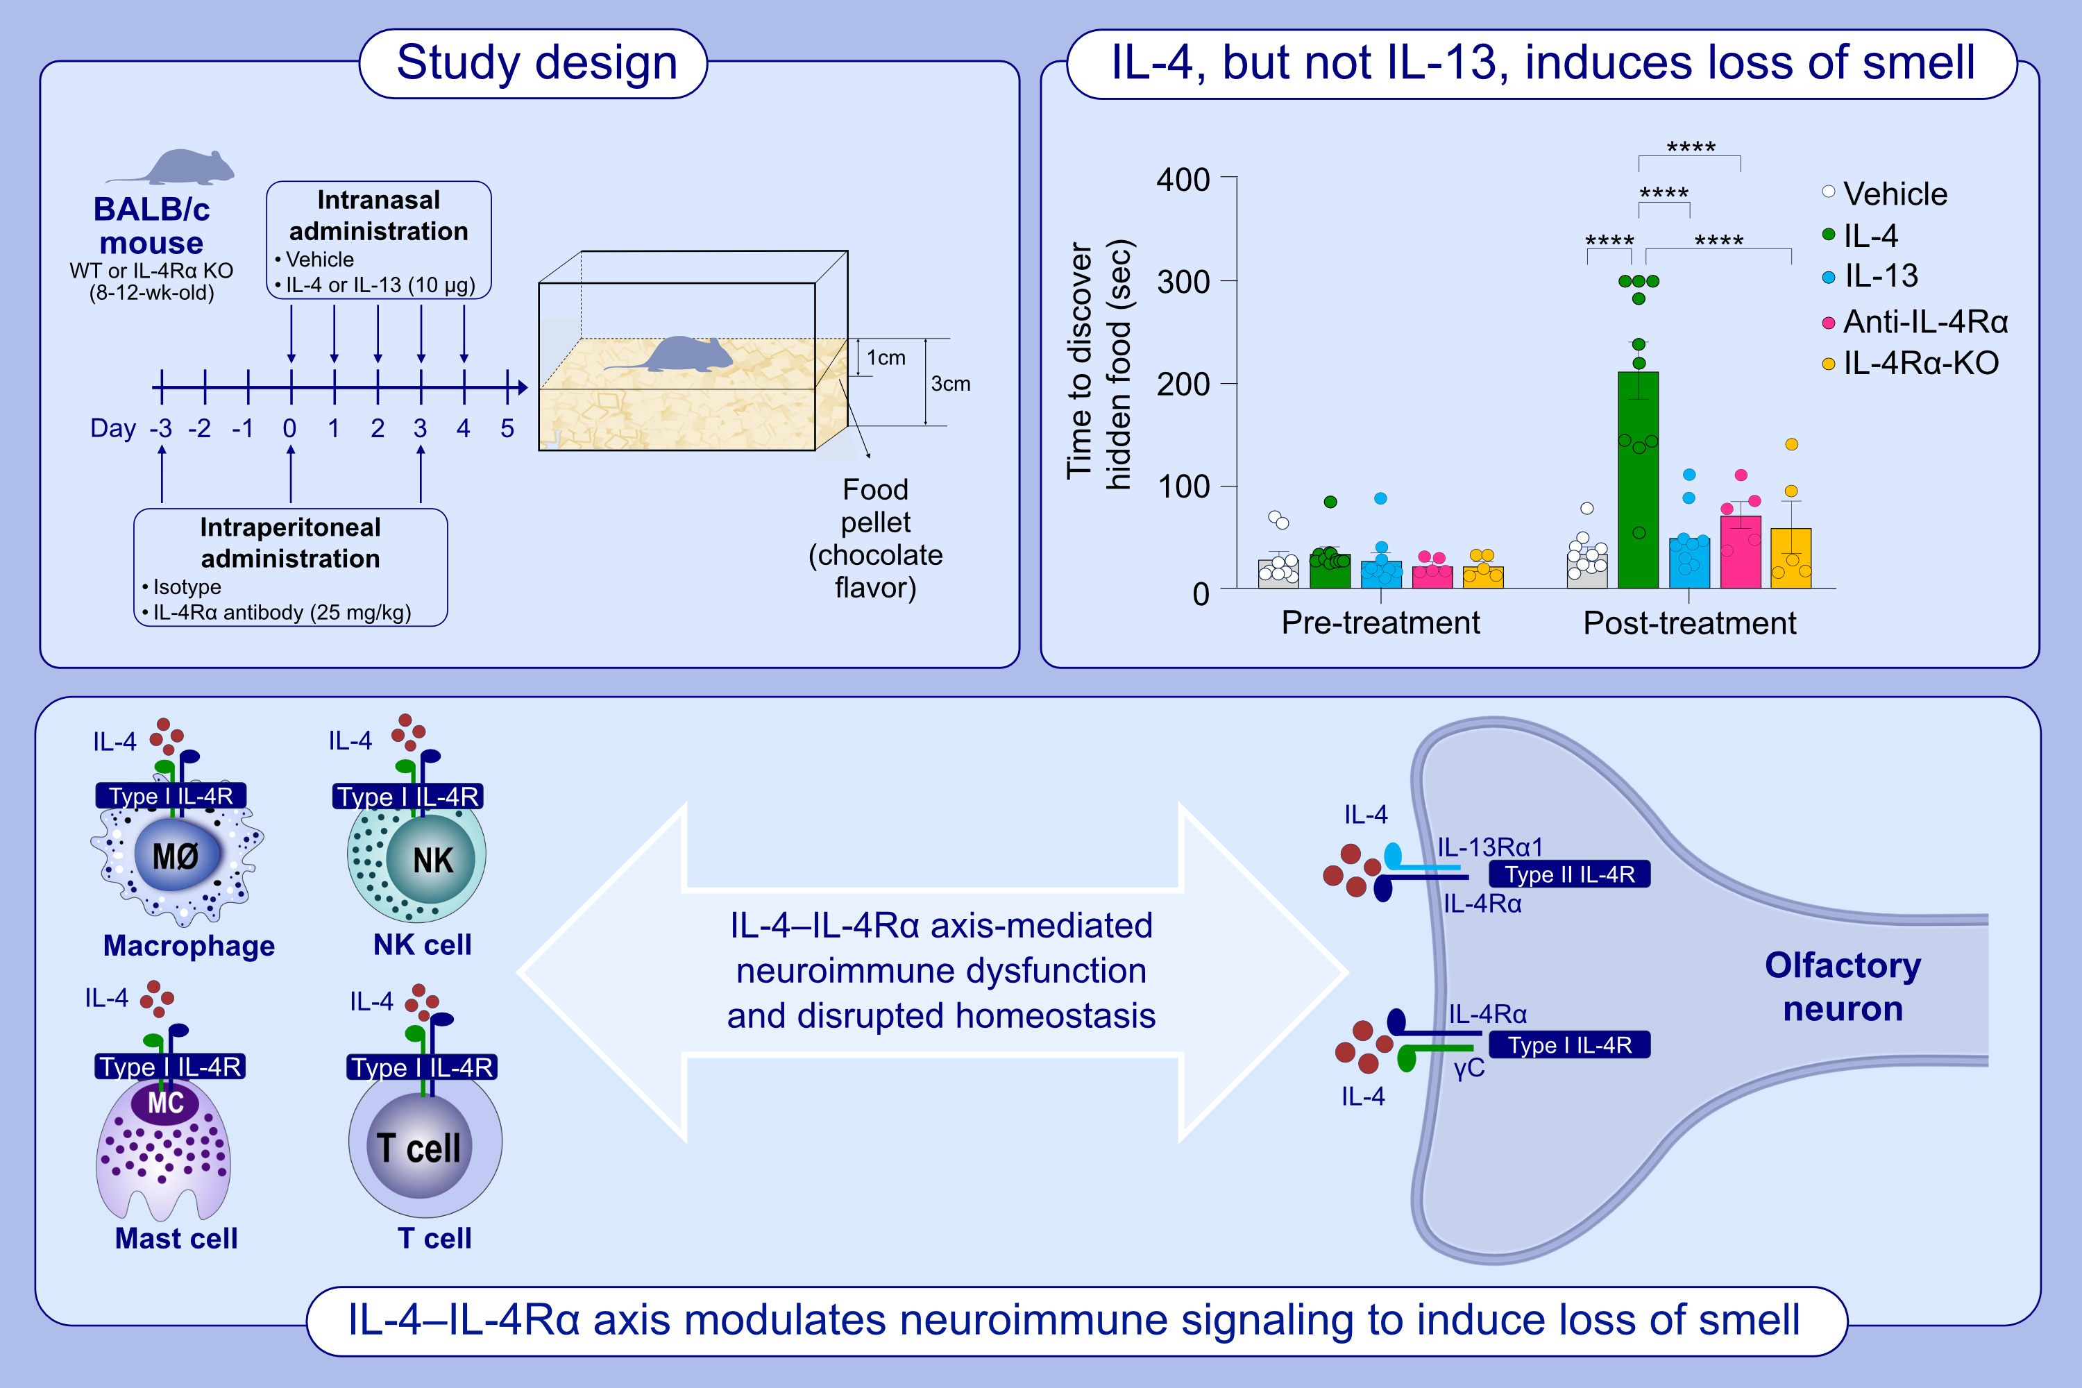
The IL-4–IL-4Rα axis modulates olfactory neuroimmune signaling to induce loss of smell
Yannis Hara, Mithilesh Kumar Jha, Jeremy Y. Huang, Yingnan Han, Ingeborg M. Langohr, et al.
Allergy. 2025; pages: 440-461
https://doi.org/10.1111/all.16338
© 2019 EAACI and John Wiley and Sons A/S. Published by John Wiley and Sons Ltd.
Notes:
HIGHLIGHTS
• IL-4 and IL-13 have non-redundant effects in olfaction, with loss of smell in mice evoked only by intranasal administration of IL-4, but not IL-13.
• IL-4-evoked pathophysiological effects on olfaction is independent of compromised structural integrity of the olfactory neuroepithelium.
• IL-4–IL-4Rα signaling modulates neuronal crosstalk with immune cells, suggesting a functional link between olfactory impairment and neuroinflammation. .

