Slide 1
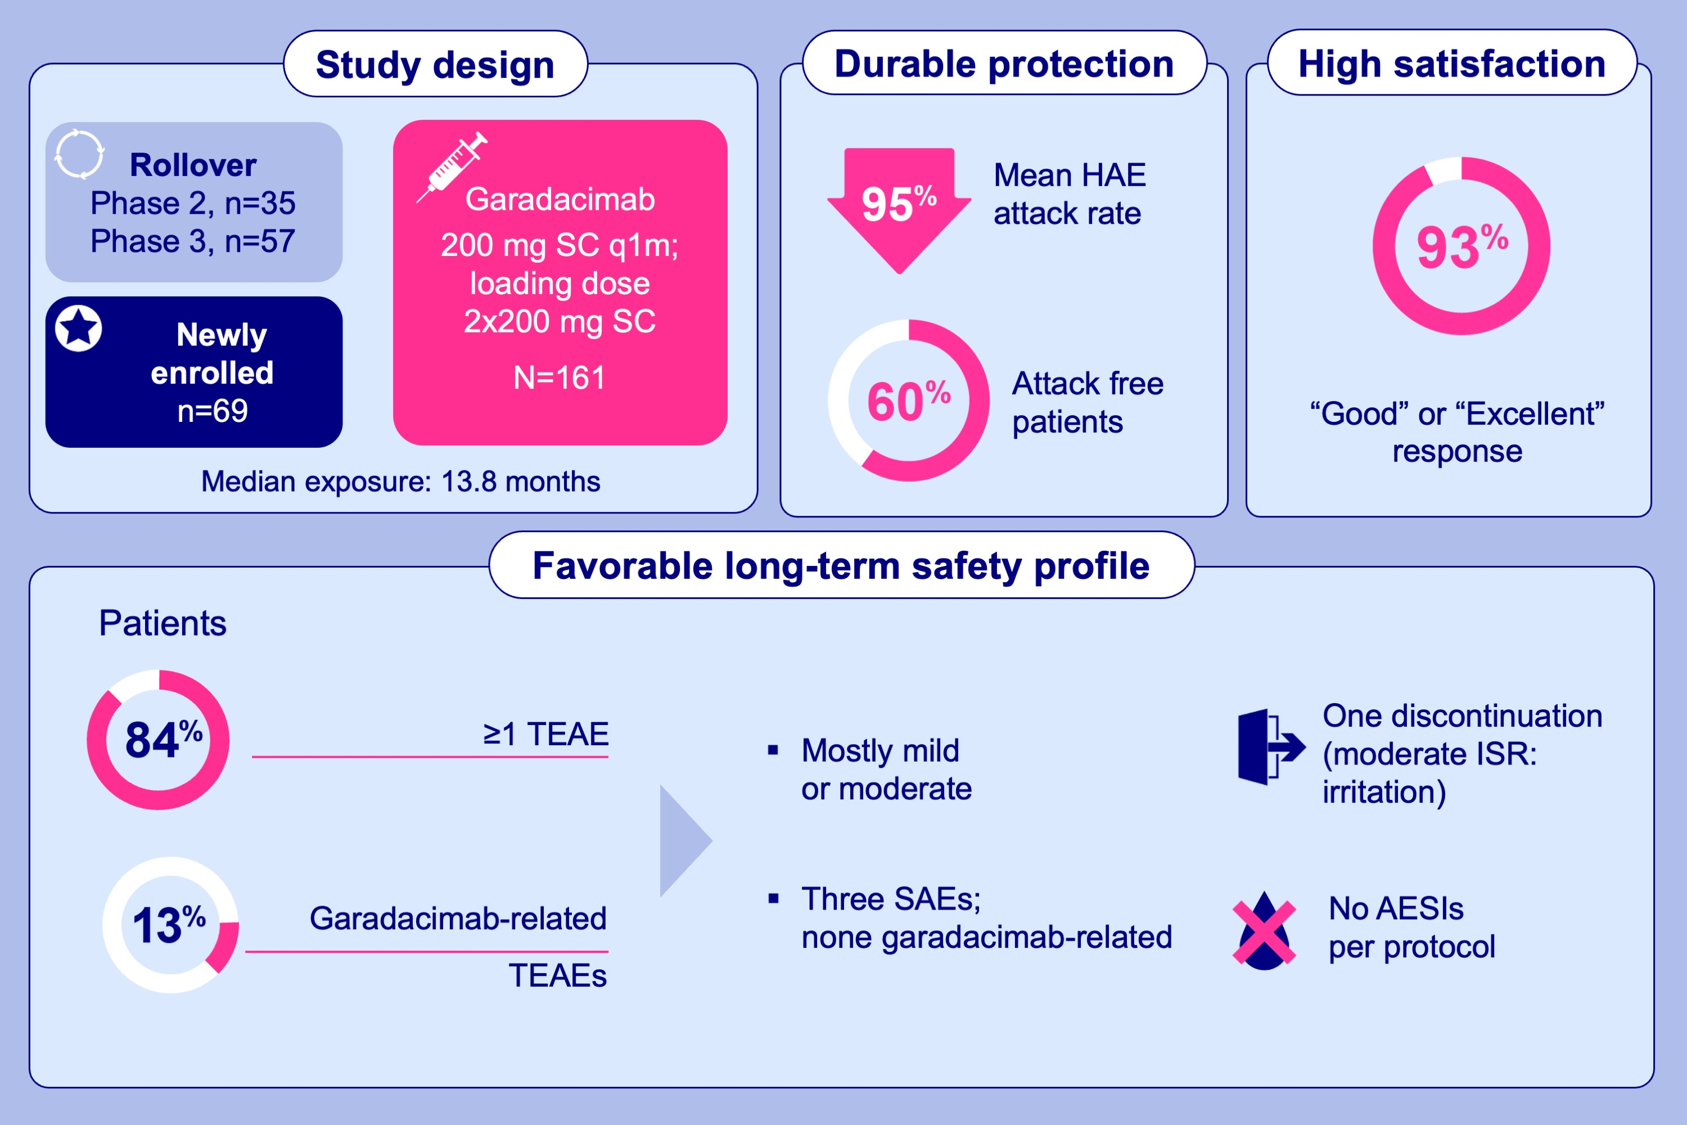
Long-term safety and efficacy of garadacimab for preventing hereditary angioedema attacks: Phase 3 open-label extension study
Avner Reshef, Connie Hsu, Constance H. Katelaris, Philip H. Li, Markus Magerl, et al.
Allergy. 2025; Pages: 545-556
https://doi.org/10.1111/all.16351
© 2019 EAACI and John Wiley and Sons A/S. Published by John Wiley and Sons Ltd.
Notes:
HIGHLIGHTS
• The ongoing Phase 3 (VANGUARD) OLE study evaluated the long-term safety and efficacy of garadacimab (FXIIa inhibitor) for HAE prophylaxis.
• Garadacimab demonstrated a favorable safety profile.
• Most patients were attack free and substantial attack rate reduction was sustained.
• Garadacimab showed durable protection against attacks, a favorable long-term safety profile, and high patient-reported satisfaction, making it suitable for long-term HAE prophylaxis.
.

