Slide 1
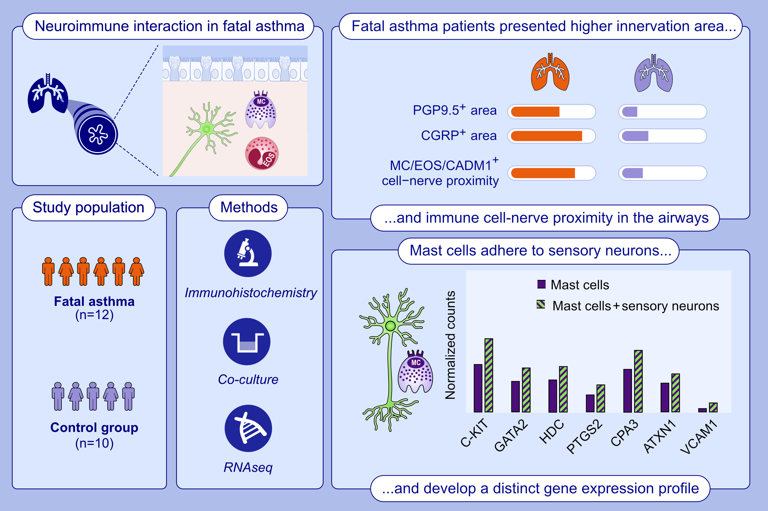
Neuroplasticity and neuroimmune interactions in fatal asthma
Guilherme Dragunas, Carli S. Koster, Natalia de Souza Xavier Costa, Barbro N. Melgert, Carolina D. Munhoz, et al.
Allergy. 2025; pages: 462-473
https://doi.org/10.1111/all.16373
© 2019 EAACI and John Wiley and Sons A/S. Published by John Wiley and Sons Ltd.
Notes:
HIGHLIGHTS
• This study analysed neuroplasticity and neuroimmune interactions in tissue of asthmatic individuals.
• Fatal asthma airways displayed increased innervation area, increased proximity between nerves and eosinophils, mast cells and CADM-1+ cells, and heightened CGRP expression within nerve bundles.
• Mast cells co-cultured with hPSCs-differentiated sensory neurons were submitted to RNAseq, which showed mast cell differentiation marker genes, linked to asthma severity, upregulation.
•
.

