Slide 1
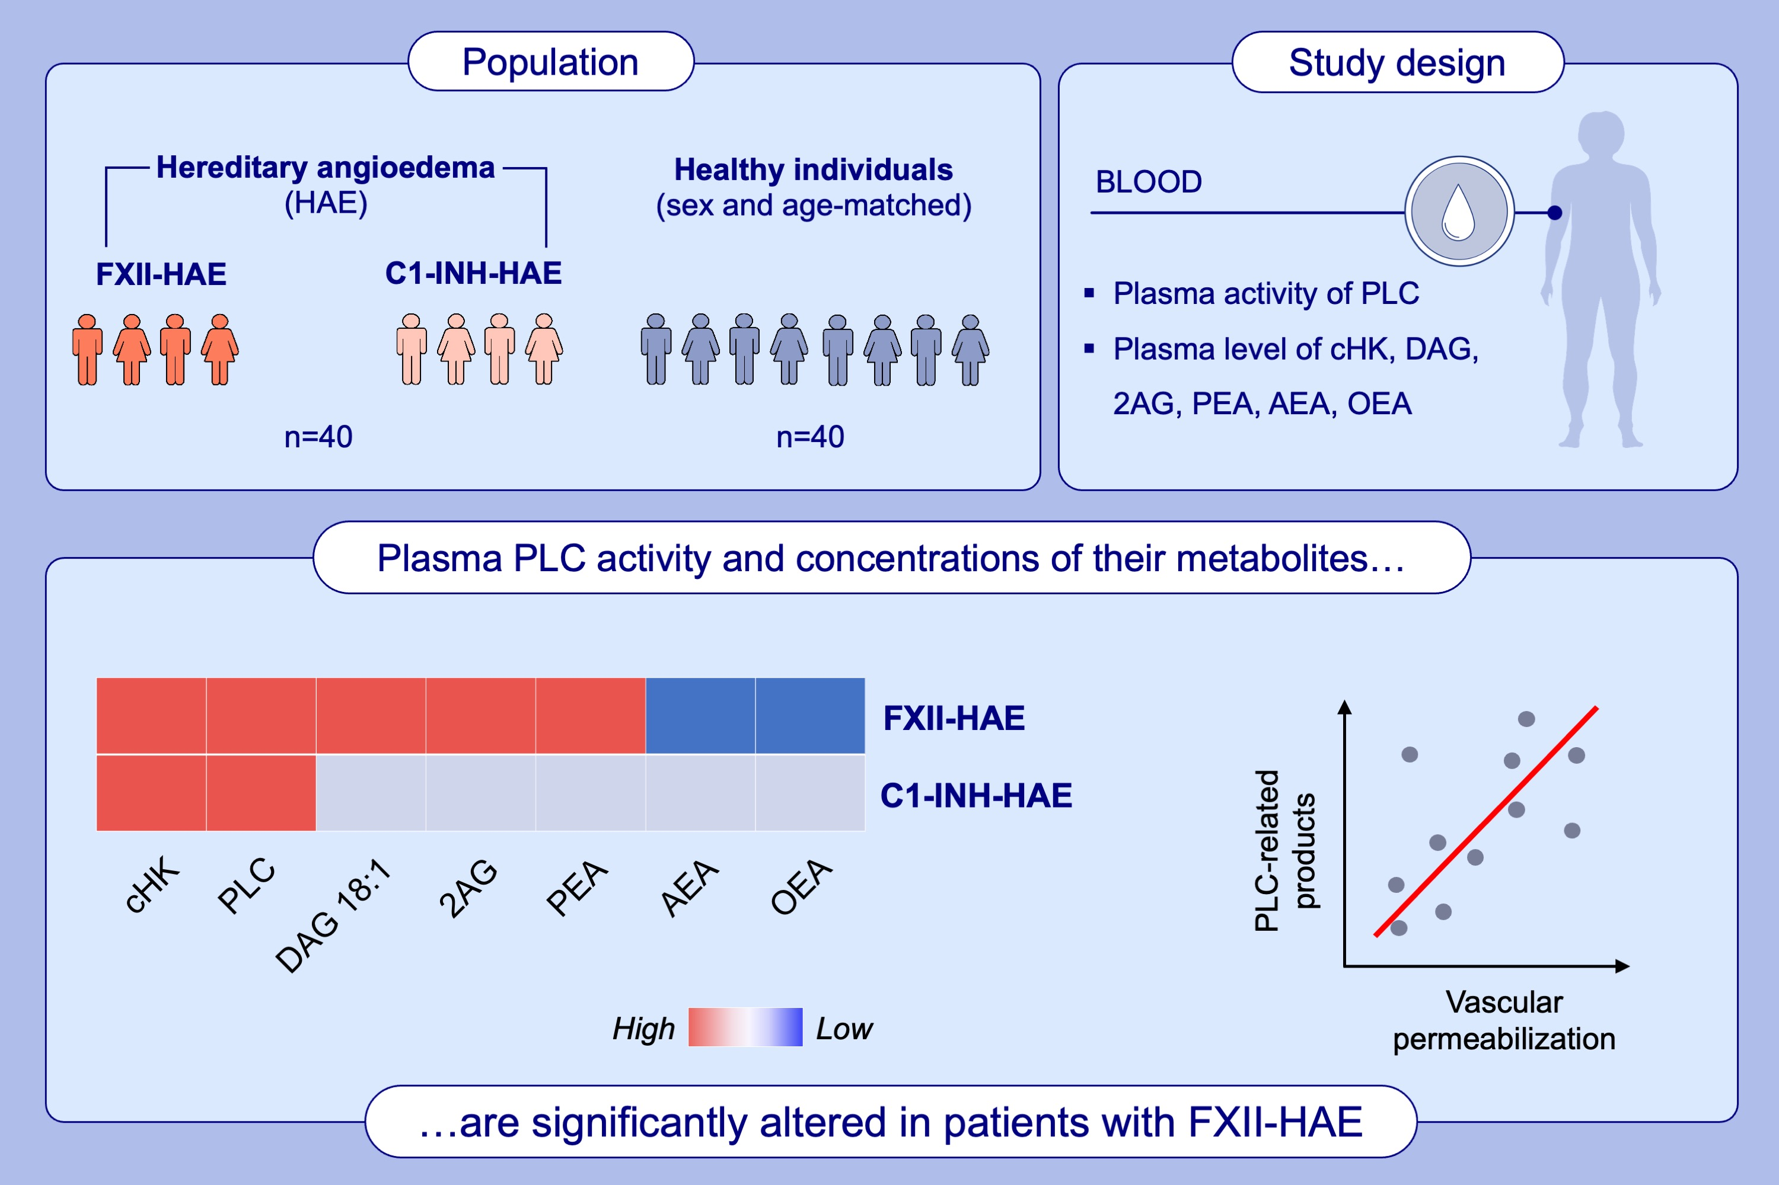
Altered levels of phospholipases C, diacylglycerols, endocannabinoids, and N-acylethanolamines in patients with hereditary angioedema due to FXII mutation
Anne Lise Ferrara, Francesco Palestra, Fabiana Piscitelli, Angelica Petraroli, Chiara Suffritti, et al.
Allergy. 2025; pages: 287-296
https://doi.org/10.1111/all.16197
© 2019 EAACI and John Wiley and Sons A/S. Published by John Wiley and Sons Ltd.
Notes:
HIGHLIGHTS
Plasma PLC activity and DAG 18:1-20:4 concentrations are increased in FXII-HAE patients compared to controls.
2-AG (a DAG metabolite) concentrations are altered in FXII-HAE. AEA and OEA are decreased in FXII-HAE patients compared to controls. By contrast, PEA, is increased.
C1-INH-HAE patients have elevated plasma activity of PLC but the levels of DAGs and eCBs are not altered.

