Slide 1
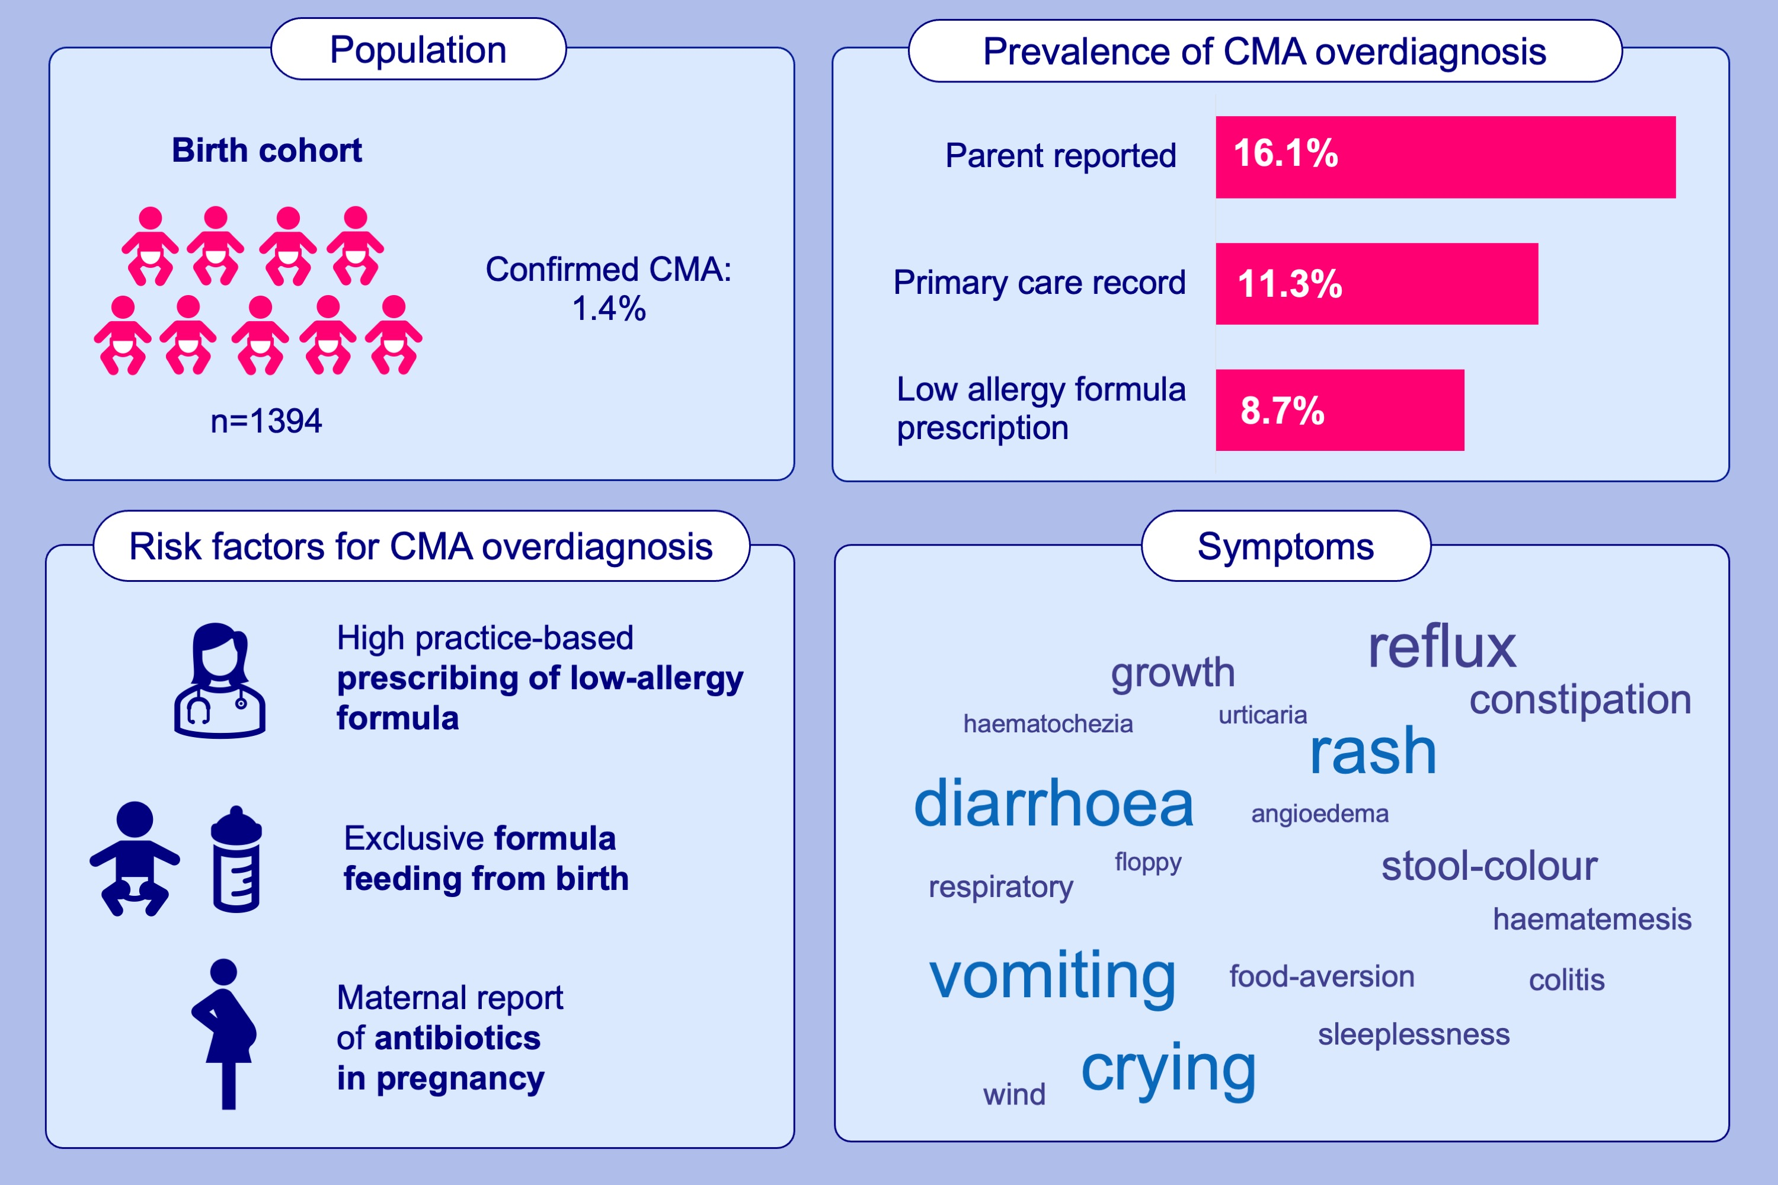
Prevalence and risk factors for milk allergy overdiagnosis in the BEEP trial cohort
Hilary I. Allen, Olivia Wing, Dara Milkova, Emilia Jackson, Karen Li, et al.
Allergy. 2025; pages:148-160
https://doi.org/10.1111/all.16203
© 2019 EAACI and John Wiley and Sons A/S. Published by John Wiley and Sons Ltd.
Notes:
HIGHLIGHTS
• In BEEP, cow’s milk hypersensitivity was commonly reported in infants without confirmed milk allergy.
One in six parents reported non-confirmed cow’s milk hypersensitivity in their child, and half of these were prescribed low-allergy formula during the first year.
The strongest risk factor for milk allergy overdiagnosis was high primary care practice-based prescribing of low-allergy formula in the year before birth.

