Slide 1
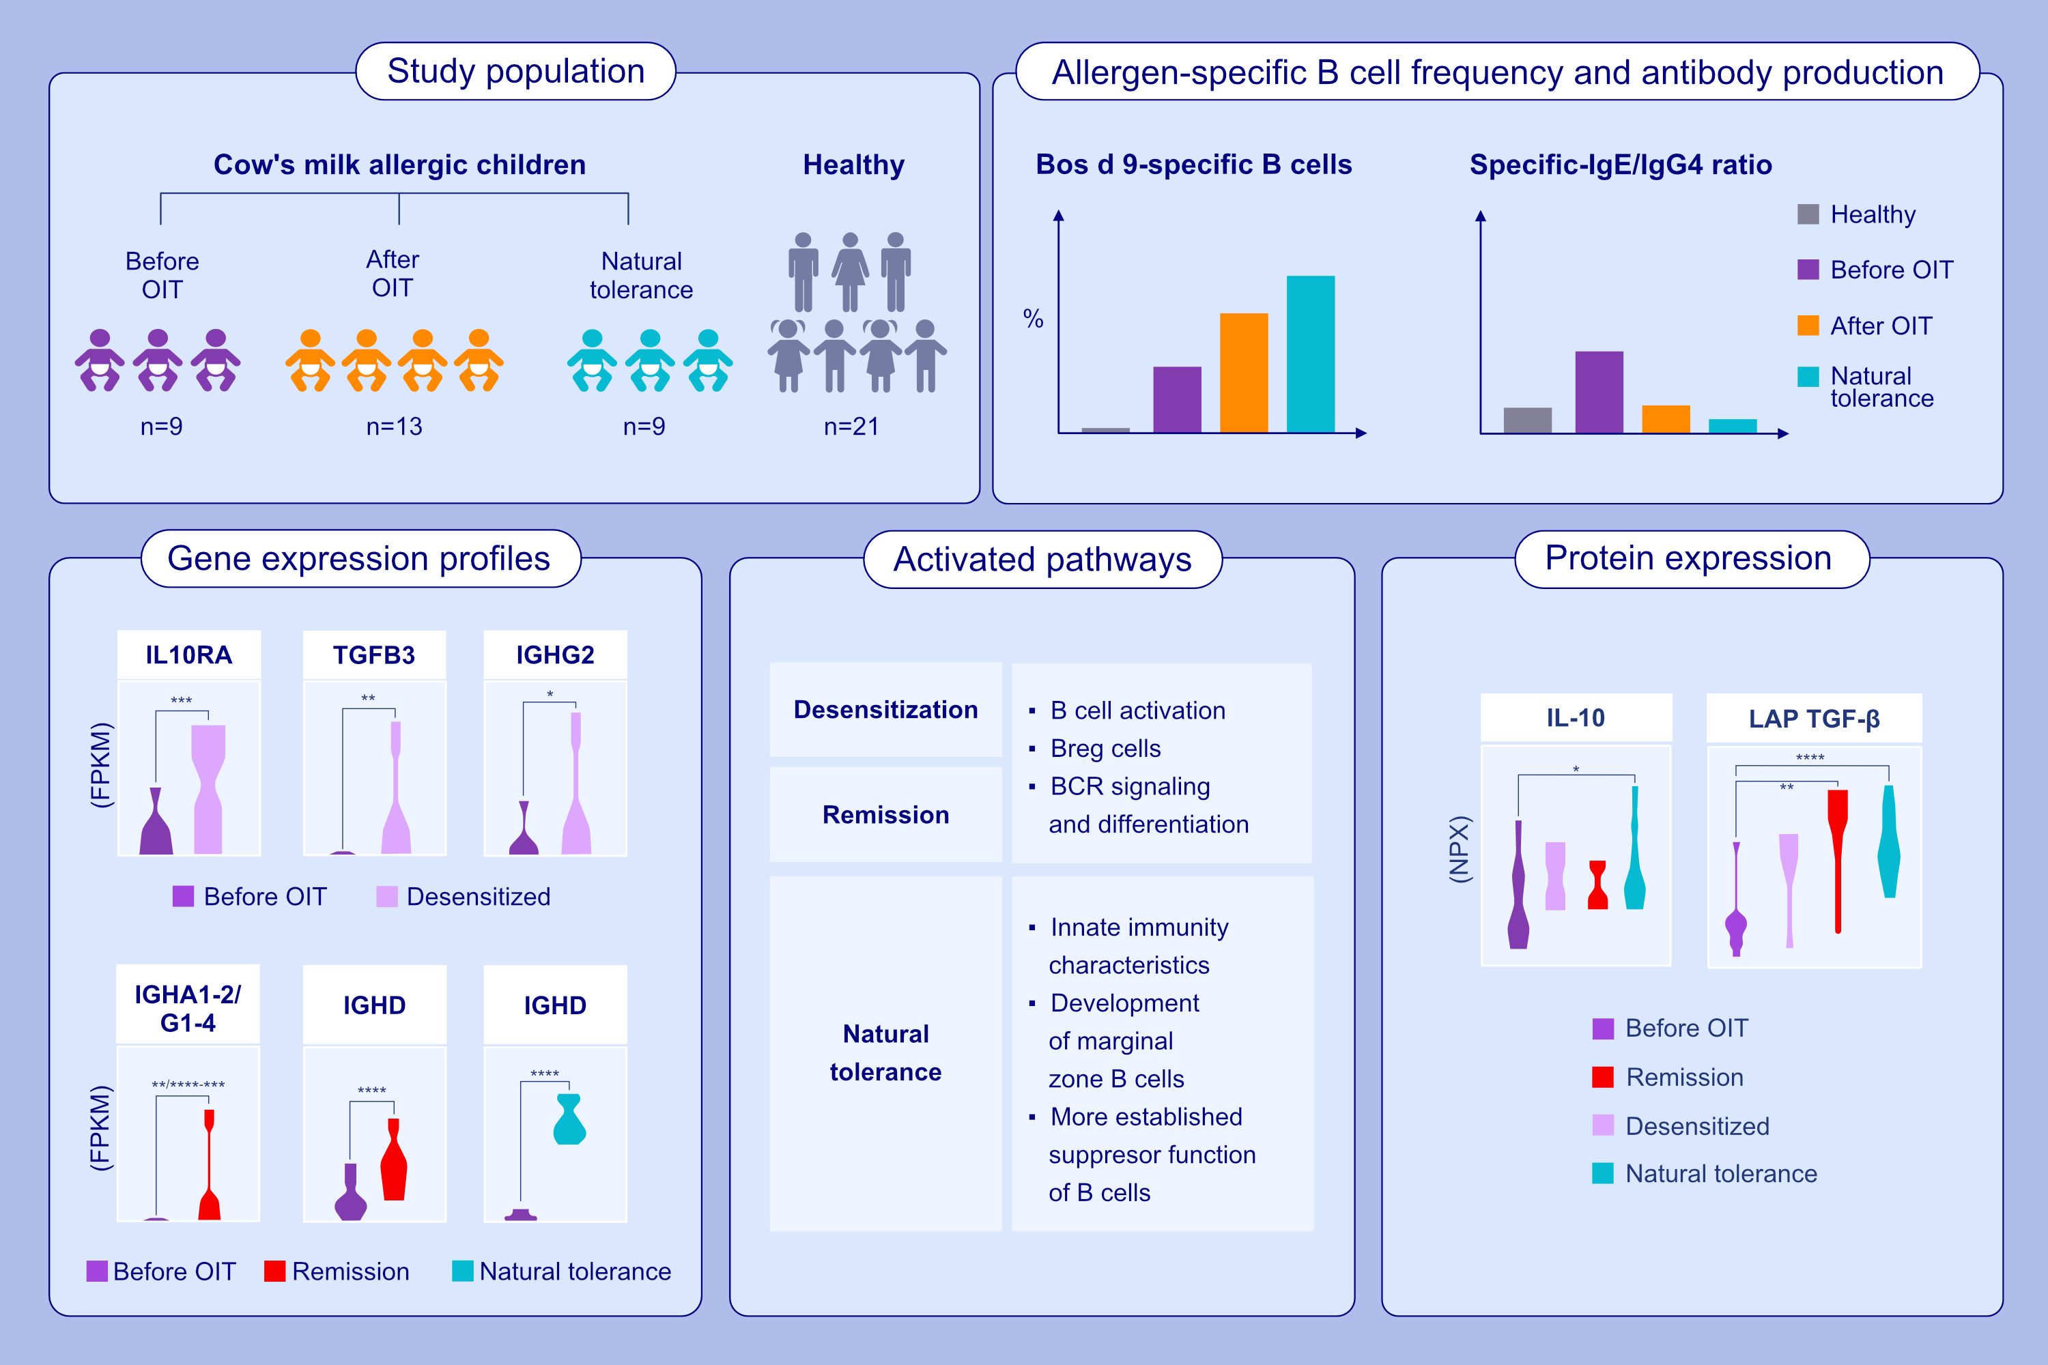
Allergen-specific B cell responses in oral immunotherapy-induced desensitization, remission, and natural outgrowth in cow's milk allergy
Pattraporn Satitsuksanoa, Willem van de Veen, Ge Tan, Juan-Felipe Lopez, Oliver Wirz, et al.
Allergy. 2025;pages:161-180
https://doi.org/10.1111/all.16220
© 2019 EAACI and John Wiley and Sons A/S. Published by John Wiley and Sons Ltd.
Notes:
HIGHLIGHTS
• Increased frequency of αS1-casein-specific B cells associated with immunotherapy for milk allergy and natural outgrowth allergic (NT) individuals. Under the influence of OIT, downregulated the cellular activation gene machinery in desensitized patients mostly shut down during the remission and NT. Protein signatures displayed immune-regulatory and anti-inflammatory in NT and OIT-induced-remission as compared to before OIT.
• .

