Slide 1
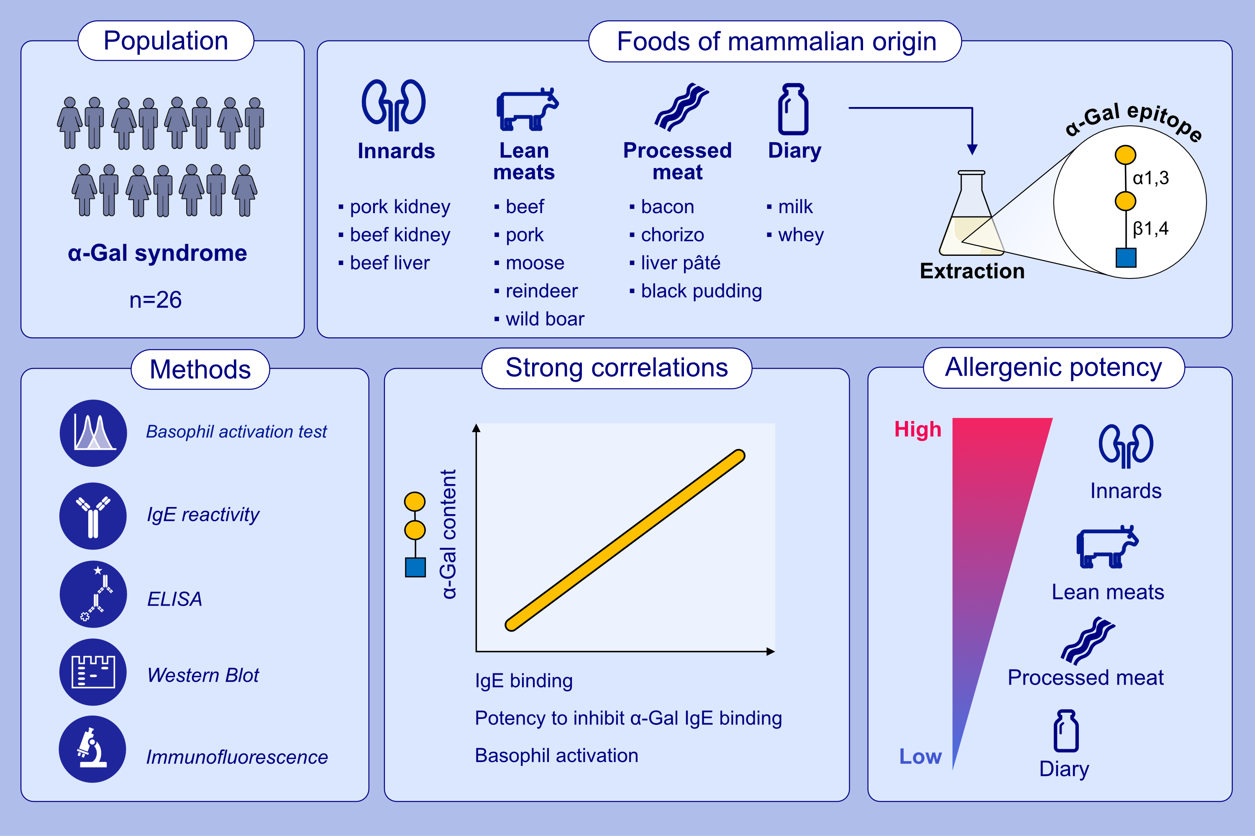
Allergenic potency of various foods of mammalian origin in patients with α-Gal syndrome
Marija Perusko, Jeanette Grundström, Maria Eldh, Annika Reinhardt, Verena Fuhrmann, et al.
Allergy. 2025; pages:181-192
https://doi.org/10.1111/all.16235
© 2019 EAACI and John Wiley and Sons A/S. Published by John Wiley and Sons Ltd.
Notes:
HIGHLIGHTS
• This study aimed to investigate the allergenic potency of various foods of mammalian origin among patients with α-Gal syndrome.
• The allergenic potency of foods of mammalian origin depends on the origin of the meat, the different cuts and type of processing, with innards posing the greatest risk to patients with α-Gal syndrome.
• Even processed meat constitutes a risk, and some processed meat products pose equal allergenic potency as lean meats. .

