Slide 1
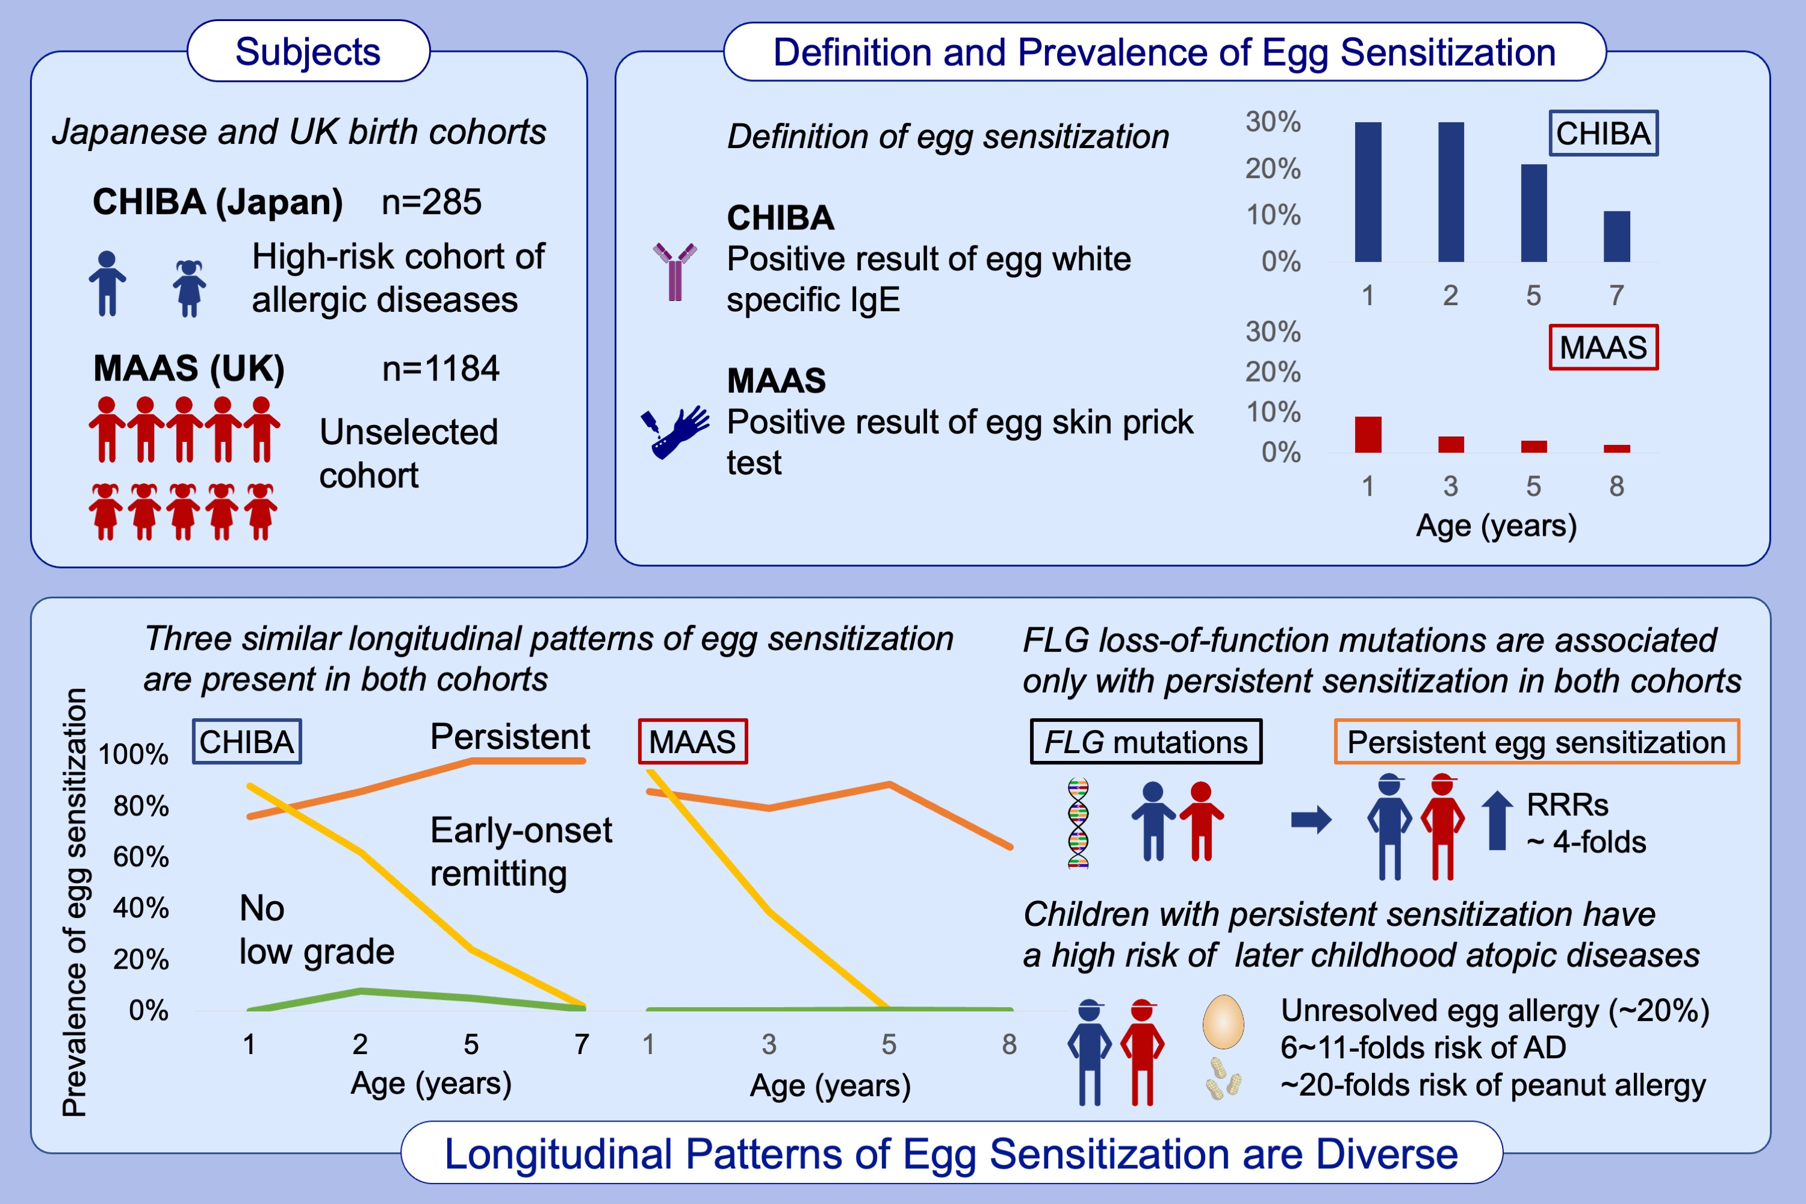
Trajectories of egg sensitization in childhood: Two birth cohorts in Asia and Europe
Toshinori Nakamura, Taiji Nakano, Angela Simpson, Michihiro Kono, John A. Curtin, et al.
Allergy. 2025; pages: 193-204
https://doi.org/10.1111/all.16264
© 2019 EAACI and John Wiley and Sons A/S. Published by John Wiley and Sons Ltd.
Notes:
HIGHLIGHTS
• The longitudinal patterns of egg sensitization can be classified into three patterns: persistent, early-onset remitting, and no/low grade sensitization.
• Approximately 20% of the children in the persistent sensitization had unresolved egg allergy in late childhood.
• Only children exhibiting the persistent sensitization significantly associated with FLG loss-of-function mutations.
•
.

