Slide 1
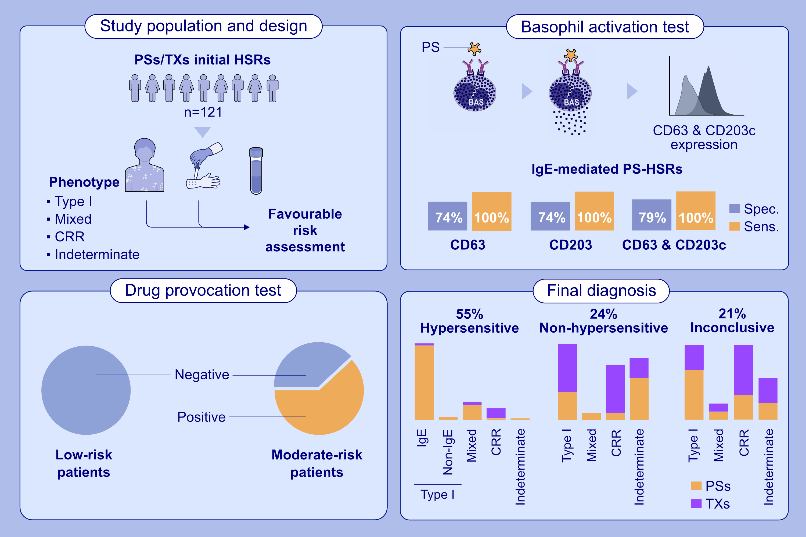
Basophil activation test is a complementary tool in the diagnosis of immediate reactions to platinum salts and taxanes
Gádor Bogas, Adriana Ariza, Paula Vázquez-Revuelta, Marina Labella, Ricardo Madrigal-Burgaleta, et al.
Allergy. 2025;pages: 271-286
https://doi.org/10.1111/all.16296
© 2019 EAACI and John Wiley and Sons A/S. Published by John Wiley and Sons Ltd.
Notes:
HIGHLIGHTS
• Basophil activation test is able to identify Type I IgE-mediated hypersensitivity reactions with a high sensitivity and specificity when using as activation markers CD63 or CD203c or the combination of both markers.
• Drug provocation test is safe even in the delabeling of grade 2 chemotherapy hypersensitivity reactions.
• Non-hypersensitivity patients are mainly taxanes and indeterminate phenotypes.
•
.

