Slide 1
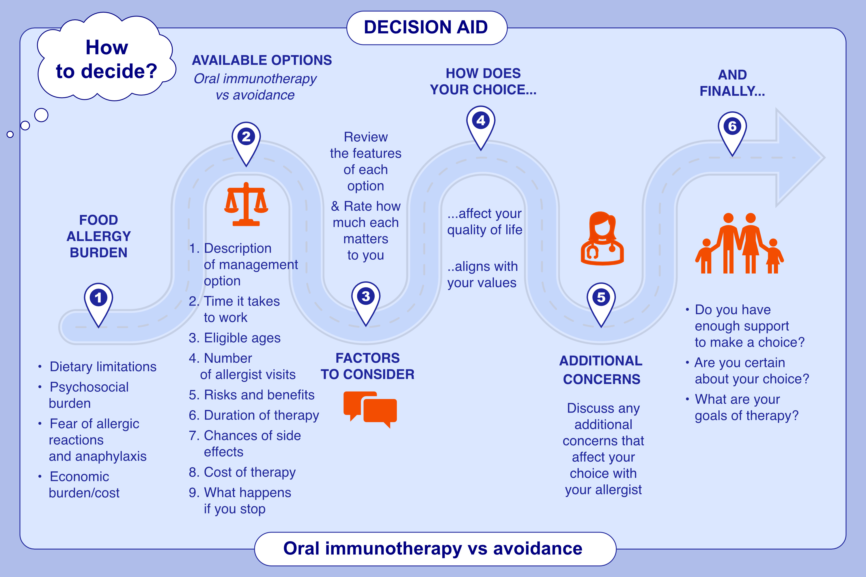
Development and acceptability of a decision-aid for food allergy oral immunotherapy in children
Aikaterini Anagnostou, Elissa M. Abrams, Melanie Carver, Edmond S. Chan, Sanaz Eftekhari, et al.
Allergy. 2025;pages:205-214
https://doi.org/10.1111/all.16332
© 2019 EAACI and John Wiley and Sons A/S. Published by John Wiley and Sons Ltd.
Notes:
HIGHLIGHTS
• Shared decision-making helps enable patients to make decisions based on their individual goals, values and preferences.
• Few shared decision-making tools exists to assist patients in the shared decision-making process regarding initiating food allergy treatment.
• This decision-aid is associated with low decisional-conflict, high decisional self-efficacy, and appropriate for any age child where the family is considering oral immunotherapy to any allergen.
• .

