Slide 1
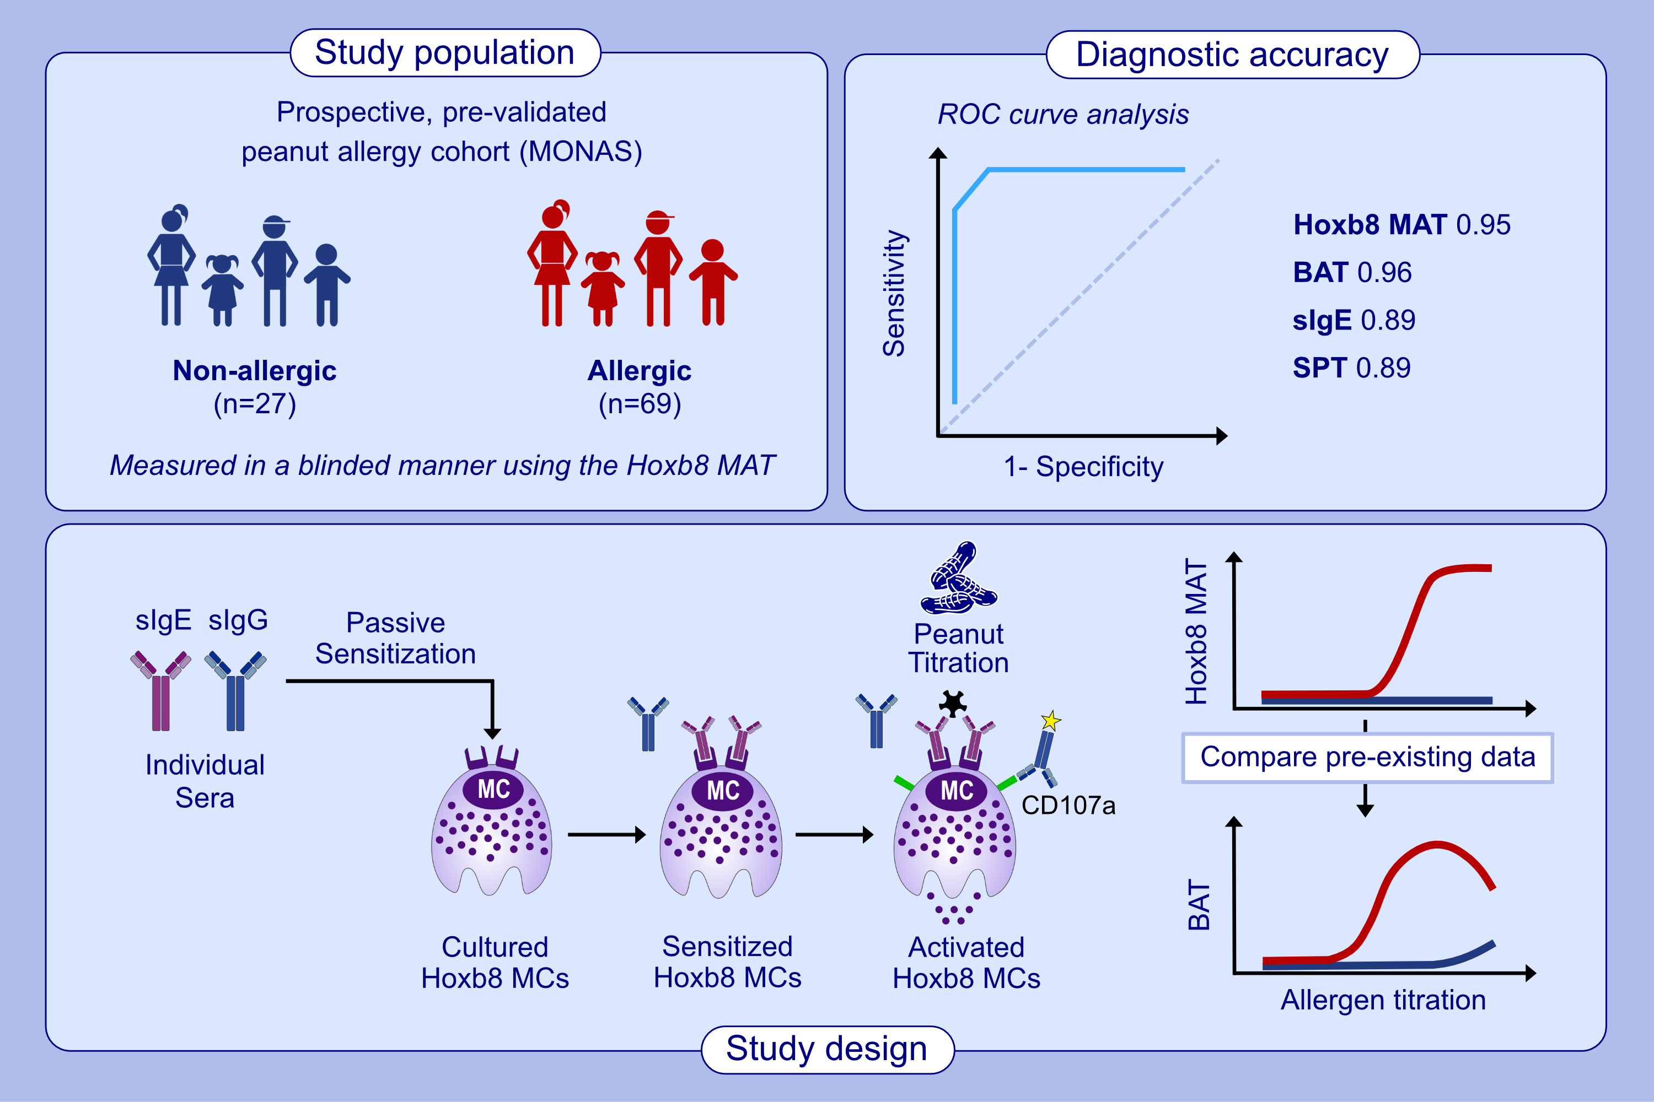
Clinical utility analysis of the Hoxb8 mast cell activation test for the diagnosis of peanut allergy
Noemi Bachmeier-Zbären, Alper Celik, Robin van Brummelen, Nadine Roos, Melanie Steinmann, et al.
Allergy. 2025;pages:215-226
https://doi.org/10.1111/all.16341
© 2019 EAACI and John Wiley and Sons A/S. Published by John Wiley and Sons Ltd.
Notes:
HIGHLIGHTS
• The Hoxb8 MAT demonstrates high diagnostic accuracy, as determined by measuring blinded sera from a prospectively enrolled, pre-validated peanut allergy cohort.
• Similar to the BAT, the Hoxb8 MAT distinguishes between allergic and non-allergic patients who underwent clinically indicated OFCs to peanut.
• Additionally, it has the ability to accurately classify sera from BAT non-responders.
•
.

