Slide 1
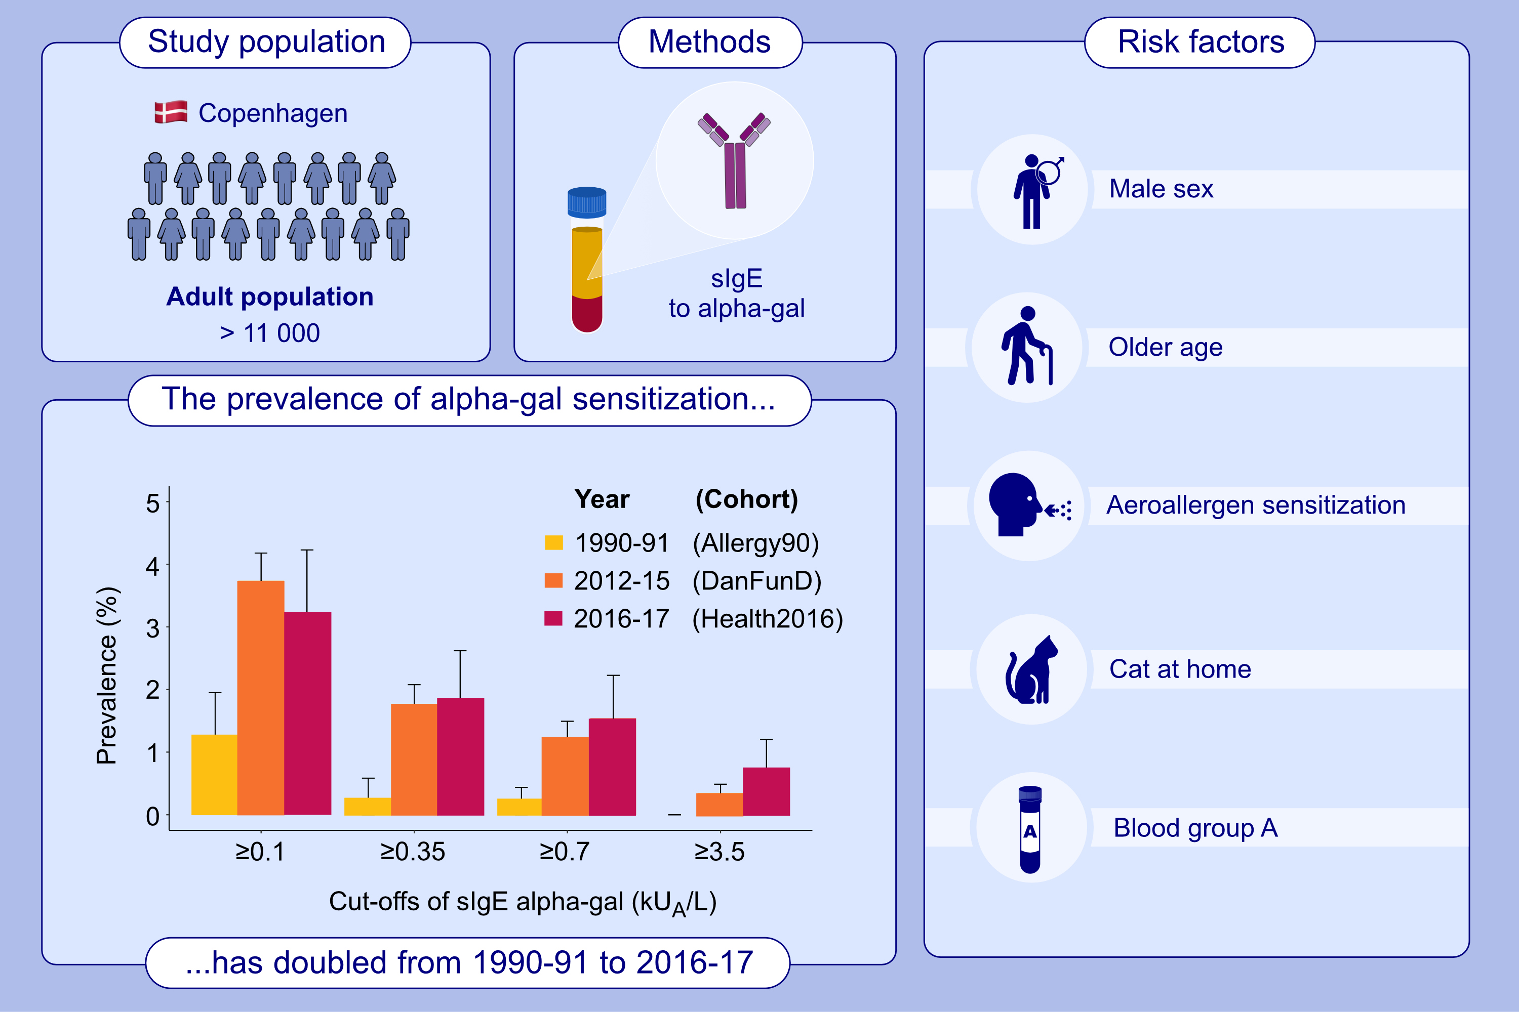
Increasing prevalence of galactose-α-1,3-galactose sensitization in the Danish general adult population
Katja Biering Leth-Møller, Marianne van Hage, Danijela Apostolovic, Jennifer Astrup Sørensen, Christian Vestergaard, et al.
Allergy. 2025; pages:297-308
https://doi.org/10.1111/all.16360
© 2019 EAACI and John Wiley and Sons A/S. Published by John Wiley and Sons Ltd.
Notes:
HIGHLIGHTS
• Serum specific IgE to alpha-gal (present in mammalian meat) was assessed in >11,000 adults from Danish population-based health examination studies performed during 1990 to 2017.
• The prevalence of alpha-gal sensitization more than doubled from 1990 to 2017.
• Older age, male sex, blood group A, aeroallergen sensitization, and cat at home were associated with increased odds of alpha-gal sensitization. .

