Slide 1
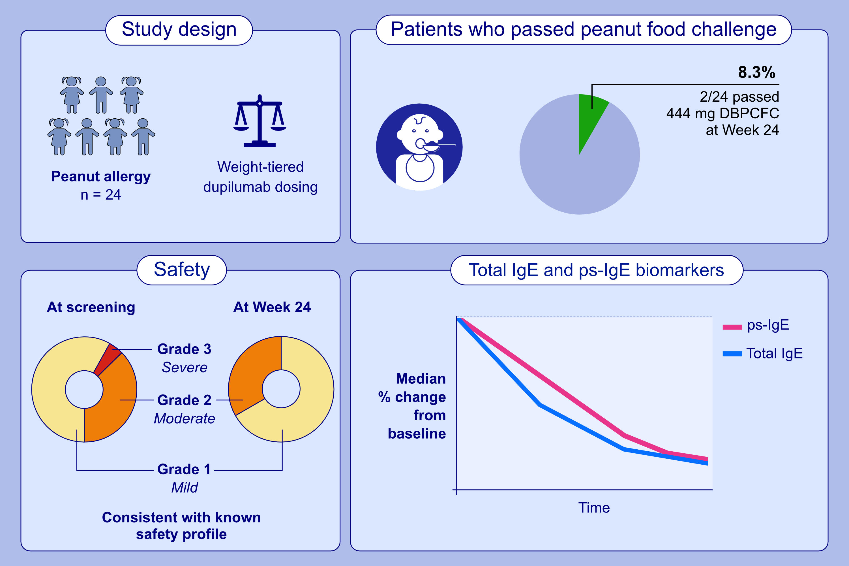
Efficacy and Safety of Dupilumab in Children With Peanut Allergy: A Multicenter, Open-Label, Phase II Study
Sayantani B. Sindher, Kari C. Nadeau, R. Sharon Chinthrajah, Jeffrey G. Leflein, Philippe Bégin, et al.
Allergy. 2025; pages:227-237
https://doi.org/10.1111/all.16404
© 2019 EAACI and John Wiley and Sons A/S. Published by John Wiley and Sons Ltd.
Notes:
HIGHLIGHTS
• Dupilumab was well tolerated in children and adolescent patients with peanut allergy, and safety was consistent with known dupilumab safety profile.
• Dupilumab monotherapy treatment for 24 weeks did not induce tolerability to peanut after food challenge, however, allergic reactions of grade 2 or higher numerically decreased.
• Dupilumab treatment resulted in around a 50% reduction in total IgE and ps-IgE.
• .

