Slide 1
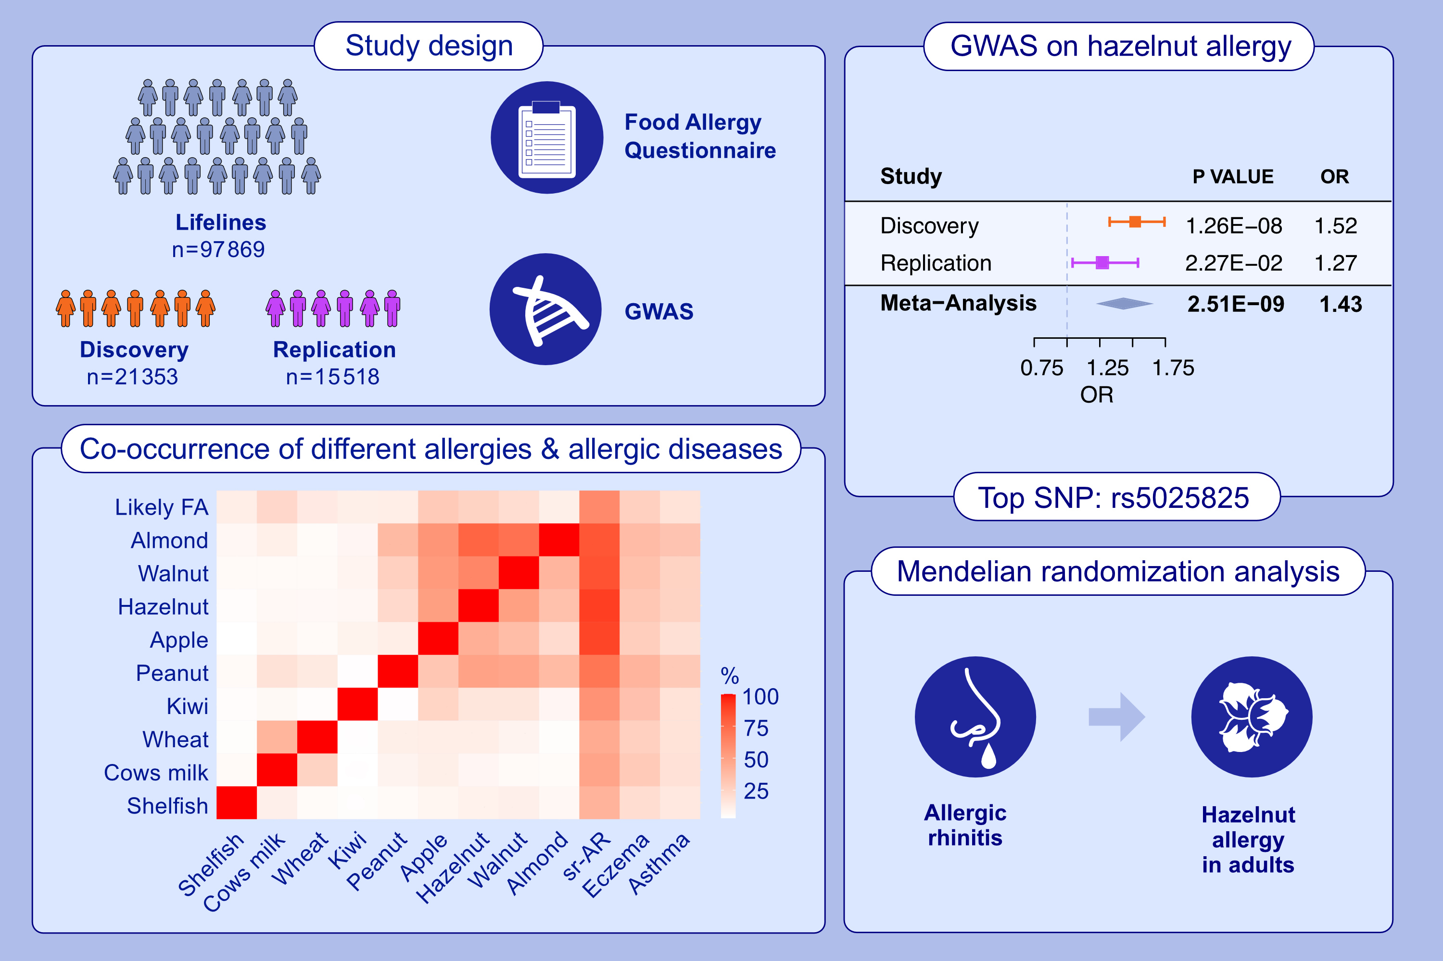
Genome-Wide Association Study Reveals a Causal Relationship Between Allergic Rhinitis and Hazelnut Allergy
Yidan Sun, Judith M. Vonk, Elin T. G. Kersten, Cancan Qi, Aline B. Sprikkelman, et al.
Allergy. 2025; pages:309-318
https://doi.org/10.1111/all.16411
© 2019 EAACI and John Wiley and Sons A/S. Published by John Wiley and Sons Ltd.
Notes:
HIGHLIGHTS
• This study investigates genetic susceptibility to food allergy in an adult population.
• One genome-wide significant locus near HLA-DPA1 was identified to be associated with hazelnut allergy.
• Co-occurrence of tree nuts and apple allergies with allergic rhinitis in adults is very common.
• .

