Slide 1
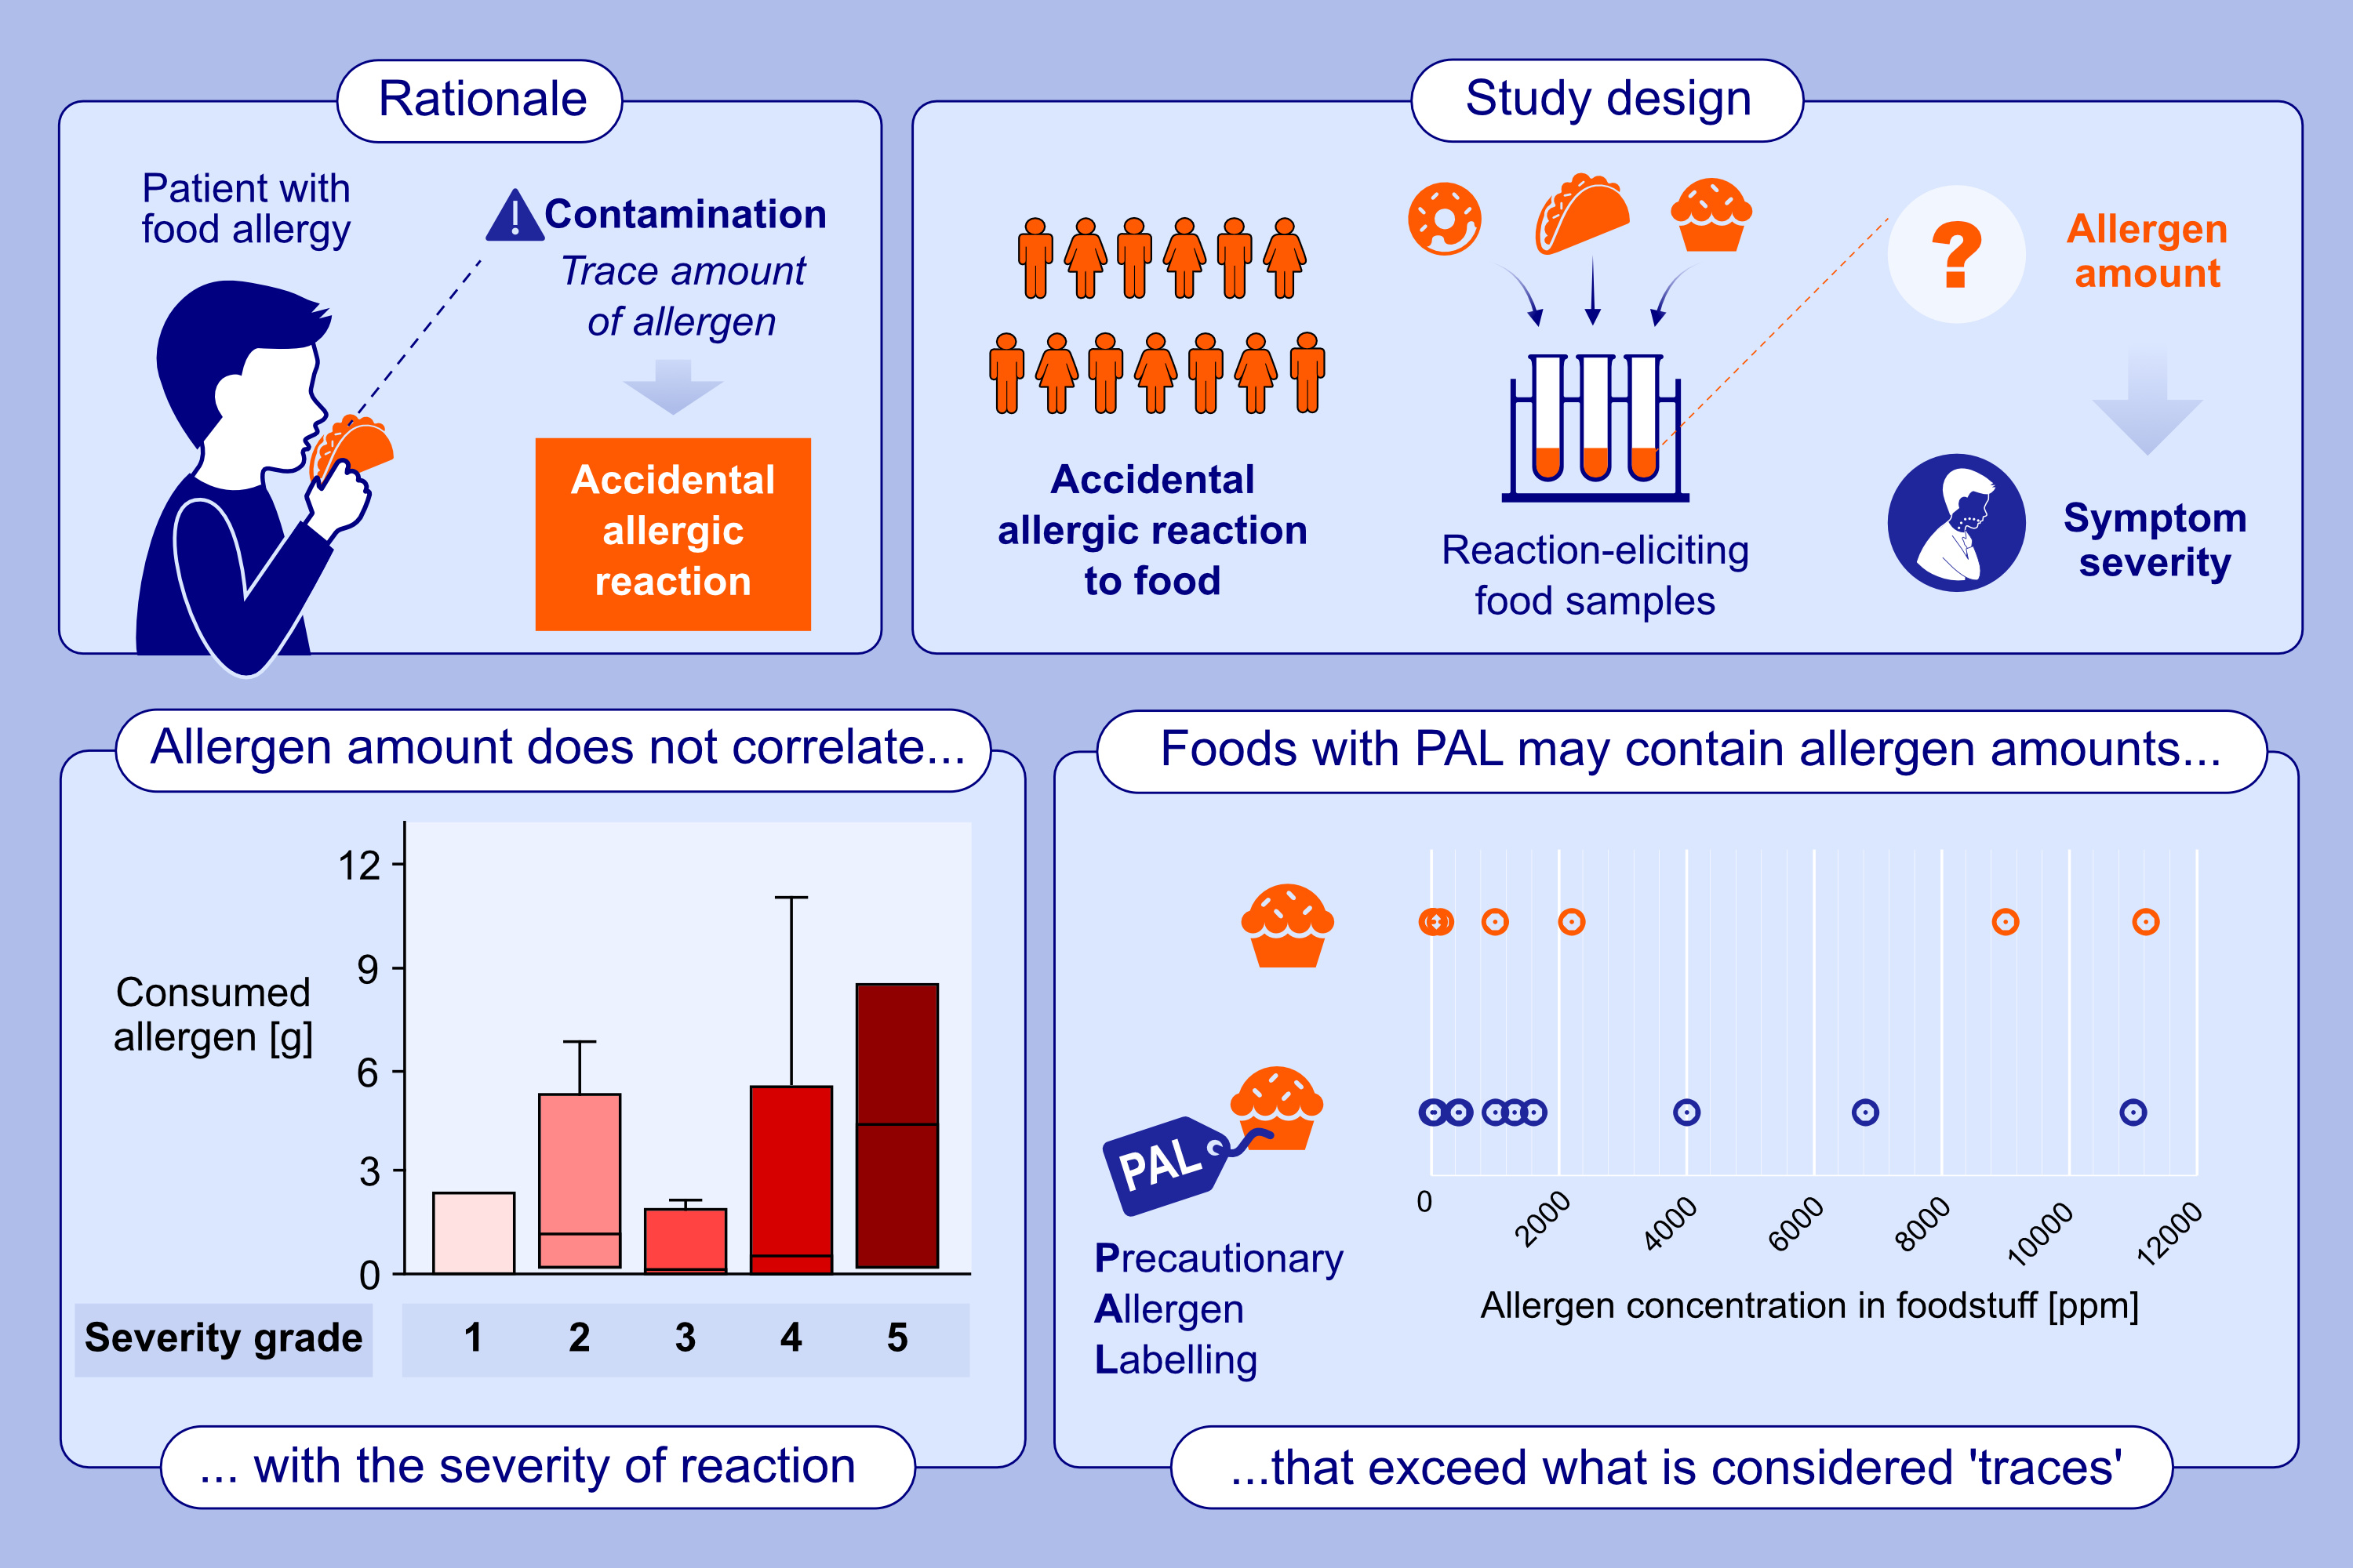
The Severity of Allergic Reactions in a Real-World Environment Is Independent of the Eliciting Amounts of Foods
Alexandre Piletta-Zanin, Alexander Scherl, Avigael Benhamou, Gabriel Braendle, Jean-Christoph Caubet, et al.
Allergy. 2025; pages:238-247
https://doi.org/10.1111/all.16413
© 2019 EAACI and John Wiley and Sons A/S. Published by John Wiley and Sons Ltd.
Notes:
HIGHLIGHTS
• This multicentric study aimed to investigate the relationship between the nature and amount of food allergens consumed in "real-life situations" and the severity of symptoms during accidental reactions.
• We found no link between the severity of the reaction and the eliciting amount of allergen. Foods with precautionary allergen labelling may indeed contain allergen amounts far exceeding the notion of "traces," raising questions about the accuracy of allergen labeling and regulations in Switzerland. .

