Slide 1
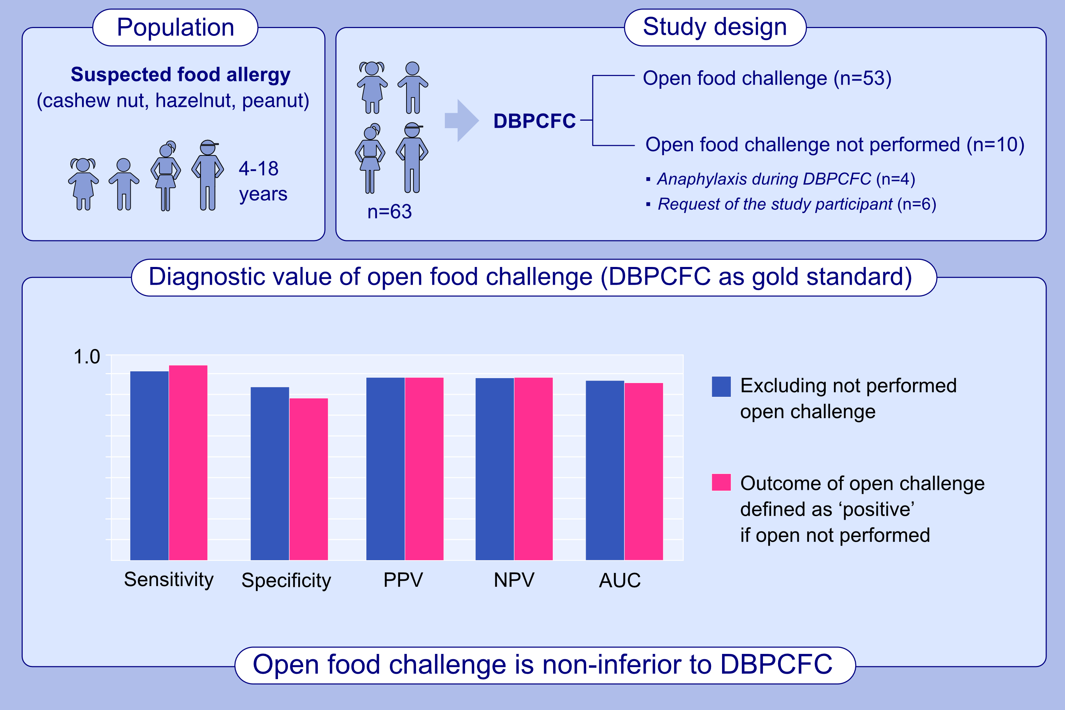
Comparison of Double-Blind and Open Food Challenges for the Diagnosis of Food Allergy in Childhood: The ALDORADO Study
Wouter W. de Weger, Aline. B. Sprikkelman, Catherina. E. M. Herpertz, Gerbrich N. van der Meulen, Judith. M. Vonk, et al.
Allergy. 2025; pages:248-257
https://doi.org/10.1111/all.16428
© 2019 EAACI and John Wiley and Sons A/S. Published by John Wiley and Sons Ltd.
Notes:
HIGHLIGHTS
• We performed the first non-inferiority diagnostic study comparing food challenge outcome.
• Open food challenge outcome was found to be non-inferior compared to double-blind placebo-controlled food challenges for children aged 4 years and older, suspected of cashew nut, hazelnut or peanut allergy.
• Our results imply that less demanding open food challenges may be implemented for selected children in clinical practice. .

