Slide 1
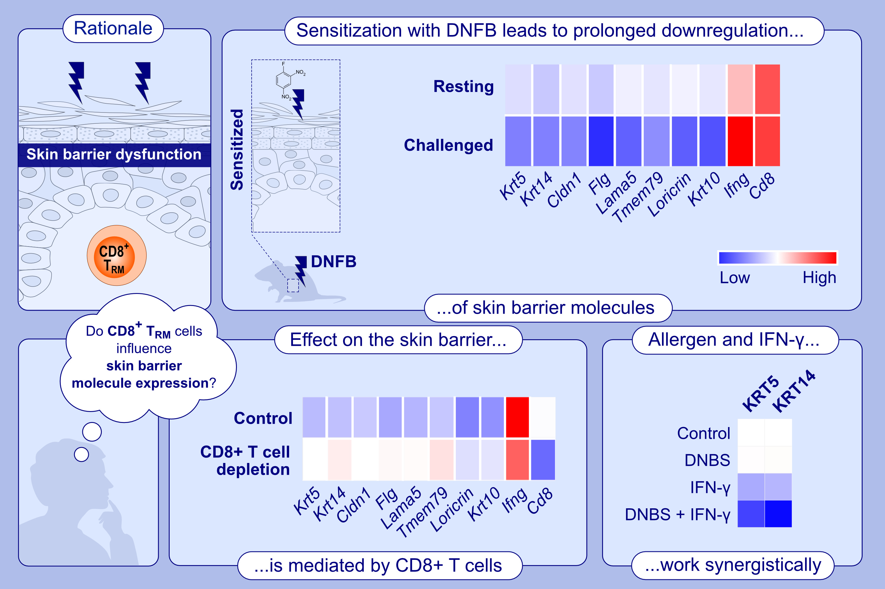
T Cells Induce Prolonged Downregulation of Barrier Molecules in a Mouse Model of Allergic Contact Dermatitis
Helen Vaher, Anne-Sofie Ø. Gadsbøll, Alexandra T. Seibel, Martin Kongsbak-Wismann, Rebecca K. D. Lohmann, et al.
Allergy. 2025 Pages:
https://doi.org/10.1111/all.16421
© 2019 EAACI and John Wiley and Sons A/S. Published by John Wiley and Sons Ltd.
Notes:
HIGHLIGHTS
• In a mouse model of allergic contact dermatitis, sensitization with DNFB increased numbers of CD8+ TRM cells and expression of IFN-γ with prolonged downregulation of KRT5 and KRT14 in the epidermis.
• Depletion of CD8+ T cells prevented this effect.
• In keratinocytes, IFN-γ and DNBS synergistically down-regulated the expression of KRT5 and KRT14. .

