Slide 1
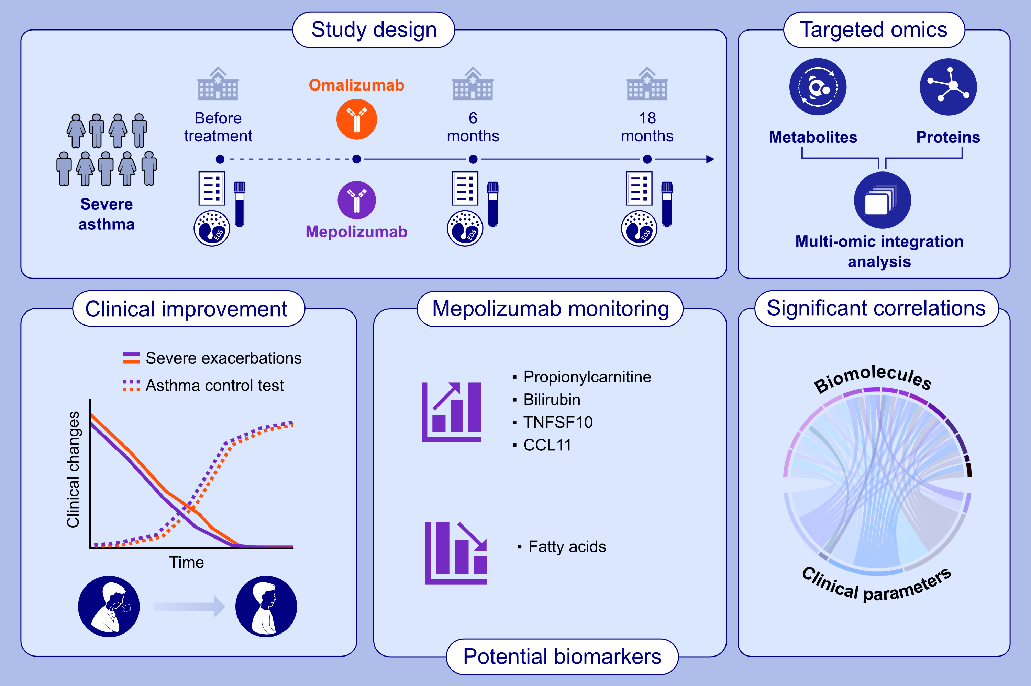
Multiomic Integration Analysis for Monitoring Severe Asthma Treated With Mepolizumab or Omalizumab
Nuria Contreras, Andrea Escolar-Peña, María I. Delgado-Dolset, Paloma Fernández, David Obeso, et al.
Allergy.
https://doi.org/10.1111/all.16434
© 2019 EAACI and John Wiley and Sons A/S. Published by John Wiley and Sons Ltd.
Notes:
HIGHLIGHTS
• Mepolizumab and Omalizumab induce a distinct clinical effect. • Mepolizumab and Omalizumab induce both common and treatment-specific metabolic and protein profiles over time in patients with severe asthma. • Multi-omic integration and ROC curve analyses reveal a specific set of biomolecules suggesting their value as potential biomarkers for Mepolizumab treatment. .

